Slide 1
Spread of Protestantism
Chapter 16, Lesson 2

Slide 2
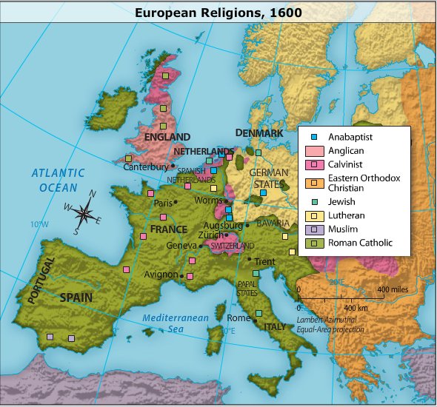

Slide 3
Zwingli and Calvin
Reformation in Zürich: Ulrich Zwingli tried to introduce religious reforms in Zürich, Switzerland, but he was killed in a war with Swiss Catholics.
John Calvin: John Calvin became a Protestant leader based on his writings about predestination.

Slide 4
The Reformation in England
A royal divorce: England's King Henry VIII divorced his wife, Catherine of Aragon, to marry Anne Boleyn, which led to the king's excommunication.
The Church of England: In 1534, Henry defied the Catholic Church and had Parliament declare the Act of Supremacy, which created the Church of England.
The closing of monasteries: Henry closed Catholic monasteries in England and sold to the English nobility the lands and other possessions that had belonged to the monasteries.
Edward VI and "Bloody Mary": Edward VI became king in 1547 at the age of nine. The Church of England became more Protestant. Mary I became queen in 1553. She tried to restore England to Roman Catholicism, burning almost 300 Protestants as heretics.

Slide 6
Anabaptists
A community of believers: Modeling themselves after the early Christians, Anabaptists considered all believers to be equal. Any member was eligible to be a minister or spiritual leader.
Views on church and state: Anabaptists believed in the complete separation of church and state. They refused to hold political office or bear arms.
Persecution: Both Catholics and Protestants persecuted Anabaptists for their beliefs. In Münster, Germany, a center of the Anabaptist community, Anabaptist leaders were tortured and killed in 1535.

Slide 7
Catholicism's Counter-Reformation
The Jesuits: A Spanish noble, Ignatius of Loyola, created the order of the Jesuits, which used education to spread its message.
Reform of the papacy: Pope Paul III appointed a reform commission to examine corruption in the Catholic Church.
The Council of Trent: The Council of Trent reaffirmed traditional Catholic teaching and created a clear body of doctrine.

Slide 8
The Society of Jesus, founded by Saint Ignatius Loyola, differed from other religious orders in several ways. Jesuits took vows of poverty, chastity, and obedience, mainly to the pope. But because one of their main goals was to spread the faith, they eliminated many of the traditional practices, such as performing regular penance, wearing a "habit" or distinctive clothing, and reciting the "office"—a long religious rite required to be performed as a group in religious orders. The Jesuits opened humanist schools throughout the world. Although the group was not founded to oppose the Reformation, it became intensively involved in Germany and then with similar situations elsewhere by 1550.

