Slide 1
Age of Exploration
Chapter 17

Slide 2
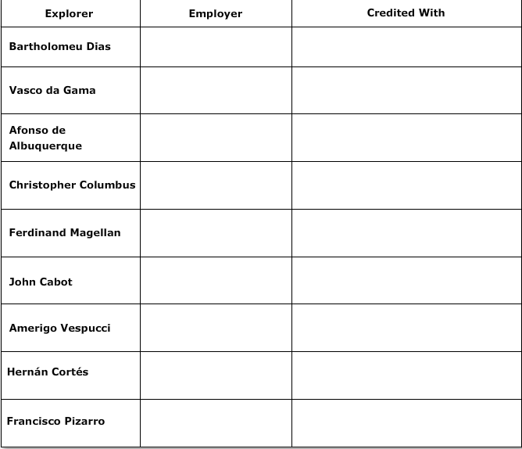

Slide 3
European Exploration and Expansion
Chapter 17 Lesson 1
Gold, Glory, and God

Slide 4
Reasons for Exploration
Trade with Asia: During the late 1200s, Marco Polo of Venice wrote an account of his travels in Asia; it inspired Europeans to seek trade with the region. Europeans were especially interested in the spices of the East, which were needed to preserve and flavor food.
Religious Zeal: Many Europeans believed they had a responsibility to spread Catholicism to foreign lands.
Spirit of Adventure: A spirit of adventure was another factor in motivating Europeans to explore distant lands.

Slide 5
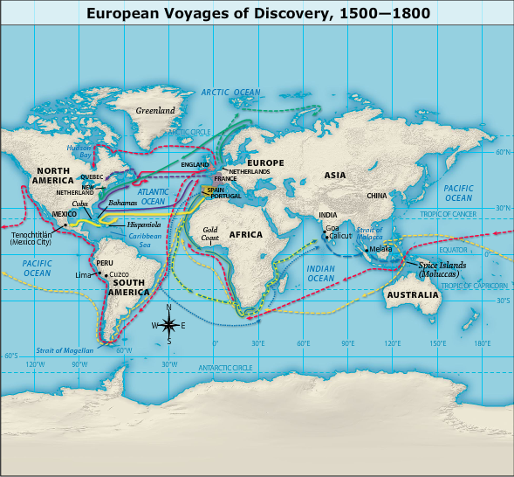
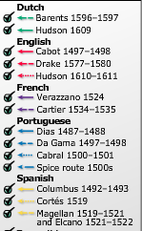

Slide 6
Portugal's Initial Voyages and Its Technology
The Gold Coast of Africa: In the 1400s, a Portuguese prince, Henry the Navigator, sponsored explorations of the west coast of Africa. He was interested in the region because it was the main location for the gold trade.
The Caravel: The Portuguese invented a fast ship called the caravel. The caravel made longer voyages of exploration possible.

Slide 7
Portugal's Initial Voyages and Its Technology
Guns: Beginning in the mid-1300s, Europeans mounted large guns on their ships.
Navigational Tools: The Portuguese were also aided by the development of more accurate maps, better information about winds and currents, and devices such as the astrolabe and the magnetic compass.

Slide 8
Spain Sails West to Try to Get to Asia
Christopher Columbus: During his four voyages, Columbus explored Caribbean islands as well as coastal areas of Central and South America.
Ferdinand Magellan: A voyage led by Magellan was the first to travel around the world, even though Magellan himself died en route in 1521.
The Treaty of Tordesillas: The Treaty of Tordesillas of 1494 divided areas of exploration in the Americas between Spain and Portugal. Spain was granted land west of the dividing line and Portugal was granted land to the east of the line.

Slide 9
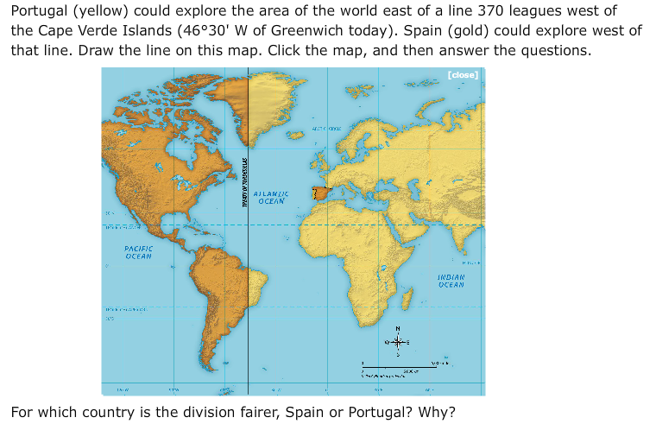

Slide 10
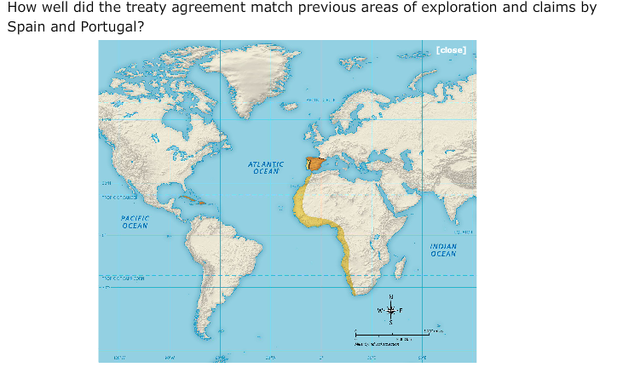

Slide 11
Conquests of the Aztec and Inca Empires
Cortés and the Aztec: In 1519, the Spanish conquistador Hernán Cortés arrived in what is now Mexico. His army conquered the Aztec Empire.
Pizarro and the Inca: In 1531, the conquistador Francisco Pizarro arrived on the coast of Peru. His army conquered the Inca Empire.

Slide 16
