Slide 1
Age of Exploration
Chapter 17

Slide 4
First Global Economic Systems
Chapter 17 Lesson 2

Slide 5
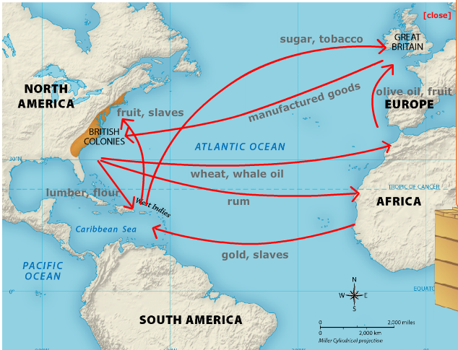

Slide 11
What do you think caused the demand for slaves to rise?

Slide 12
What effects might losing a generation of young people have on a country?

