Slide 1
Age of Exploration
Chapter 17

Slide 2
Colonial Latin America
Chapter 17 Lesson 3

Slide 3
Social Classes
Peninsulares and creoles: Peninsulares and creoles were at the top of the Latin American social structure.
Other groups: Mestizos, mulattoes, and other people of mixed ancestry were lower on the social scale. Native Americans and enslaved Africans were at the bottom.

Slide 4
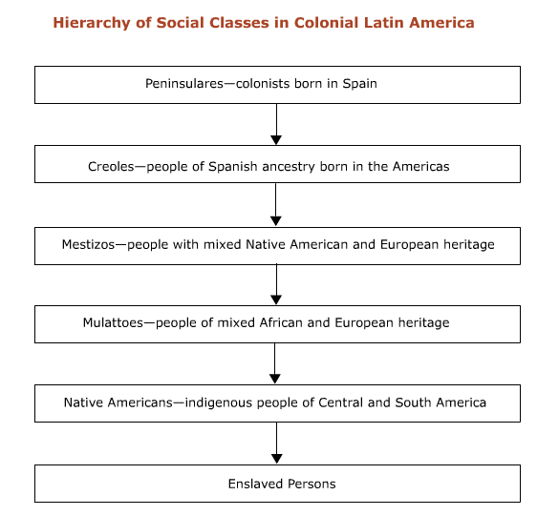

Slide 9
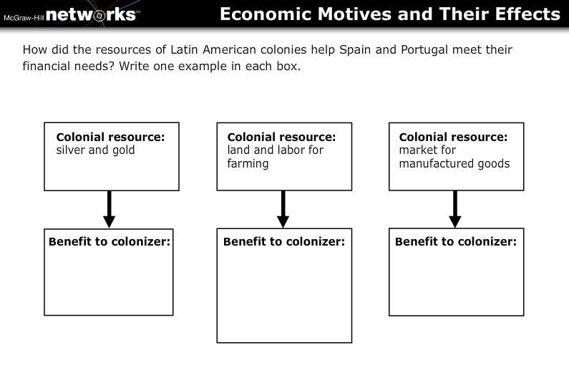

Slide 11
State and Church
Government in Latin America: Portugal and Spain governed their colonies from afar through their viceroys, who headed bureaucracies in which all the major officials were Europeans.
Catholic missionaries: Missionaries gathered Native Americans into villages where they could be converted, educated, and controlled.

