Slide 1
Europe in Crisis
Chapter 18, Lesson 1

Slide 2
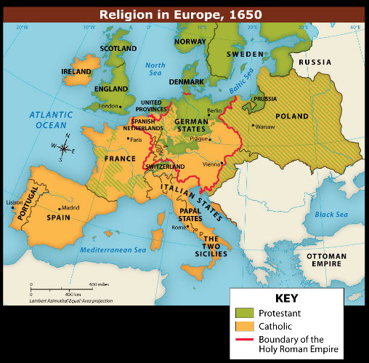

Slide 3
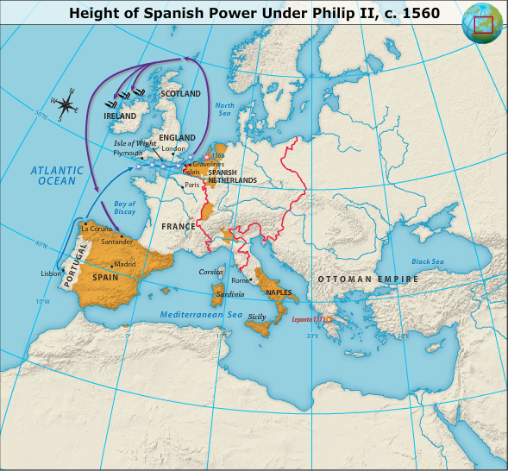
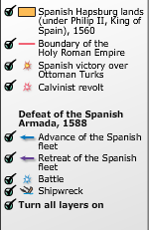
Spain and Catholicism

Slide 6
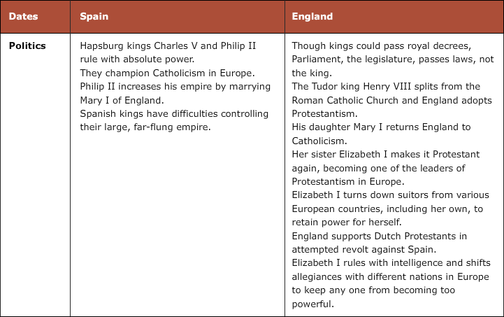

Slide 7
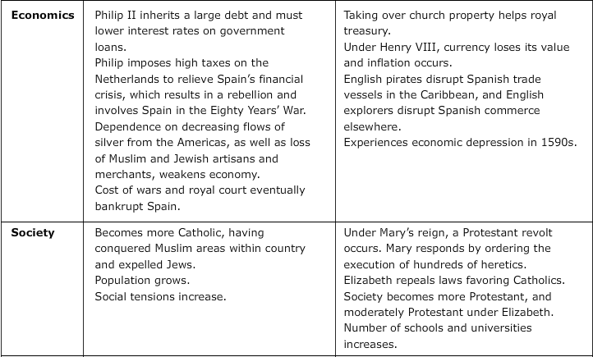

Slide 10
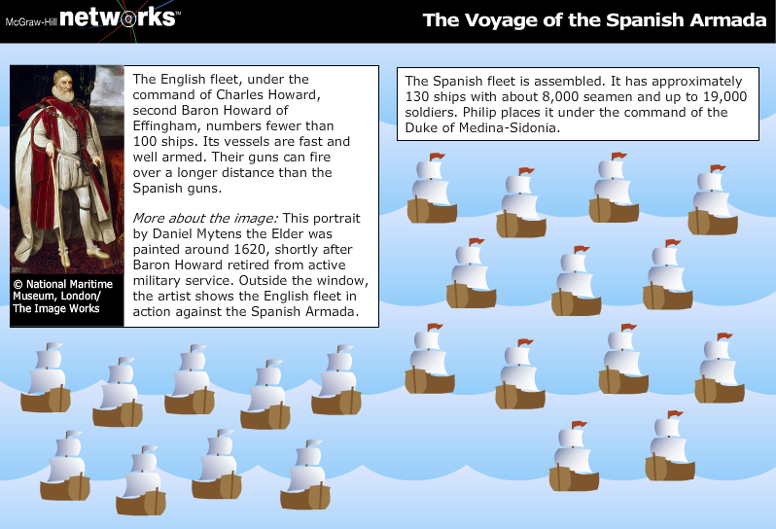

Slide 11
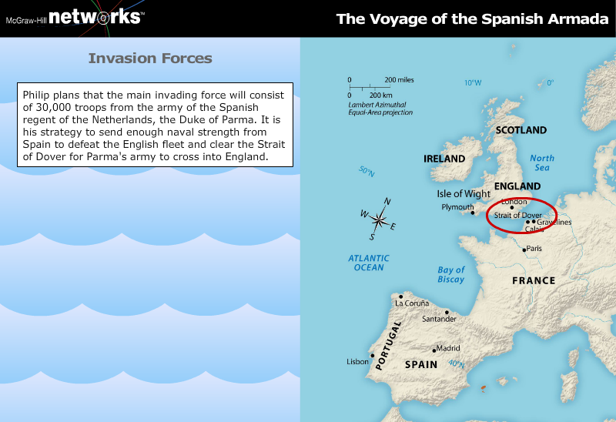

Slide 15
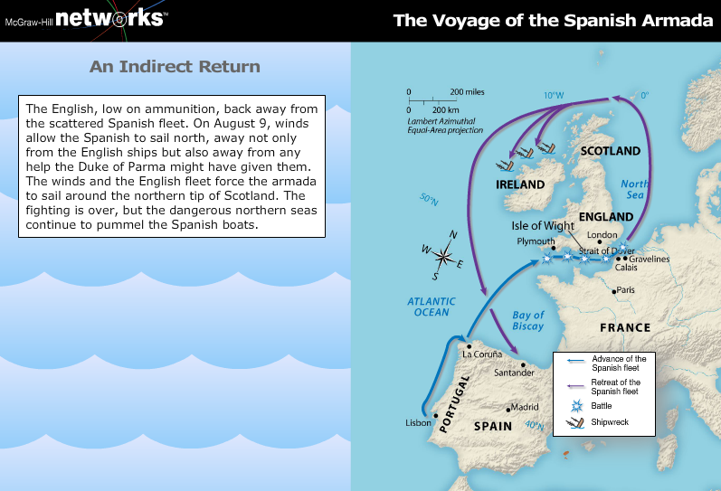

Slide 17
Population Decline, Witchcraft, and Other Crises
Economic slowdown: The economies of both Spain and Italy had begun to decline by 1600.
Population decline: War, plague, and famine helped to decrease the population of Europe after 1600.

Slide 19
The Thirty Years' War
Religious and Political Conflict: Beginning with a struggle between the Catholic rulers of the Holy Roman Empire and the Protestant nobles of Bohemia, the war became more political as Denmark, Sweden, France, and Spain became involved.
Peace and Effects: The war was ended by the Peace of Westphalia, with Sweden, France, and their allies gaining territory and the Holy Roman Empire being dissolved into independent states.

Slide 20
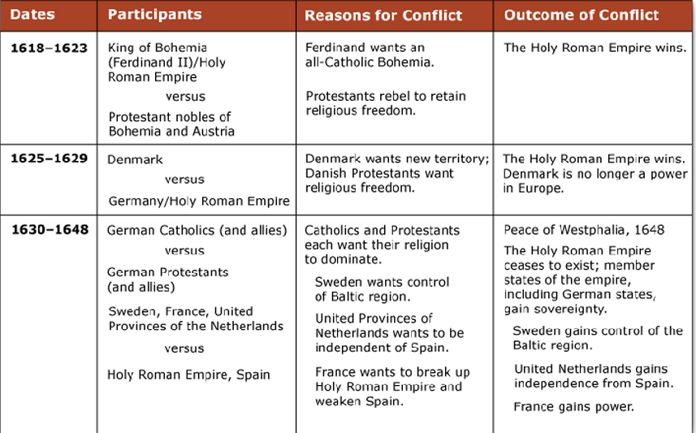
Thirty Years War

Slide 21
