Slide 1
English Revolution and Reform
Chapter 18, Lesson 2

Slide 2
England Before Revolution
Led by absolute monarch – rules by “divine right” – (because God said so…)
Parliament – acted as advisors to the king, also as the voice of the people – even though under the king’s control
House of Lords: Nobility (clergy, landowners), appointed, served for life, stronger body of govn’t.
House of Commons: Bergers (middle class merchants), elected, served terms, weaker body of govn’t.

Slide 3
England Before Revolution
Religion
Anglican (Church of England)
Protestant church, but had Catholic style services.
All people expected to be COE members.
Puritans Anglicans Catholics
Want to rid (COE)
COE of Catholic
influence

Slide 5
Charles I – King of England
The most interesting thing about Charles I is that he was five feet six inches tall at the start of his reign, but only four feet eight inches tall at the end of it.

Slide 6
Causes of Revolution
1) Unpopular Methods of Rule
Often occurs where people have no voting rights
King Charles I believed in absolute monarchy – (not popular with parliament.)
Repeatedly asks parliament for money to spend on wars, then dissolves parliament when they don’t give it to him.

Slide 7
Social Injustice
Specific groups are treated better or worse.
Charles I used martial law in areas that people protested – took away their rights, and imprisoned them.
Orders people in coastal cities to pay “Ship Money” to fund his spending habits.

Slide 8
Nationalism
Pride in your people or country
English wanted a ruler that would follow the Rule of Law. (Monarchy with limits – rule by the people.)

Slide 9
Economic Problems
Money! Taxes, land ownership, disparity of wealth, unemployment, pay rates.
Costly wars and royal spending creating debt.
Ship money – taxes on shipping
Charles I also forced nobles to give him loans.

Slide 10
Enlightenment Ideas
Concept of Natural Rights (John Locke)
Democracy
Charles = absolute power (divine right)
People wanted a Constitutional Monarchy (king or queen with limited powers)

Slide 11
Religious Intolerance
Specific groups singled out or oppressed.
Charles married a Catholic (Henrietta Maria of France) - hates puritans, jails those that speak out, banned puritan writings.
Orders Scots to use specific prayer books during church.

Slide 12
Causes of Revolution
U SNEER

Slide 13
Review!!
Absolute Monarch
Pariliament
Constitutional Monarchy
Religion of England??
King of England during Revolution
What countries make up Great Britian?
United Kingdon?
6 causes of revolution – and Explanation!!

Slide 14
Civil War begins…
Irish declare war on England (b/c of land claims)
Creates a division in parliament.
War breaks out in 1641 – lasts until 1646
Roundheads (Pro-parliament, Puritan) led by Oliver Cromwell vs. Cavaliers (Pro-King, Catholic)
Charles surrenders in 1647, tried and executed in 1649.

Slide 15
Commonwealth begins
Oliver Cromwell – “Lord Protector”
Military Rule
Roundheads in control
Anti-Catholic – Ireland’s Catholic majority either killed or stripped of their land. Protestants take over.
Religious freedom to all non-Anglican protestants

Slide 16
Cromwell Restoration
Cromwell dies in 1658
Stuarts return to the throne in 1660
Create Constitutional Monarchy under Charles II.
Birth of political parties due to succession of the king
Whigs (anti-Catholic)
Tories (keep the line of succession)

Slide 17
Under Charles II
He was king, but gave up power to Parliament - to make sure he would stay king
Religion – Parliament ruled in this – Forced the Church of England
When the Puritans left to North America
Constitutional Monarchy – form of government where the monarch’s powers are limited by a constitution.
The Plague and London’s Great Fire
Parliament is worried about James II (Catholic)
English Constitution – Magna Carta and the Petition of Rights, listed laws and customs
Charles agreed to the limits

Slide 18
King James II
Forming Political Parties –
Whigs – wanted to exclude James from the throne
Tories – defended the hereditary policy
Compromise – Habeas Corpus – could not be held in prison without just cause or trial
James has a son (Catholic)
Force James II out and put in William III and Mary II “Glorious Revolution” - Bloodless
First to agree to rule the people according to Parliament

Slide 19
Glorious Revolution
1688 – Who succeeds?
Charles II
James II
Mary (Protestant)
James (Catholic)
-flees to Ireland and tries to start war w/ England
- fuels hatred b/w Catholics and Protestants
Solution – Mary and William or Orange take the throne in “bloodless revolt”
Bill Of Rights passed: Parliament’s consent to raise taxes, habeas corpus, speech
Act of Settlement: no Catholic could take the throne

Slide 20
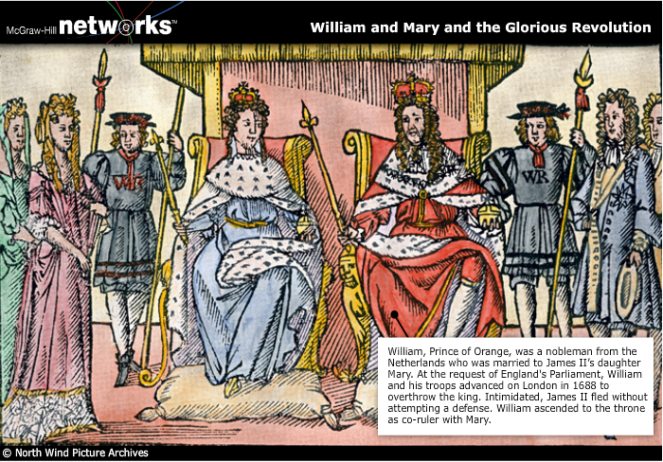

Slide 21
William and Mary
Bill of Rights
King could not raise taxes or an army without consent of Parliament
Could not suspend laws
People had the freedom to debate
Trial by Jury
Outlawed cruel and unusual punishment
Right to bail and the Appeal
James II tries to get his throne back and loses (Ireland) – United Kingdom is formed – Ireland, England, Scotland
Parliament passes the Act of Settlement
King could not be Catholic

Slide 22
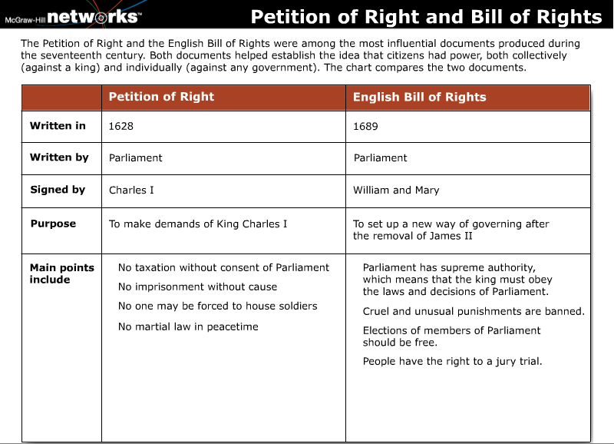

Slide 23
Hobbes and Locke on Government
Hobbes and absolute rule: Thomas Hobbes was alarmed by the violence and disorder related to the English Civil War. In his book Leviathan, Hobbes recommended that governments be led by an absolute ruler, who could preserve order.

Slide 24
Hobbes and Locke on Government
Locke and equality: John Locke believed that the natural state of human beings is equality and freedom. His book Two Treatises of Government argues against the absolute rule of one person.
Locke's influence abroad: Locke's idea that all humans had certain natural rights was influential outside of England. It influenced leaders in other European countries and in the United States. Parts of the Declaration of Independence and the U.S. Constitution are based on the ideas of Locke.

