Slide 1
Absolutism in Europe
Chapter 18, Lesson 3

Slide 2
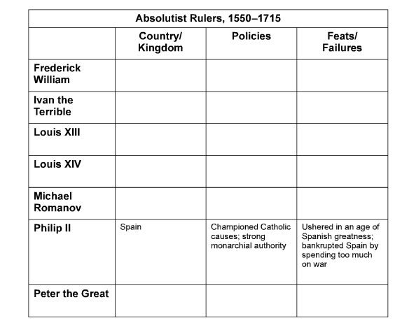

Slide 10
