Slide 1
Eisenhower’s Cold War Policies
Chapter 22.4 Notes

Slide 2
Rise and Spread of Communism
The Russian Revolution In 1917 the people of the Russian Empire overthrew Czar Nicholas II and formed a provisional democratic government. The government was weak, and in November of that year, a second revolution, led by the Bolshevik Party of Vladimir Lenin, established a Communist state.
The Rise of Stalin Lenin died in 1924. After a brief power struggle, Joseph Stalin rose to become the new dictator of the Soviet Union. Almost immediately, he began a campaign of terror against his own people that would last for the next 29 years.

Slide 3
Rise and Spread of Communism
Iron Curtain In May 1945, after the death of Adolf Hitler, Stalin’s USSR imposed Communist rule across Eastern Europe. As Churchill famously stated, “An Iron Curtain has descended across the continent.”
Warsaw Pact In 1955, as a response to the creation of the North Atlantic Treaty Organization, the Soviet Union and eight Communist puppet regimes signed the Treaty of Friendship, Cooperation and Mutual Assistance. This alliance became known as the Warsaw Pact.

Slide 4
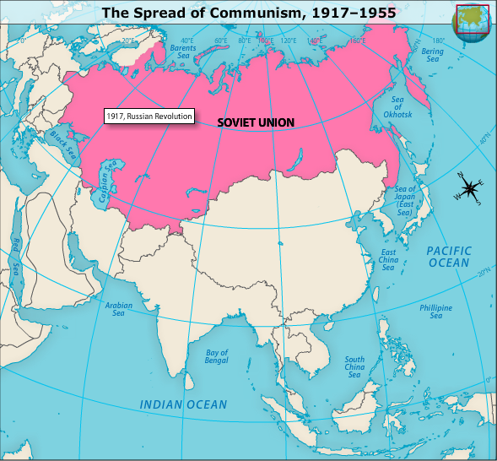

Slide 5
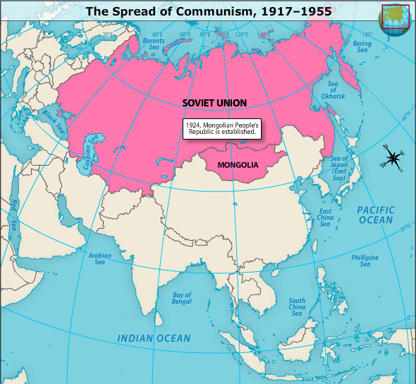

Slide 6
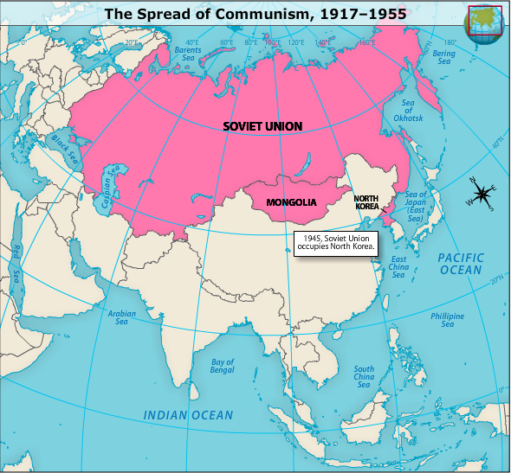

Slide 7
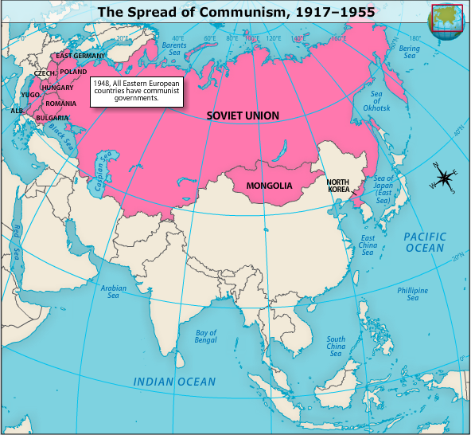

Slide 8
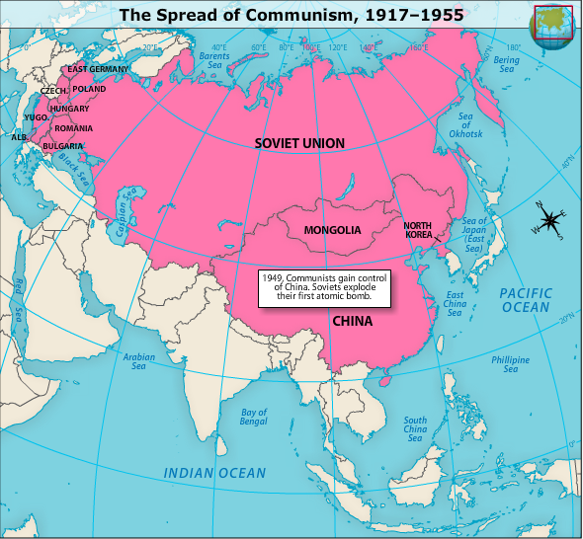

Slide 9
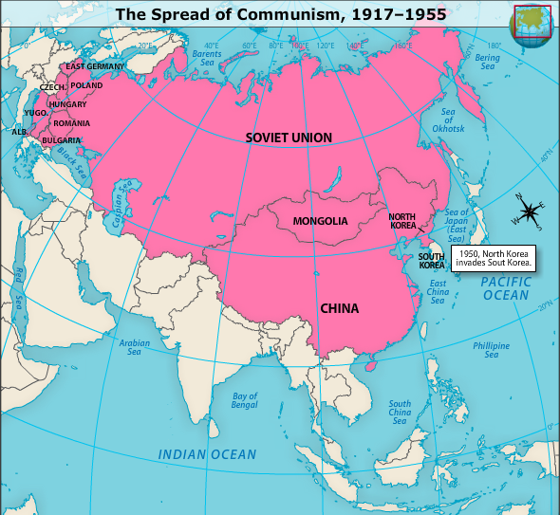

Slide 10
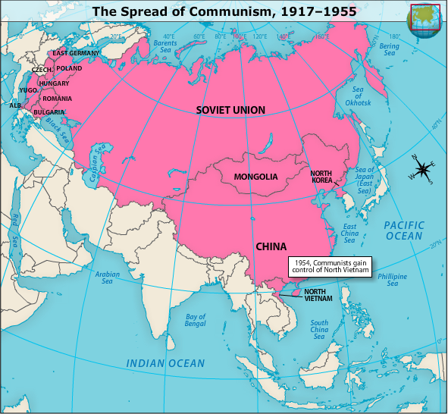

Slide 11
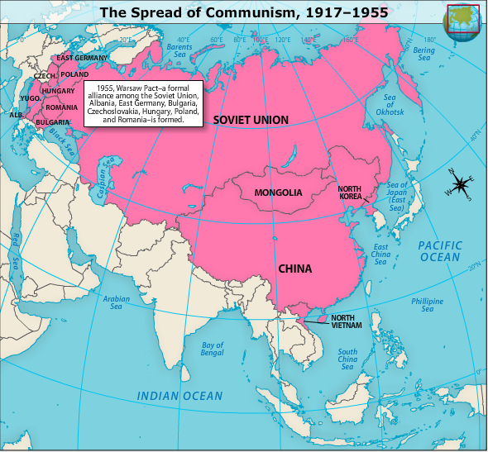

Slide 12
U.S. Foreign Policy Under Eisenhower
Eisenhower’s Policies After his election in 1952, Eisenhower sought to balance military and economic strength to guard against Cold War threats.
Massive Retaliation Eisenhower believed that nuclear weapons offer the most “bang for the buck.” He developed a policy of threatening to use nuclear weapons to prevent war. This policy was known as massive retaliation.

Slide 13
U.S. Foreign Policy Under Eisenhower
Brinkmanship Critics complained that Eisenhower’s policy brought the nation too close to war and was dangerous. They called it brinkmanship because it showed the country’s willingness to go to the brink of war.
Taiwan and Suez Crises Eisenhower threatened to go to war with China after that nation began shelling the democratic island of Taiwan. The next year, he again threatened to go to war when Egyptian forces seized control of the Suez Canal. The situation intensified when Britain and France invaded Egypt. Ultimately, war was prevented, but the Soviets gained influence in the Middle East.

Slide 14
Covert Operations Under Eisenhower
Importance of the CIA Eisenhower also relied on covert operations conducted by the CIA to deter communism. These typically took place in developing nations, and sometimes involved the overthrow of anti-American leaders.
Iran and Guatemala The CIA helped force Iranian Prime Minister Mohammed Mossadegh out of power in 1953. The next year, it trained and armed forces that opposed Guatemalan president Jacobo Arbenz Guzmán. These forces invaded Guatemala, and Arbenz Guzmán left office.

Slide 15
Covert Operations Under Eisenhower
Eastern Europe In 1956, the CIA encouraged dissent among Communist Eastern European nations by distributing copies of a secret letter by Soviet leader Nikita Khrushchev. As a result, an uprising began in Hungary that was crushed by Soviet forces.
Eisenhower Doctrine This policy extended the Truman Doctrine and the policy of containment to the Middle East in response to increasing Egyptian and Arab ties to the Soviet Union.

Slide 16
Covert Operations Under Eisenhower
Sputnik The Soviet Union launched the Sputnik satellite in 1957, which Soviets saw as proof of their superiority.
A Failed Summit Eisenhower and Khrushchev planned to hold a summit in Paris in 1960. However, the Soviets shot down a U.S. spy plane over the Soviet Union shortly before the scheduled summit, and Khrushchev cancelled the meeting.

