Slide 1
The Other Side of American Life
Chapter 23.3

Slide 2
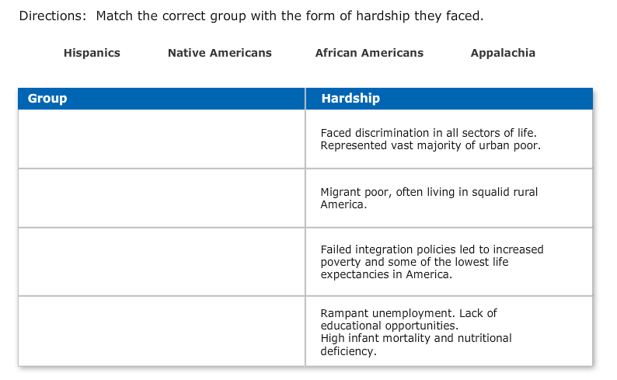

Slide 3
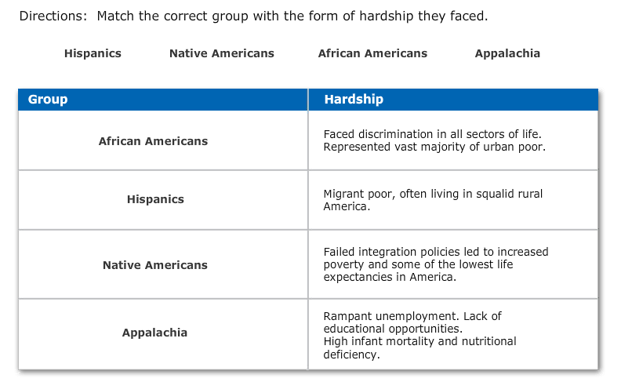

Slide 4
Poverty Amid Prosperity
Inner City With the population shifting to the suburbs, the tax revenue in cities eroded. Poorer, less educated populations remained in the city. African Americans who had moved to the cities were trapped in a grinding, often self-perpetuating, cycle of poverty.
Hispanics Millions of Mexicans came to the United States as temporary contract workers. A small percentage of them settled in the United States permanently to work on large farms. Bracero workers toiled long hours for little pay; they lived in squalor. Puerto Ricans migrated to cities on the East Coast and often lived in poverty similar to that of other inner city residents.

Slide 5
Poverty Amid Prosperity
Native Americans Native Americans earned less than any other group of Americans. The federal government stopped recognizing tribes as legal groups and moved them off of reservations in an attempt to assimilate them into U.S. society. The overall results were worse poverty, loss of land, and near destruction of Native American culture and traditions.
Rural Appalachia Mechanization of coal mines put coal miners out of work, removing the backbone of the economy in Appalachia. Many people left the region for cities, leaving behind decimated communities with a shrinking tax base. Appalachia had fewer doctors per thousand people than any other part of the country. Combined with poor diet, this contributed to malnutrition and high infant mortality rates. Illiteracy rates were among the highest in the nation.

Slide 7
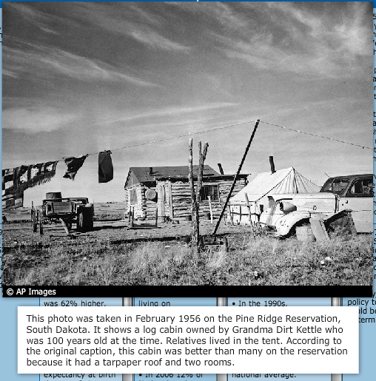

Slide 8
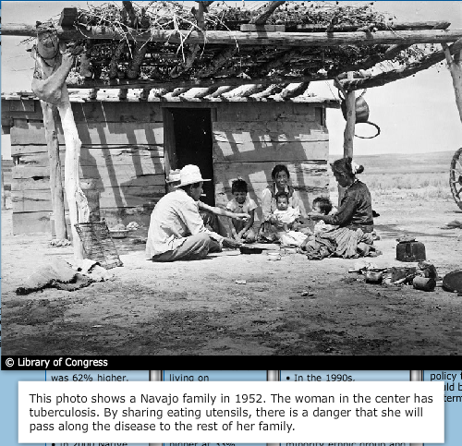

Slide 9
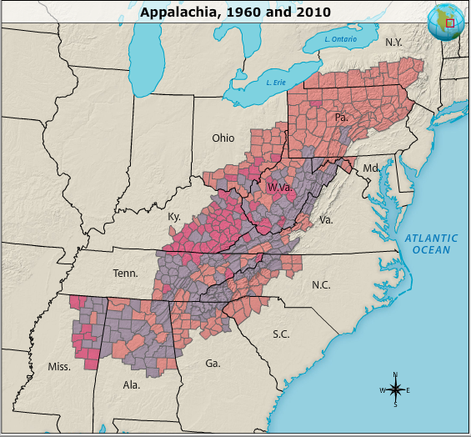

Slide 10
Urban Issues
Urban Crisis The flight of middle class Americans to the suburbs in the 1950s caused a decline in tax revenue in cities. This resulted in cuts in public transportation and public safety—fire and police. Public education suffered. The number of city residents living in poverty increased, especially among minority groups.
Urban Renewal Government-funded high-rise housing projects created crowded conditions for poor residents, contributing to an increase in crime and violence.

Slide 11
Juvenile Delinquency
Fear: Fear about the youth of the United States sprang from several sources: the power of a mass media influence that was largely unknown; changes in family structure and roles, including more child-centered, permissive parents; heightened expectations of the family; creation of a new teen culture; antagonism of middle-class parents and other adults toward what they saw as “lower-class” culture.

Slide 12
Juvenile Delinquency
The Role of Media: Americans felt widespread fear that the media were inciting children to antisocial, rebellious behavior and even crime.
Stereotypes: Juvenile delinquency came to be associated with the style of clothing, hair, and speech that had been adopted by the youth culture.
Schools as Solution: Adults hoped schools could set right youth who acted out.

