Slide 1
JFK and the Cold War
Chapter 24 Lesson 2

Slide 2
Kennedy’s Foreign Policy
Cold War: The Cold War with the Soviet Union dominated Kennedy’s foreign policy concerns. Kennedy continued the existing U.S. policy of containment to prevent the spread of communism.
Military Buildup: Kennedy preferred not to rely on a nuclear arsenal. He advocated a buildup of troops, including the Green Berets, and of conventional weapons, such as small arms, bombs, missiles, and rockets, to support a “flexible approach.”

Slide 3
Kennedy’s Foreign Policy
Diplomacy: Kennedy did not want to rely on a military response alone. To combat the ideology of communism, Kennedy provided aid to Latin American countries through the Alliance for Progress. This aid included economic assistance for schools, housing, health care and land distribution reforms. However, the aid was channeled through existing governments, some of which kept the money. These policies caused an anti-U.S. backlash among some people. Kennedy also established the Peace Corps, through which U.S. citizens volunteered in developing nations, providing humanitarian services like medical care.

Slide 4
The Space Race
Soviet space program: In 1957 the Soviet Union launched the first satellite, called Sputnik, into orbit. In 1961 Soviet astronaut Yury Gagarin became the first person to orbit Earth.
U.S. space program: Soviet accomplishments spurred the U.S. space program. Kennedy responded that the United States should be the first to put a person on the Moon. In 1962 John Glenn became the first U.S. astronaut to orbit Earth. In 1965 three U.S. astronauts went into orbit aboard Apollo. In 1969 Neil Armstrong, Edwin “Buzz” Aldrin, and Michael Collins were carried into space by the Saturn V rocket. Armstrong and Aldrin then boarded a lunar module and landed on the Moon. Armstrong became the first human to set foot on the Moon.

Slide 5
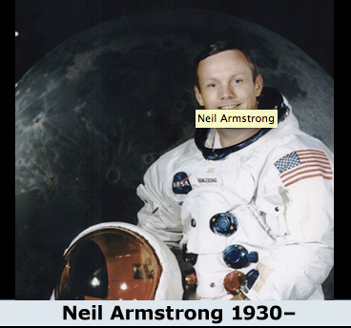
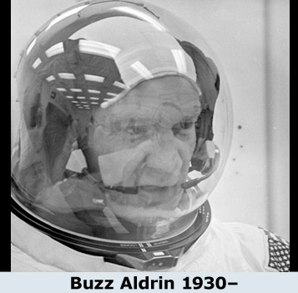

Slide 6
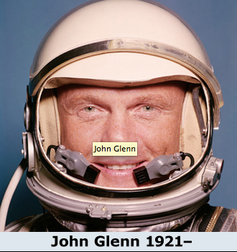
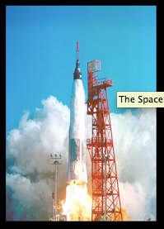

Slide 7
Cold War Crises
Bay of Pigs: Under Fidel Castro, Cuba struck a close alliance with the Soviet Union. The Cuban government seized U.S. businesses in Cuba, and the Soviet leader, Nikita Khrushchev, supported expanding the Cuban military. Kennedy inherited a plan from the Eisenhower administration to train and arm a group of Cuban exiles, known as La Brigada, to invade Cuba and incite a revolution. La Brigada invaded Cuba in April 1961, but Kennedy cut off their air support to avoid implicating the United States in the operation. The invasion failed to spark a revolution as most of La Brigadawere captured or killed.
Berlin Wall: In a meeting with Kennedy, Krushchev demanded that Western forces withdraw from West Berlin and recognize East German sovereignty. Kennedy refused. In response, Khrushchev had the Berlin Wall built through the city, cutting off West Berlin from East Berlin and preventing the migration of East Germans to the West.

Slide 8
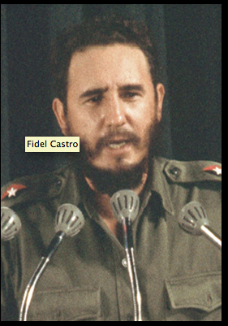
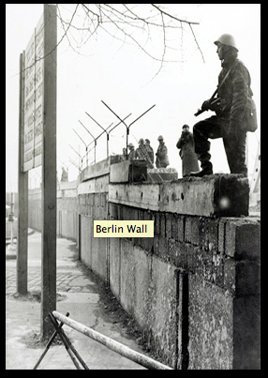

Slide 9
Cold War Crises
Cuban Missile Crisis: In 1962 the Soviets sent weapons and military equipment to Cuba and stationed long-range nuclear missiles on Cuban territory. In October this sparked a standoff as Kennedy quarantined the island to prevent further missiles from reaching Cuba, demanded that existing missiles be dismantled, and promised full retaliation if the United States were attacked. Secret negotiations resulted in an agreement: The Soviets would withdraw the missiles if the United States promised not to attack Cuba and withdrew its nuclear missiles from Turkey, near the Soviet border.
Outcome: The Cuban missile crisis led to a new agreement between U.S. and Soviet leaders in August 1963. Both countries banned the testing of nuclear weapons in the atmosphere. However, the resolution of the crisis made the Soviets look weak and exposed their military inferiority. This sparked a new arms race, because the Soviets undertook to build up their arsenals, and the United States responded in kind.

Slide 10
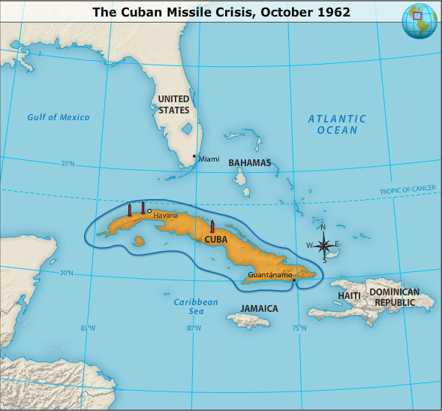

Slide 11
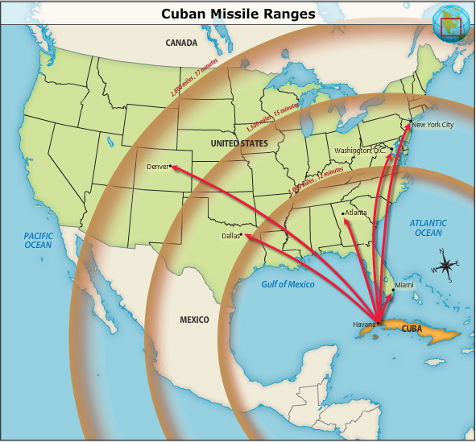

Slide 12
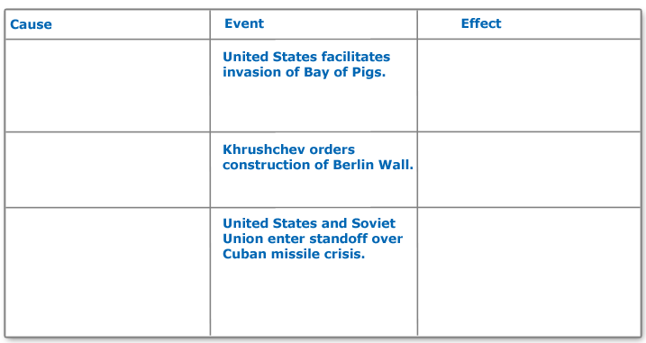
Three Cold War Crises

Slide 13
Death of a President
Nov. 22nd, 1963 – assassinated in an open motorcade in Texas by Lee Harvey Oswald.
Oswald was shot 2 days after by Jack Ruby.
Warren Commission – Oswald acted alone
However, there are still many conspiracy theories.
Lyndon B. Johnson took the oath of office just hours after Kennedy’s death.

Slide 14
