Slide 1
America and World War II 1941-1945
Chapter 21

Slide 2
Minorities in World War II
African Americans in the Military - remained segregated, commanded by white officers, in non-combat units
The Tuskegee Airmen - African American volunteers, fighter-escort pilots
flew missions in North Africa, Sicily, and Italy.
Japanese Americans - 442nd Regimental Combat Team and the 100th Infantry Battalion (volunteer units)
family members of these soldiers were confined to internment camps.
among the most decorated combat units in U.S. history.
Hispanic Americans
Hundreds of thousands of Mexican Americans and Puerto Ricans served both on the front lines and in support services.

Slide 3
Minorities in World War II
Native Americans >30 percent of all eligible Native Americans saw battle. Because of their history - were regarded as fierce warriors and were welcomed to front lines.
Jewish Americans 500,000 Jewish American
Many volunteered to serve in Europe
Women - allowed to enlist but limited to clerical duties
Women’s Army Auxiliary Corps (WAAC). In 1943 the
Women’s Army Corps (WAC) became part of the regular army, but could not serve in combat
Women Airforce Service Pilots (WASP) were allowed to deliver planes and supplies

Slide 4
Background
War Production – increased
Gov’t turned many peace-time factories over to war production.
Cost Plus - system that gave businesses monetary incentives to produce military goods quickly.

Slide 5
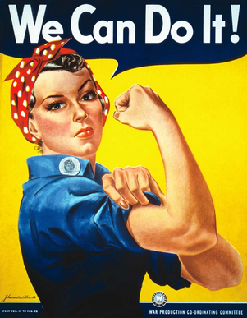
Background
Factory Workers - women into factory jobs usually done by men
changed the perception of women as workers
“Rosie the Riveter” became the iconic image from that period.

Slide 7
African American and Hispanic Workers
African Americans
Roosevelt created The Fair Employment Practices Commission to eliminate discrimination
Mexican Workers
Bracero Program allowed Mexican workers to harvest crops and work on railroads
Migrant workers remained in the United States after the war.

Slide 8
Background
Population shift
War industries expanded in S. California and SW. called “the Sunbelt,” from the Midwest and Northeast.
Conflict
Competition for jobs and housing and recurring prejudice, created tension between ethnic groups.

Slide 9
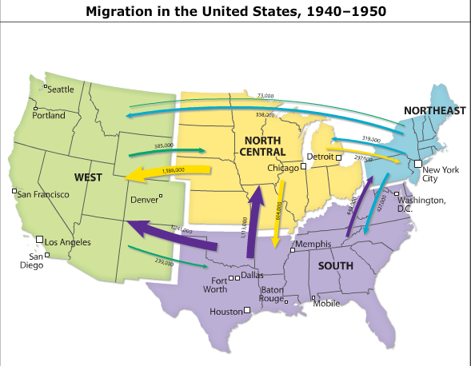

Slide 10
Forced Relocation
Japanese discrimination: Japanese homes and businesses were vandalized. They could not cash checks or buy goods.
Internment Camps
1942 the gov’t declared the West Coast military zone. People of
Japanese Americans citizens sent to internment camps farther inland.
German and Italian descent were also interned.
Supreme Court Decisions
Upheld because it was based not on race, but on “military urgency.”
later the court ruled that U.S. citizens could not be held against their will. This led to the release of Japanese Americans from the camps.
1988 President Ronald Reagan apologized to Japanese Americans on behalf of the U.S. government.
Each surviving internee was given $20,000 in reparations.

Slide 11
Background
Scrap Drives
collected raw materials to aid in military prod.
People donated pots, tires, cans, car parts, and broken toys.
Victory Gardens
grew fruits and vegetables in virtually any available space in cities, suburbs, and rural areas to provide food.
Rationing
U.S. gov’t placed limits on purchasing items ranging from meat to shoes to gasoline.

Slide 12
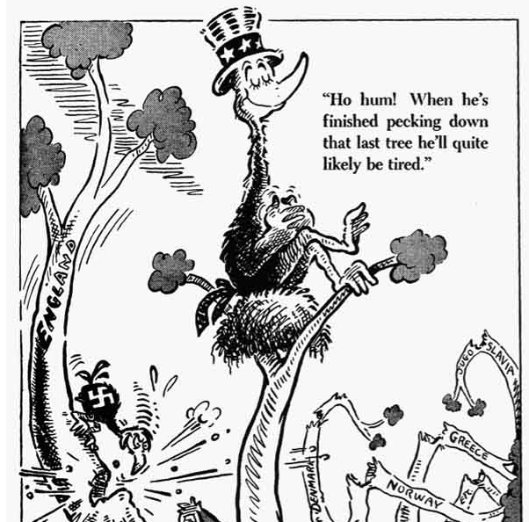

Slide 13
Halting the Germans
Military Strategy
first attack the periphery of the German empire before engaging Germany in Eur.
Allied forces invaded German-controlled North Africa in 1942
El Alamein and Kasserine Pass
Br. Victory @ El Alamein in Nov. 1942 that helped secure the Suez Canal.
Am. lost Battle of Kasserine Pass.
British and U.S. forces ultimately forced German troops to surrender in North Africa in May 1943.
Allied and Axis Leaders
German forces in North Africa were commanded by Erwin Rommel, nicknamed the “Desert Fox.”
Generals Dwight D. Eisenhower and George Patton commanded U.S. forces in the region.

Slide 14
Battle in Europe
Battle of the Atlantic - 1942, Am. and Ger. ships faced off
Convoys of warships escorted cargo ships to help prevent German attacks.
U.S. military technology turned the conflict in favor of the Allies.
Battle of Stalingrad
Ger. forces invaded the SU in 1942. By winter, they had reached Stalingrad (street to street battle – ugly fight, lots of civilian causalities)
The combination of cold and Soviet reinforcements led to a German surrender in February 1943, putting Ger on the defensive and turning the tide of the war.

Slide 15
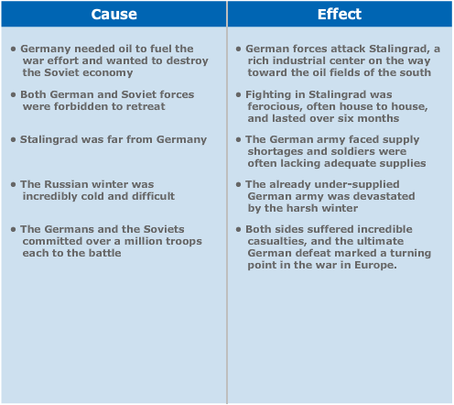

Slide 16
European Operations
Strategic Bombing
bombing campaign against Germany, destroying factories and rail lines.
Sicily
Eisenhower, Patton, and British general Bernard Montgomery led attacks on Sicily in 1943. Italy soon surrendered.
Anzio
Ger forces regained control of n. Italy. Allied forces invaded at Anzio, near Rome, and spent months fighting before the Germans finally retreated.

Slide 17
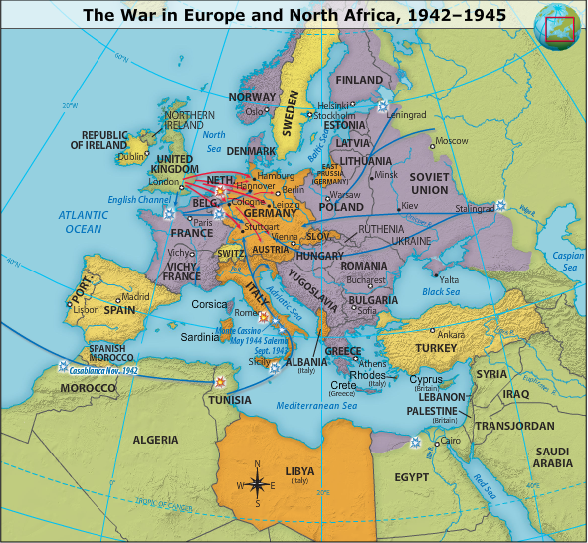

Slide 18
The Tehran Conference
Tehran Conference Roosevelt, Churchill, and Stalin met at Tehran, Iran, in late ‘43.
Soviet Attack of Germany The Soviets agreed to launch an offensive against Ger. from the east once the Allies invaded France in 1944.
Division of Germany To prevent Germany from becoming too powerful, Roosevelt and Stalin agreed to divide the nation into smaller nations after the war.
Soviet Efforts Against Japan The SU agreed to help the US battle Japan after the war in Europe ended.
The United Nations Stalin agreed to the creation of an international peacekeeping organization after the end of the war.

Slide 19
Operation Overlord: D-Day
Operation Overland
Make Ger. fight on both Fronts. They decided to
Launch an invasion of France.
Eisenhower oversaw Operation Overlord
Planning and Strategy Eisenhower decided to
Invade the beach in Normandy
access to air, sea, and land transportation.
American soldiers and equipment massed in England in preparation for the invasion.
June 6, 1944 - 100,000 soldiers stormed the Normandy beaches.
General Omar Bradley oversaw particularly heavy fighting at Omaha Beach.
Victory Despite casualties and difficult conditions, more than 100,000 American, British, and Canadian troops occupied the beaches by the end of the day.

Slide 20
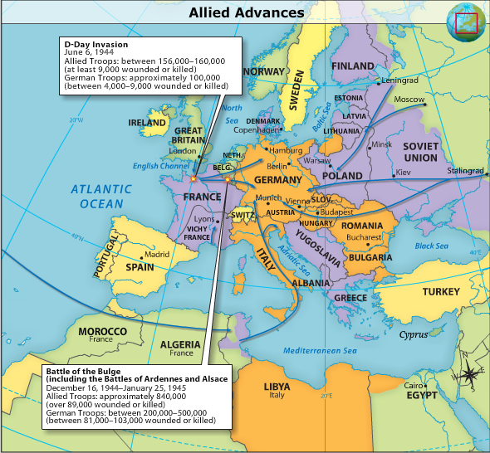

Slide 21
The War Ends in Europe
Battle of the Bulge
December 1944, Hitler staged an offensive in Belgium that he hoped would cut Allied supply lines.
Allied troops forced the Germans to retreat in January 1945.
Approach on Berlin
The Battle of the Bulge drained Ger. resources, and Soviet troops had made progress into Ger.
March, U.S. troops attacking from the west crossed the Rhine River.
Soviets reached Berlin on April 21.
V-E Day
Hitler committed suicide on April 30.
May 8, 1945 became known as "V-E Day" for "Victory in Europe."

Slide 22
Holding the Line Against Japan
Why was the Doolittle Raid important for U.S. forces in the Pacific?

Slide 23
The United States at War in the PACIFIC
After Doolittle raid, Japanese changed strategy
Convinced to attack New Guinea and Midway Island
N.G. cut off American supply lines to Australia
Midway - Last American base in the Northern Pacific
Would lure the U.S. into battle where the Japanese would DESTROY the American Fleet
Battle of the Coral Sea
May 1942 - Defensive Battle
Americans were prepared
Japanese plans had been decoded
American carriers Yorktown/Lexington hit hard
American’s defeat the Japanese fleet
Holds off an invasion of Australia

Slide 24
Pacific Con’t
Battle of Midway
Code breaking is a key advantage
Will allow the U.S. to ambush the Japanese fleet
Japanese retreat after a loss of 4 aircraft carriers
First major defeat for the Japanese navy
Slows the Japanese advance across the pacific
Brings to an end the threat faced by Hawaii

Slide 25
Pacific Strategy Changes
After Midway the U.S. moves from defensive to offensive
Soviet Union has pledged assistance to defeat the Japanese after Germany surrenders (Tehran Conference)
Island Hopping
U.S. strategy to capture key islands
Use the islands as bases to attack other Japanese lands
Worked to slowly cut Japanese supply lines

Slide 26
Pacific Offensive
Guadalcanal (Solomon Islands) (August 1942)
Begin the long road to Tokyo
Air, ground, naval war for 6 months
U.S. forces win even though poorly supported
Will continue island hopping toward Philippines
Tarawa Atoll - November 1943
Geography presents a problem
High casualties (1000+ at Tarawa)
Americans wondering how many lives would be lost

Slide 27
Pacific Offensive Con’t
Marshall Islands (Feb. 1944)
Make better use of the amphtrac (alligator)
Can now have air bases and continue island hopping
Mariana Islands (August 1944)
Captured and used as a base for the B-29 Superfortress to bomb Japan

Slide 28
Pacific Offensive Con’t
Philippines - October 1944
General MacArthur returns
MacArthur’s land advance paired with amphibious operation led b Admiral Chester Nimitz
Japanese assault at the Battle of Leyte Gulf
Largest naval battle in history
Japanese begin using “kamikaze attacks”
Japanese retreat -expecting U.S. reinforcements
High casualties 80,000 Japanese w/only 1,000 surrendering

Slide 29
Pacific Offensive Con’t
Iwo Jima
Important refueling post
Goal is more successful bombing campaigns on Japan (Marianas were a touch too far)
U.S. wins
Heavy casualties
Okinawa 279 kamikaze hits
U.S. marines 25,000 casualties

Slide 30
Pacific Offensive Con’t
American Bombing Campaigns
Building airbases on Iwo Jima takes time
U.S. begins “firebombing” to “hit” targets
Bombs filled with jellied gasoline (napalm)
Explode/start fires which destroy
Production centers
Controversial due to civilian casualties
March 1945 raid on Tokyo
83,000 civilians killed (burned, asphyxiation)
June 1945 - 6 industrial cities firebombed
No signs of surrender

Slide 31
Pacific Offensive Con’t
Okinawa
Base from which to launch a land invasion
Japanese dug in in mountainous caves/bunkers
June 1945 captured by U.S.
Casualties - 12,000 Americans
U.S. calls for unconditional surrender
Japanese want the Emperor to remain

Slide 32
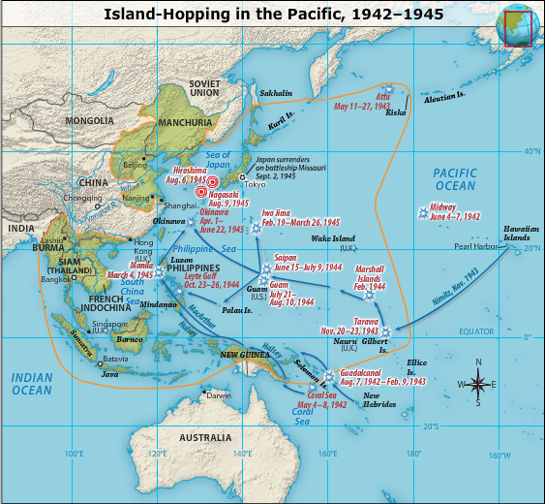

Slide 34
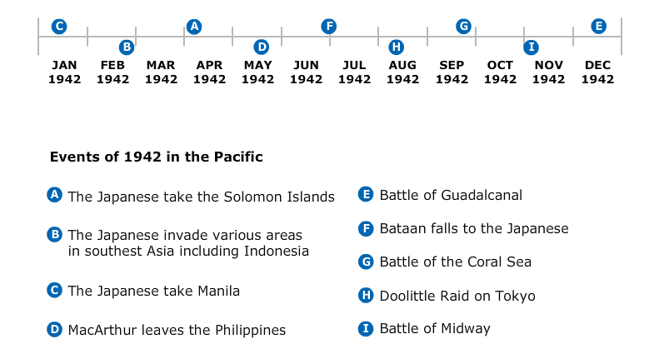

Slide 35
Use of the Atomic Bomb
Dated back to 1939
Germans had split uranium atoms
Leo Szilard drafted letter to Einstein to have it sent to FDR
FDR sets up a scientific committee
Influenced by the British
Code named the Manhattan Project
University of Chicago (Nuclear Reactor)
Los Alamos New Mexico (atomic bomb)

Slide 36
Atomic Bomb
Tested in 1945 in New Mexico
Truman forced to choose
Invasion which could cost huge numbers of lives (1/2 to 1 million) and lengthen war (10)
Use the Atomic bomb (20,000 tons of TNT force) with a guarantee of civilian losses
Warn about the bomb
Give a demonstration of the power
Think about the Soviet Union too ~ the Cold War dance has already begun

Slide 37
Atomic Bomb
Truman warns Japanese to surrender or risk utter destruction
Japanese gov’t does not
August 6, 1945 - Hiroshima is bombed
Japanese industrial city
60% is destroyed
80,000-120,000 die immediately
More casualties from radiation burns/sickness

Slide 38
Atomic bomb
U.S.S.R. declares war on Japan
August 9, 1945 - Nagasaki is bombed
35,000-75,000 casualties
Emperor orders a surrender
V-J Day ~ “Victory in Japan” August 1945

Slide 39
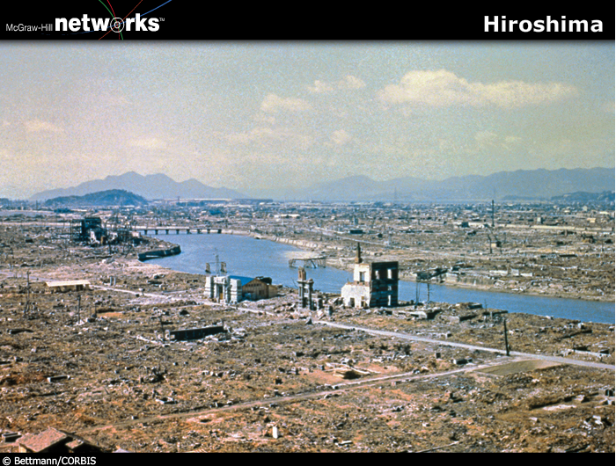

Slide 41
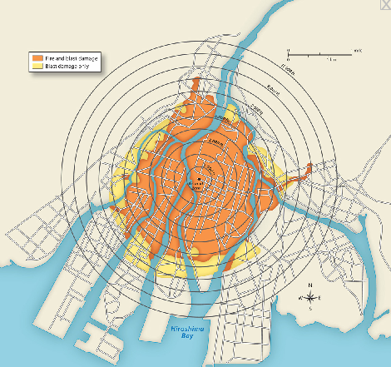
Destruction path at Hiroshima

Slide 42
Costs of WWII
Total 38 Million lives
U.S.S.R - 7.5 million and 22 million civilians
Germans - 3.5 million
Japanese 1.2 million
Chinese 2.2 million
Great Britain and France 100,000’s each
U.S. 300,000 dead; 700,000 wounded
Holocause 12+ million total

Slide 45
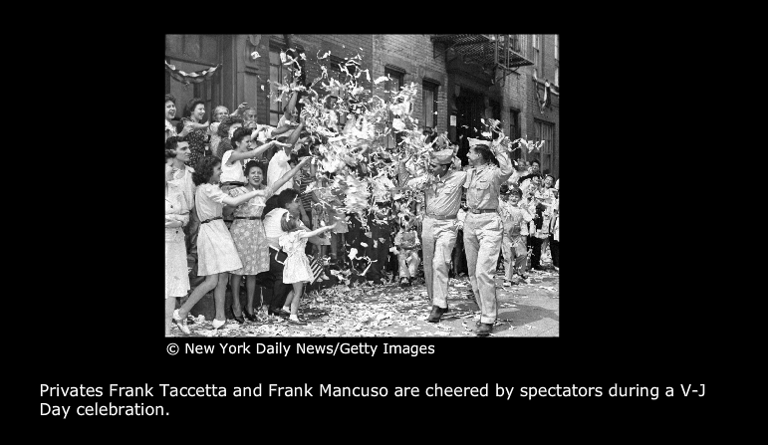

Slide 47
Putting the Enemy on Trial
Nuremberg Trials
22 prosecutions of Nazi leaders
3 acquitted
12 executions
7 given prison sentences
Lower ranking officials
24 executions
107 imprisonments

Slide 48
Driving Back Japan
GUIDING QUESTIONS What was the military strategy behind “island-hopping”? Was it successful?
Has your personal opinion about the atomic bomb changed?

