Slide 1
The Jazz Age
Chapter 17
1920’s

Slide 2
Art & Culture
Chapter 17, Lessons 4 and 5

Slide 3
Artists of 1920’s
John Marin
known for abstract landscapes and watercolors depicting cities as living landscapes.
Charles Sheeler
incorporate photography into his work, Sheeler
emphasized linear precision in his work.
Edward Hopper – A
realist painter, Hopper’s work
emphasized isolation across rural and urban America.
Georgia O’Keefe
naturalistic imagery
chiefly responsible for legitimizing American art across the globe.

Slide 4
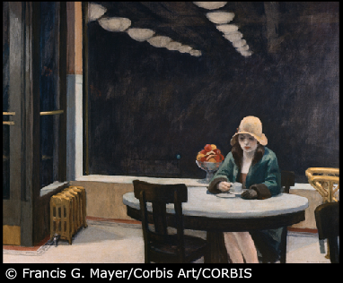
1920’s Painting - Realism

Slide 5
Literature of 1920’s
Diverse writing styles
Carl Sandburg – Used poetry to glorify everyday life and common places
F. Scott Fitzgerald – Fostered a criticism of upper classes
Eugene O’Neill – Wrote to express realism and tragedy
Ernest Hemingway – Developed a literature of the postwar “Lost Generation”

Slide 6
Literature of 1920’s
Claude McKay: first important writer of the Harlem Renaissance.
Wrote about American racism in Harlem Shadows.
Expressed both defiance and contempt for racism.
Langston Hughes:
Writer of such works as Black Nativity and "The Negro Speaks of Rivers," among many others.
Highly political in his writings.
Zora Neale Hurston:
rural African American culture
first major writer to have African American women as central characters

Slide 7
Movies, Radio, and Sports
Silent films and “talkies” took the nation by storm
new breed of celebrity and entertainment.
Movie theaters became esp popular in Southern states because they provided air-conditioning
Popularity of radio broadcasts increased as several powerful radio broadcasters developed.
Thanks to the new media technologies, sports such as baseball became more popular than ever.
Babe Ruth - baseball
Red Grange - football

Slide 8
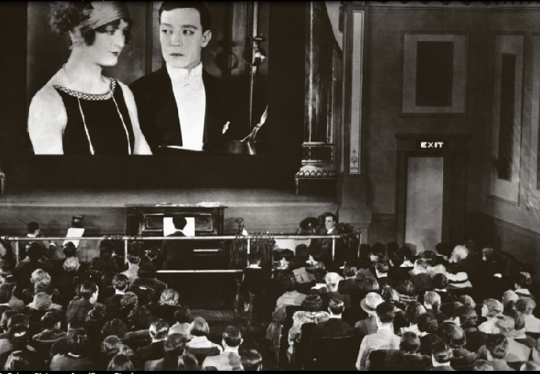

Slide 9
Jazz, Blues, and Theatre
Jazz – an improvisational style of music
Louis Armstrong and Duke Ellington who enjoyed wide celebrity across racial lines.
Blues – Coming out of African American spirituals
way for African American culture to express the lows of oppression and poverty
Theater – African American performers took to the stage
challenged racial stereotypes and showcasing a wide range of talent

Slide 10
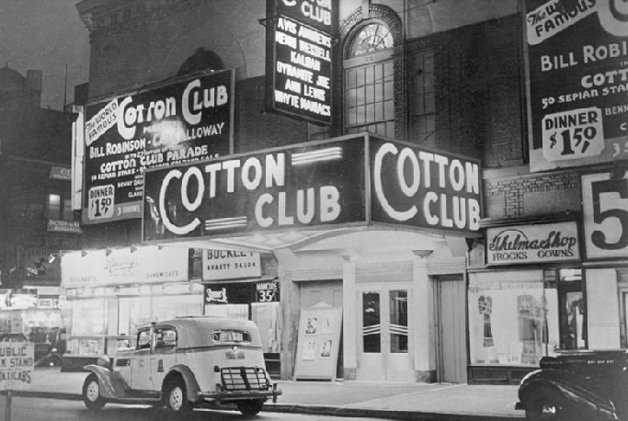

Slide 11
African American Politics
Northern Migration (Great Migration)– Industrial jobs in the North and segregation in the South
triggered a mass migration of African Americans beginning in World War I
NAACP – New powerful organization
fight segregation and lynching.
Black Nationalism – Marcus Garvey and others promoted the ideas of black nationalism
notion of a separate and unique African American identity

Slide 12
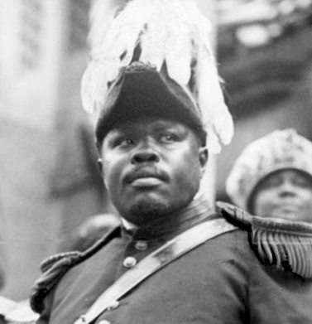
Marcus Garvey

