Slide 1
The Persian Wars

Slide 2
Our Plan
5 W’s
Who (Who was fighting who?)
Where?
Why?
When?
What happened?

Slide 3
The Battle of Marathon

Slide 4
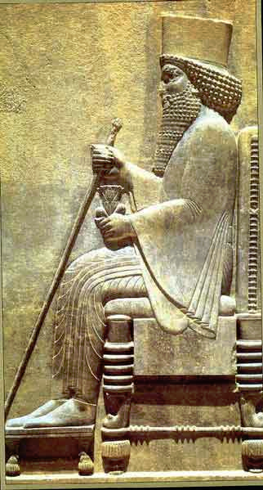
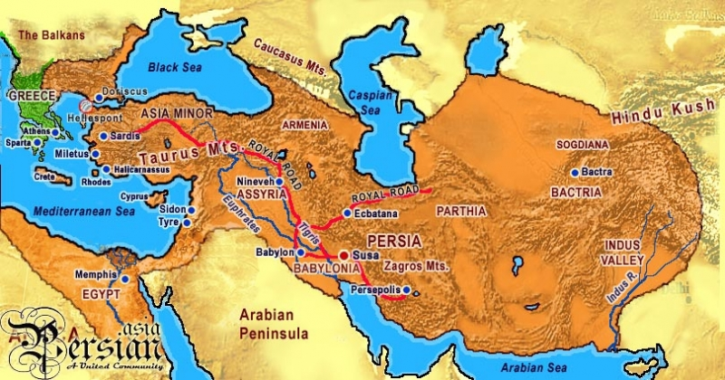
The Battle of Marathon
Who?
The Persian Army vs. Athenian Army
King Darius I of Persia

Slide 5
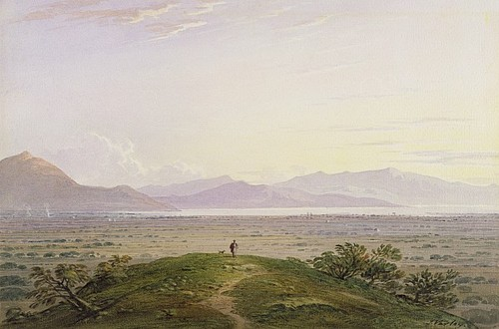
The Battle of Marathon
Where?
Marshy plains of Marathon outside of Athens

Slide 6
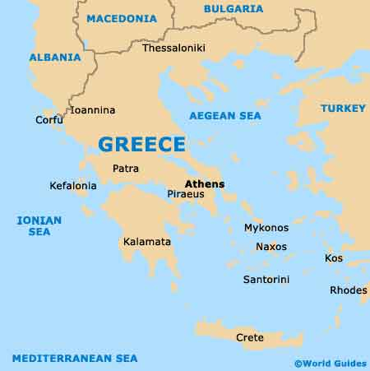
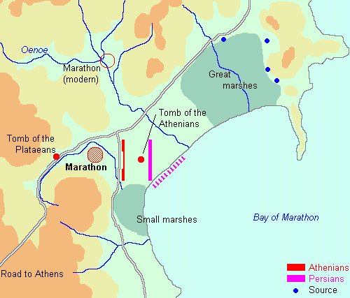

Slide 7
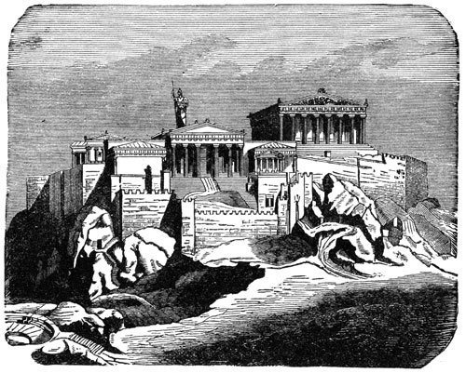
The Battle of Marathon
Why?
The Persians wanted to invade & conquer Greece.
When?
490 B.C.

Slide 8
The Battle of Marathon
What happened?
Greeks significantly outnumbered
5 day stand off followed by Greek charge
Persian cavalry/good omens
Strengthened flanks and weakened center
Persians retreated to ships
Greeks able to capture as many as 7 ships

Slide 9
Pheidippedes

Slide 10
The Battle of Marathon
Who won?
Athens! (The Greeks)
Marathon was considered a small loss for the Persians, but big for the Greeks because it proved they could be beaten.

