Slide 1
The Persian Wars

Slide 2
The Battle of Thermopylae

Slide 3
The Battle of Thermopylae
Who?
Xerxes (Son of Darius) & The Persians
King Leonidas & 300 Spartans
Where?
A mountain pass called Thermopylae or the Hot Gates

Slide 4
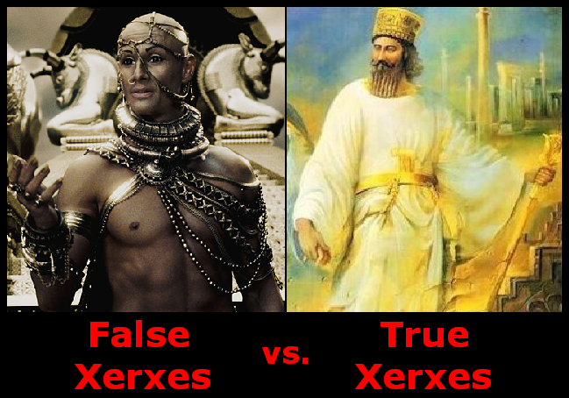

Slide 5
King Leonidas
The training of Spartan Boys - ~ 10 min in.
The Last Stand of the 300 – History Channel
http://youtu.be/ka12FNcTwh4

Slide 6
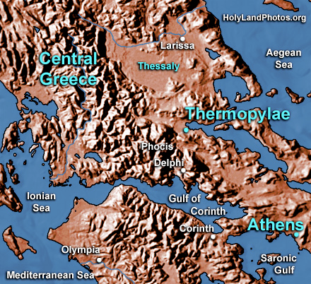
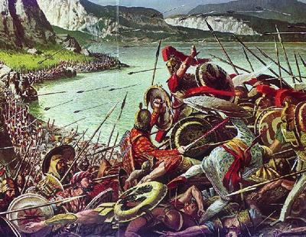
The Battle of Thermopylae
When?
480 B.C.

Slide 7
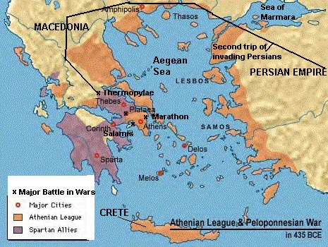
The Battle of Thermopylae
Why?
Xerxes was eager to defeat Greece after their loss at Marathon ten years earlier.
When?
480 B.C.

Slide 8
The Battle of Thermopylae
What happened?
10,000 Greeks led by Leonidas met the Persians at Thermopylae
The Greeks led the Persians into the narrow pass.
A Greek traitor showed the Persians an alternate route.
Leonidas and 300 Spartans stayed to defend the pass.
All of the Spartans and Leonidas were killed.

Slide 9
The Battle of Thermopylae
Who Won?
The Persians
Xerxes burned Athens to the ground
But…
The Spartans had held on long enough to allow many others to get to safety.

