Slide 1
Origins of Buddhism
Chapter 5.2

Slide 2
Life of Buddha
Siddhārtha Gautama:
Born in northern India
led a princely life
as a young man discovered suffering and death
renounced his comfortable lifestyle to seek the true meaning of life.
Enlightenment:
through meditation
spent the rest of his life teaching his findings
Perhaps intending to reform rather than supplant Hinduism
attracted many devoted followers

Slide 3
Noble Truths
The wisdom of the Buddha is based on four truths
that life is full of suffering
suffering is caused by selfish desires
suffering can be ended by eliminating these desires
desires can be ended by following the Middle, or Eightfold, Path.

Slide 5
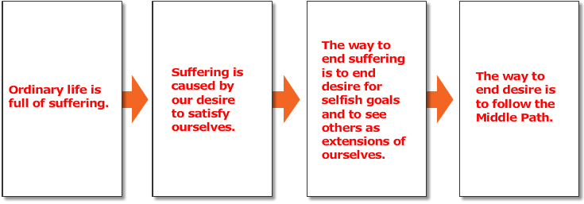

Slide 6
Eight Fold Path
The eight steps of the Middle Path
right view
right intention
right speech
right action
right livelihood
right effort
right mindfulness
right concentration
What similarities do you see between Buddhist teachings and the teachings of other religions?

Slide 7
Comparing Hinduism and Buddhism
Reincarnation and castes:
Siddhārtha accepted the Hindu idea of reincarnation but rejected the division of people into castes
holding that all people were able to attain nirvana
Gods and worship:
Hindus worship many deities as manifestations of the supreme reality,
Buddhism has no gods.
Siddhārtha also forbade worship of himself or his image.

Slide 8
Comparing Hinduism and Buddhism
Position of women:
In line with the social views of his time
Siddhārtha considered women inferior to men
position in Buddhist societies was generally better than elsewhere in India
Rivalry of religious believers:
After death of the Buddha, followers spread his message throughout India and, eventually, elsewhere
Buddhist and Hindu religious leaders began to compete for followers

Slide 9
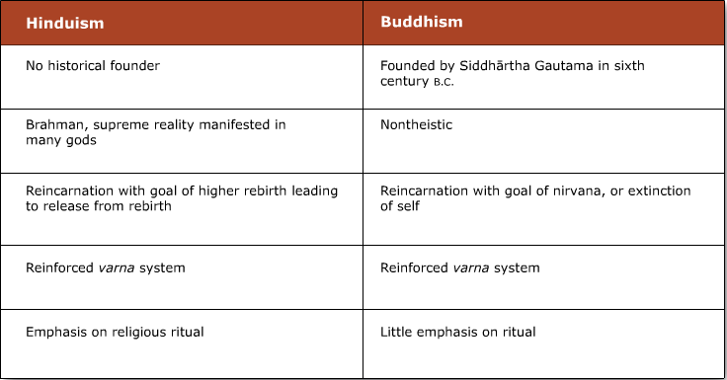

Slide 10
Growth of Buddhism in India
Beginning of 20th century, few Buddhists left in India.
changed dramatically in 1956, hundreds of thousands of former Hindus adopted Buddhism.
had been part of the "scheduled classes," formerly known as Untouchables.
followed the example of B. R. Ambedkar, a member of a scheduled class who had helped to write the constitution of India.
Since then, Buddhist community in India has grown to more than 3 million.

