Slide 1
World War I
1914-1920
The Great War

Slide 2
President Wilson and Foreign Affairs
Presidential Promises and Policy
“U.S. would never again seek one foot of territory by conquest” (1913)
The U.S. should continue to expand economically
Moral Diplomacy
Desire to transform other countries behavior with the U.S. leading by example
Example Latin America
Promote human rights, national integrity, opportunity
Need guidance from the U.S.

Slide 3
President Wilson and Foreign Affairs
Willing to use the military to achieve both economic and parenting goals
Intervening in Latin America creates tensions
Mexico – Pancho Villa v. John J. Pershing
Pershing pulled out of Mexico as WWI is brewing in Europe

Slide 4
Causes of World War I
Imperialism
Industrial Europe competes for empires in
Africa
Asia
German Kingdom – wages wars to unite “German States”
Takes land from France in 1870’s (Alsace-Lorraine)
Austro-Hungarian Empire (Austria-Hungary) sought to control Balkans

Slide 5
Causes of WWI Con’t
Formation of Alliances
Triple Alliance
Pushed by Germany
Alliance of Germany, Italy, Austria-Hungary
Franco-Russian Alliance
Entente Cordiale
Great Britain
France
Russia

Slide 6
Causes of World War I Con’t
Nationalism – feeling of intense pride toward one’s culture and homeland
Led to tension b/w Europeans
Viewed e/o as competitors - willing to war to advance power/national interests
Conquered nationality groups push for self-determination (right to self rule)
Example Balkans and the “South Slavs”
Serbia gains independence → wants to unite other Slavs
Austria Hungary annexes Bosnia – outrages Serbia

Slide 7
Causes of World War I Con’t
Militarism – AKA “The Arms Race”
Aggressive build up of armed forces
To advance imperialistic ambitions
To intimidate/threaten
Easier with industrialization
Required acquisition of raw materials → hello imperialism

Slide 8
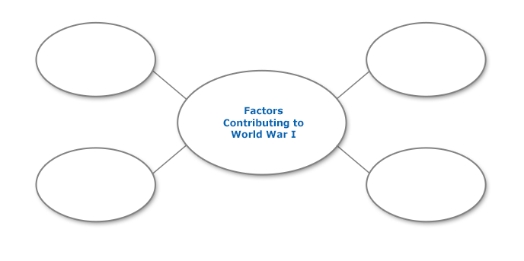

Slide 9
Causes of World War I
Country A wants more land/power/rights.
Country A arms itself to aquire this.
Country A angers country B. Country A needs someone to have their back so they ally with country C. Country B gets someone to have their back = country D.
Country A, B, C, and D are all packing weapons.
Nationality group E wants to get rid of ruling country A. How about an assassination?

Slide 10
Causes of World War I Con’t
Assassination of Archduke Franz Ferdinand
Heir to the Austro-Hungarian throne
Visiting Bosnia (annexed by A-H)
Shot by Serbian nationalist Gavrilo Princip
Serbia looking for a war to bring down the A-H empire
They’ll get what they wanted
The world gets WAR!

Slide 11
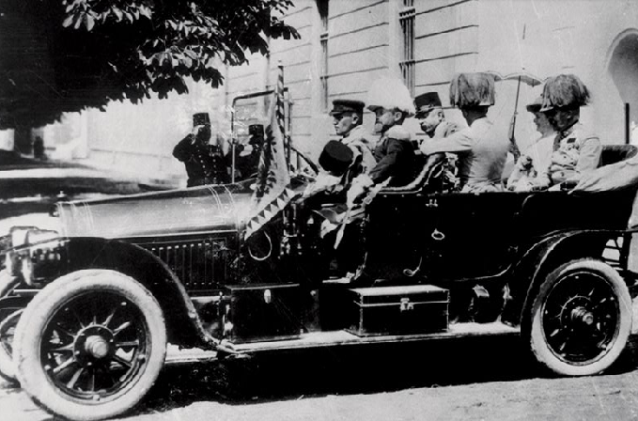

Slide 12
Immediate Effects of the Assassination
Austria Hungary declares war on Serbia
Serbia’s ally, Russia, mobilizes troops and stations troops on Austro-Hungarian and German border
Germany calls on Russia to remove troops and calls for France to pledge neutrality
Germany declares war on Russia and two days later on France

Slide 13
So what do you think?
Looking at the factors that were in place prior to the assassination of Archduke Franz Ferdinand….which factor do you believe was the most important in causing World War I?
Looking that the chain of events that occurred after the assassination of Archduke Franz Ferdinand…which country do you believe bears the most responsibility for starting the “Great War”?

Slide 14
The Schliefflen Plan
German goal is to stage a massive invasion of France
Hit first, hit hard and devote resources to the eastern border with Russia
A failed plan
Germany marches through neutral Belgium on way to France
Crap! Great Britain is now in the war as a protector of neutral Belgium
Russian troops invade Germany earlier than expected
Germany gets w/i 30 miles of Paris
Next three years on the Western Front will be a stalemate fighting in trenches along a continuous front.

Slide 15
The Alliances during the War
Central Powers
Germany
Austria-Hungary
Bulgaria
Ottoman Empire
Allies
France
Russia until March 3, 1918
Great Britain
Italy after 1915
The U.S. - April 1917

Slide 16
U.S. Opinions of War
Wilson’s position
The U.S. must remain neutral in thought and action
What is the reality of being neutral?
We had divided sympathies
8+million German Americans identify with Central Powers
4.5 million Irish wouldn’t mind the British losing
Most identify with common heritage and historical alliances with G.B. and France = Allies

Slide 17
U.S. Opinions on War
Neutrality v. Preparedness v. Outright support
Apart from trade, no taking sides
Preparation will keep us out and if not….”hey! We’re prepared!”
Allied victory will be the only thing to keep us safe and maintain balance of power.
Key cabinet members
Impacted by Info. Control & Propaganda
Impacted by Financial Interests
Business support Allied cause
Banks support Allied cause
Sec. Treasury William McAdoo is Pro-British

Slide 18
Moving Toward War
Both sides strain neutrality and ability to trade
Allies – British impose a blockade of Germany
Central Powers – Germany
Want to retaliate for British blockade
Plan to starve GB into submission
New weapon – U-boat and unrestricted submarine warfare

Slide 19
Moving Toward War
Sinking of the Lusitania
100+ Americans killed
Wilson protests threats to noncombatants
Changes attitudes of Americans toward Germany
Sussex
Wilson issues one last warning
Germany promises to sink no more merchant ships w/o warning – Sussex Pledge
Wilson 1916 election bid – “He kept us out of the war”

Slide 20
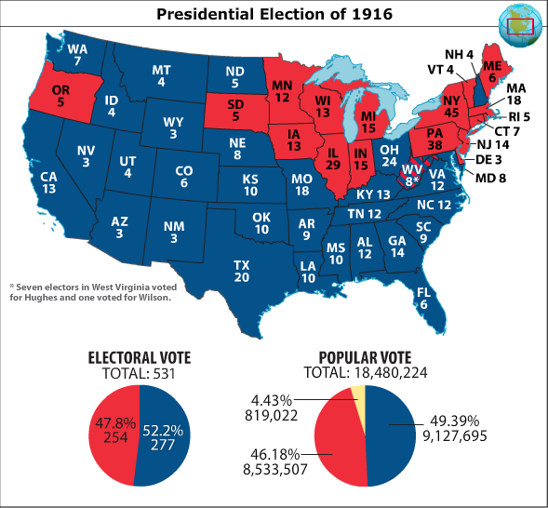

Slide 21
Moving Toward War
Wilson – only way to keep U.S. out is to end the conflict altogether
Calls on both sides to offer terms
Neither cooperates
Germany resumes unrestricted submarine warfare
Zimmerman Telegram
British intercept a message from Arthur Zimmermann
Instructs German ambassador in Mexico to work an alliance with Mexico
Promise that Mexico would get back TX, NM, and AZ

Slide 22
The U.S. Goes to War
Six more merchant ships are sunk w/o warning
Wilson asks for war
Our fight is with the masters of Germany
Am. has no selfish ends to serve
Am. is fighting to make the world safe for Democracy
Congress declares war April 6, 1917

Slide 23
War on the Home Front
Shaping a nation for war - The economy
Emphasis is on cooperation b/w business and government
Will rely on “agencies” and the creation of boards to oversee critical industries

Slide 24
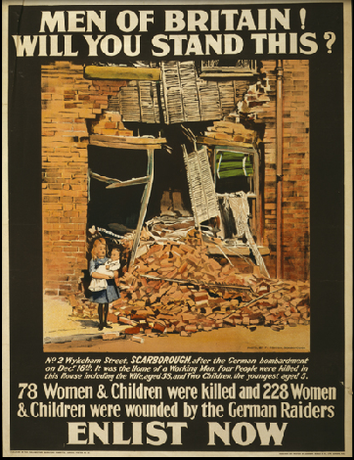
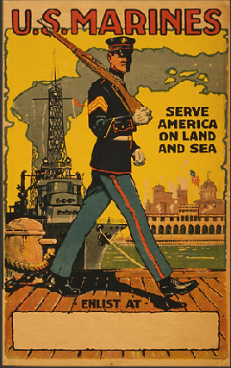

Slide 25
War on the Home Front Con’t
Federal Agencies bring
Efficiency
Conformity
Control

Slide 26
Federal Agencies
War Industries Board – Bernard Baruch
Handle purchasing for the Allies
Converted factories to wartime production
Determine Resource needs and sometimes prices
Food Administration – Herbert Hoover
To increase supplies to the Allied troops
Encouraged people to “Hooverize”
Plant “Victory Gardens”
Wheatless Mondays, Meatless Tuesdays etc.

Slide 27
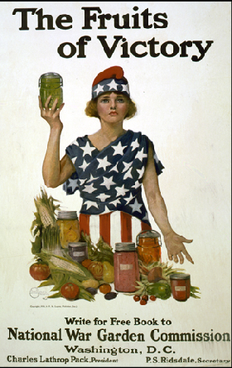
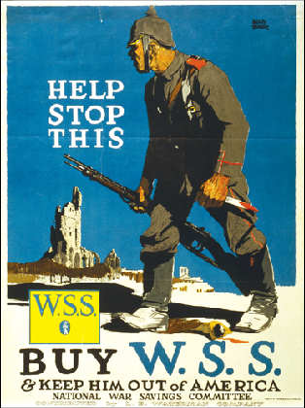

Slide 28
Federal Agencies
Fuel Administration – Harry Garfield
Purpose is to boost coal and oil products for Allies
Conservation becomes the watchword
Intro shorter work week and day light savings time
Railroad Adminstration – takes charge of RR
National War Labor Board
Work to prevent labor disputes
Will result in increased wages, shorter hours and increased labor union membership

Slide 29
American Workers & War Effort
Women – fill jobs in industry/defense plants
African Americans
Recruited to move
Great Migration – movement from South to North
Impact on
Racial make-up of North
Politics of the North
Mexican Americans
Migration to Southwest as well as Northern Cities
Barrios

Slide 30
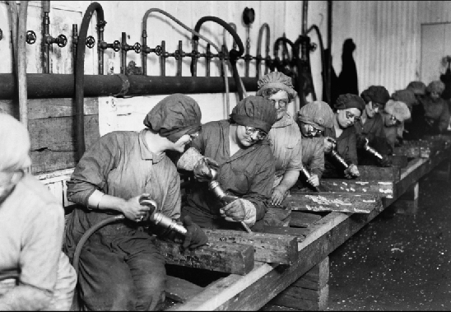

Slide 31
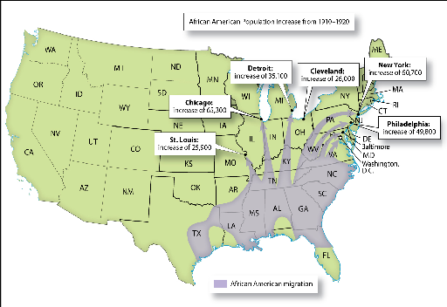

Slide 32
Raising $ for War
Costly! U.S. spends $33 Billion (44 million/day)
Taxes increased to cover 1/3
Income tax rates increase
Excess profits of corporations
Excise taxes – gum, records, theater tickets
Bonds
Liberty bonds

Slide 33
Controlling Public Opinion
British propaganda fueled early American opinion
Committee on Public Information
George Creel
Sold the war to Americans
Pamphlets
men at movie theaters

Slide 34
Controlling Public Opinion
Espionage and Sedition Acts
Illegal to aid the enemy or interfere w/war
Laws that silenced opponents of the war or the President
Vigorously enforced
Upheld by the Courts – Schenck v. the U.S.
Loyalty Leagues
American Protective League/Boy Spies of Am.
Encouraged people to spy on neighbors

Slide 35
Controlling Public Opinion
Negative Effects
Helped to promote widespread intolerance
Anti-German sentiment increased
Anti-Communist sentiment increased
Anti-Radical sentiment increased

Slide 36
U.S. Troops
Selective Service Act of 1917
All men b/w 21-30
Lottery
Draft Boards
Oversee drafting and exemption
African Americans
Drafted
Segregated
Women
Nurses, clerical, radio operators, pharmacists, photo

Slide 37
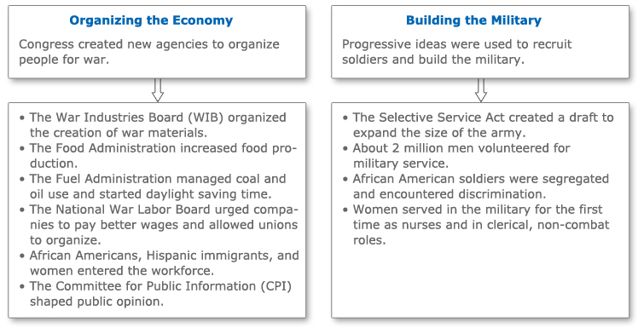
REVIEW

