Slide 1
Medieval Kingdoms in Europe
Chapter 10

Slide 2
The end of the Carolingian Empire
Carolingian Empire was divided into 3 territories, which were fought over by Charlemagne’s grandsons.
Western Europe suffered invasions by Norsemen, known as Vikings
Excellent ship builders and sailors
Used waterways to reach inland targets
Strong warriors, able to defeat small local armies

Slide 3
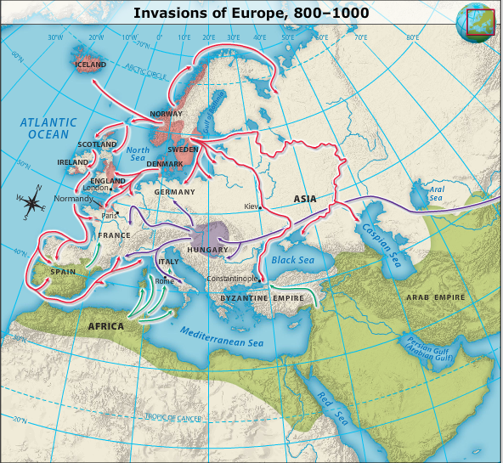

Slide 4
The end of the Carolingian Empire
Local nobles gained power during the conflicts by providing protection
Carolingian Empire was weakened by the divisions and invasions

Slide 5
Development of a feudal society
Decline of Carolingian Empire resulted in breakdown of centralized government.
Nobles gained power by providing protection and land in return for service.
New social and political order of feudalism arose.
Lords exerted control over large territories
Land was offered for sworn allegiance and other obligations
Vassals and knights provided military service to their lords.

Slide 6
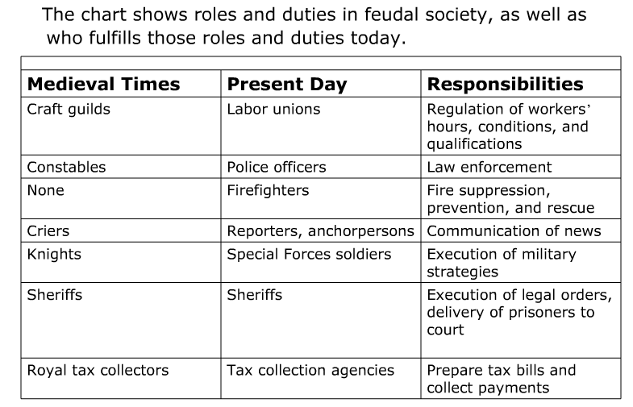

Slide 7
The Structure of Feudalism
Local lords were chief political, social, and economic authorities.
Warriors were required to pledge loyalty to their lords.
In return, warriors received lands and authority over those living therein.
Lords would defend and support warriors.

Slide 8
Structure of Feudalism
Multiple landholders maintained order rather than single government.
Complicated series of interconnected feudal relationships was based on wealth and land ownership.

Slide 9
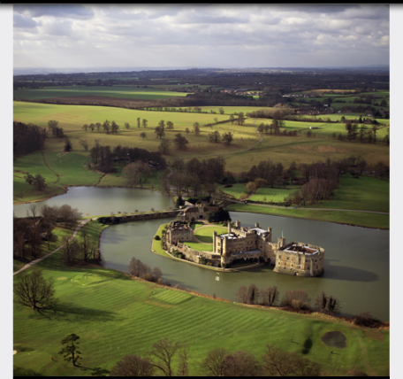
Medieval Castle

Slide 10
Characteristics of Fuedal
Focus on warfare
Ideal of chivalry
Roles of aristocratic women

Slide 15
Changes in farming
Development of new wind and water technologies, reducing human and animal labor
Development of carruca
Heavy ox-driven, wheeled plow with iron plowshare
Able to turn over heavy clay soil
Led to growth of cooperative farming villiages
Increased efficiency in land use
Three field system of crop rotation, improving yields

Slide 16
The Manorial System
Life on a manor
Manors: estate owned by a lord and farmed by peasants (most serfs)
serfs owed rent and labor and lived under the manor lord's feudal authority.
Peasant life: simple thatched cottages and performed tasks determined by the seasons.
raised food for themselves and their lords.

Slide 20
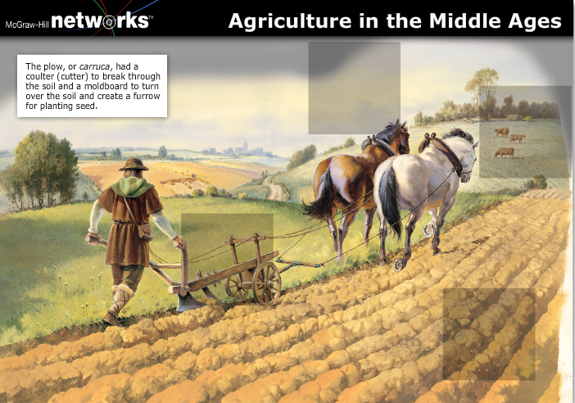

Slide 22
Revival of Trade
Centers of trade: developed gradually
Venice and other Italian cities trading in the Mediterranean
Flanders
Hanseatic League: >100 cities by Baltic Sea and North Sea banded together for protection and economic opportunity.
Rise of a money economy: based on gold and silver coins, rather than barter emerged
commercial capitalism—investment in trade and goods for profit also grew

Slide 23
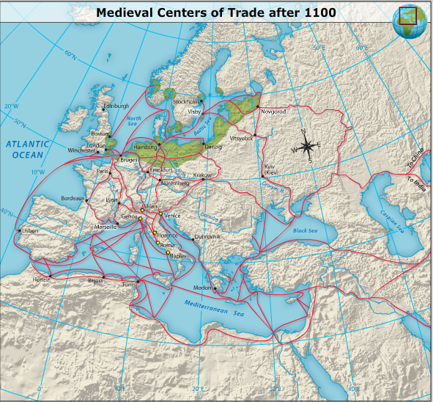

Slide 24
Growth of Cities /Urbanization
Revival of cities:
Merchants and artisans settled in old Roman cities
founded new towns near castles, for protection, and along trade routes.
Freedom from feudal lords: To ensure the freedom they needed to engage in trade, townspeople purchased rights from the lords who controlled their territories. Eventually, cities developed their own governments.

Slide 25
Growth of Cities/Urbanization
Conditions in cities:
enclosed in walls and had crowded, unsanitary living conditions.
Men outnumbered women.
Industry and guilds:
craftspeople organized themselves into guilds—associations that trained artisans, controlled the quality of manufactured goods, and set prices.
Guilds played a key role in the economic life of medieval cities.

Slide 26
England in the High Middle Ages
The Norman Conquest:
William of Normandy defeated the English at the Battle of Hastings and became king of England.
Gave English lands to Norman knights, made all nobles swear loyalty to him, and adapted existing Anglo-Saxon institutions.
The merging of Anglo-Saxon, spoken by the local population, and French, spoken by the Normans, produced the new English language.

Slide 27
England in the High Middle Ages
Reign of Henry II:
Increased the power of the monarchy by expanding its control of courts
Was not able to suppress the power of the Church.
Limits on royal power:
King John set his seal on the Magna Carta, thus recognizing the rights of nobles.
Later, the reign of Edward I saw the establishment of Parliament.

Slide 28
Development of English Law and Government

Slide 29
Expansion of the French Empire
Philip II Augustus:
After a period of French kings with little power, Philip regained control of French territories from the English and strengthened the monarchy.

Slide 30
France in the High Middle Ages
Louis IX:
Deeply religious, Louis IX tried to ensure that his people received justice.
Philip IV:
expanded the royal bureaucracy and improved royal governance.
created a French parliament called the Estates-General.

Slide 31
The Holy Roman Empire
Otto I: Pope named Otto emperor of the Romans in 962 in exchange for Otto's protection of the church.
Struggles in Italy:
The emperors Frederick I and Frederick II wanted to create a new kind of empire by conquering Italy and getting most of their revenue from there.
Military campaigns failed, as northern Italian cities and popes resisted German armies.

Slide 32
The Holy Roman Empire
Effects on empire: The German emperors' Italian campaigns left a power vacuum at home, providing nobles with the chance to increase their own power and build small German states under their own control. Both Germany and Italy failed to be unified under a national monarchy.

Slide 33
Central and Eastern Europe
Slavic Europe:
western Slavs set up kingdoms in Poland and Bohemia
became part of the Roman Catholic Church. The
eastern Slavs in Moravia were converted to Eastern Orthodoxy by Cyril and Methodius
Slavic alphabet
Most of the southern Slavs also embraced Eastern Orthodoxy.

Slide 34
Central and Eastern Europe
Kievan Rus:
Eastern Slavs who had settled in Ukraine
Russia fell under the domination of Viking invaders.
Principality of Kiev, prospered and came to cover a vast territory; its rulers made Eastern Orthodoxy the state religion.
Mongol rule:
overran Russia in the 13th century.
Prince Alexander Nevsky defended Mongol rule against German invaders, and his descendants became leaders of Russia.

Slide 35
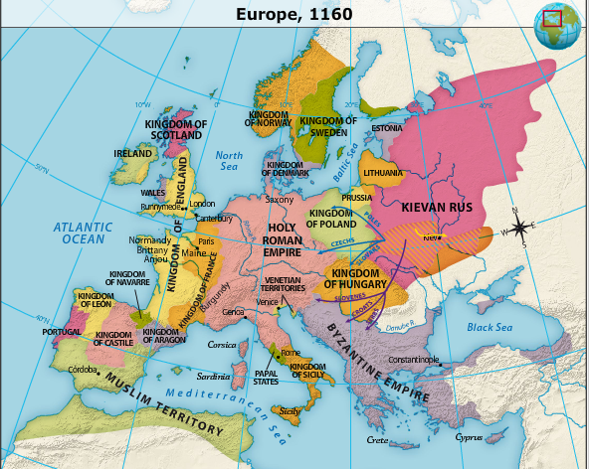
Slavic Peoples

