Slide 1
The Origins of the Cold War
Chapter 22 Lesson 1

Slide 2
The United Nations
Dumbarton Oaks The United Nations structure and membership was organized at this conference near Washington, D.C., in 1944.
San Francisco Delegates from member countries met in 1945 to develop and ratify a charter for the United Nations.
Human Rights The first meeting of the General Assembly in 1946 resulted in passage of the first UN human rights treaty, which addressed genocide. In 1948, the UN issued the Universal Declaration of Human Rights.
How did the UN agreement against genocide address issues that had arisen in World War II?

Slide 4
Yalta Conference

Slide 5
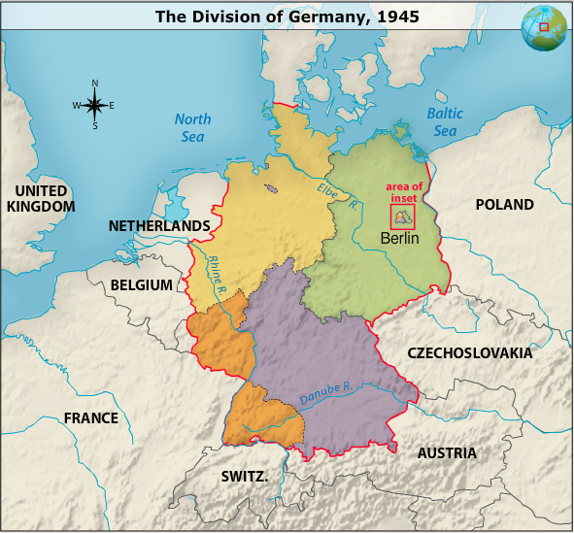

Slide 7
Rising tensions
Soviet Union: Doesn’t allow free elections in Poland, and forces Romania into appointing a communist gov.
Concerned about security – want to keep Germany weak and keep a buffer of communist states between Germany and SU.
Believed that SU should try to convert other nations to communism – so that capitalist countries can’t destroy it.

Slide 8
Rising tensions
America: believed war was caused by closing off trade b/w countries – and that free enterprise was best way to prosper.
WWII was over, but hostility b/w US and SU grew through confrontation and competition. Cold war lasts from 1946 to early 1990’s

Slide 9
Truman and the Cold War
Truman’s Position
Roosevelt’s death on April 12, 1945
Truman did not believe in compromise with the Soviets.
His belief in standing up to dictators was unshakeable.
Potsdam Germany July 1945, Truman and Stalin
Discuss future of Germany
Truman offered to let the Soviets remove some industrial equipment from areas under Allied control in return for providing food to Germany
accepted the new Polish-German border determined by the Soviets.

Slide 10
Truman and the Cold War
Atomic Weapons
Truman told Stalin of the new weapon that the United States had just tested successfully.
Stalin agreed to the terms, but disliked what he considered threats by Truman.
Iron Curtain
Soviets refused to accept the right of self-determination expressed in the Declaration of Liberated Europe.
Soviet forces remained in the countries in Eastern Europe that they had taken back from Germany.
This “Iron Curtain” made Poland, Romania, Bulgaria, Hungary, and Czechoslovakia satellites of the Soviet empire.
The Cold War - political intrigue, proxy wars, and economic competition between Western Powers and the Soviet Union.

Slide 11
