Slide 1
The New Frontier
Chapter 24
Lesson 1

Slide 2
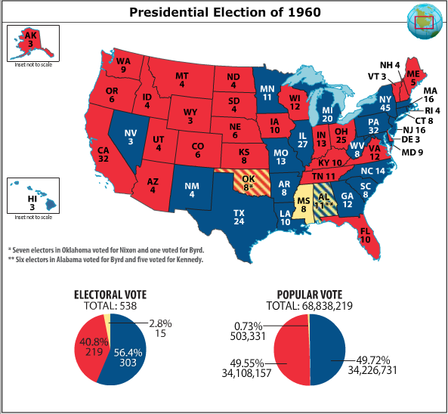

Slide 3
A Landmark Election
Television: On September 26, 1960, Kennedy and Nixon squared off in the first televised presidential debate. Millions of viewers watched, while others listened to the radio broadcast. Both candidates also used television to advertise during their campaigns.
Candidates: Kennedy, the Democratic candidate, was younger and more outgoing than Nixon. He came from a wealthy, Catholic family. Nixon, the Republican candidate, was older and more formal. He came from a Quaker family that had struggled financially.

Slide 5
A Landmark Election
Positions: Both candidates claimed to be strong on defense, prepared to combat communism, and both professed to want economic growth.
Outcome: Kennedy won, defeating Nixon, by a narrow margin, with less than 0.1 percent of the popular vote. Voters responded to his youth and optimism.

Slide 12
Kennedy’s Initiatives
New Frontier: Kennedy wanted Congress to pass laws to improve education, help the elderly, and begin a Department of Urban Affairs.
Successes: Kennedy won more spending for defense and space exploration, which created more jobs and helped grow the economy. He also succeeded in getting labor unions to reduce wage increases and pressured steel companies into cutting prices. Kennedy’s proposals for a minimum wage increase, the Area Redevelopment Act, and a Housing Act, all passed.

Slide 13
Kennedy’s Initiatives
Failures: Kennedy pushed for tax cuts, but Congress refused to pass them. Congress also rejected Kennedy’s proposals for federal aid to education and government-funded health insurance for seniors.
Social Accomplishments: Kennedy convened the Presidential Commission on the Status of Women, which led to passage of the Equal Pay Act, affirming women’s right to equal pay for equal work. In response to the President’s Panel on Mental Retardation, Congress passed the Mental Retardation Facilities and Community Mental Health Centers Construction Act, awarding grants to build research centers and mental health centers as well as to train people to work with individuals with developmental disabilities.

Slide 14
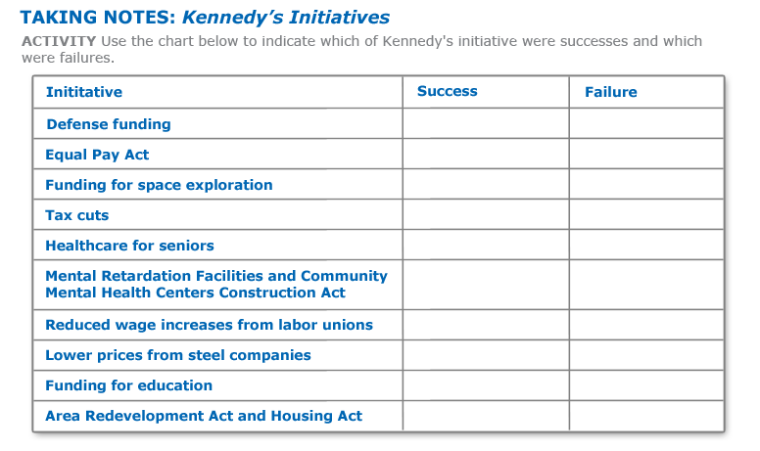

Slide 15
Warren Supreme Court Cases
Baker v. Carr (1962): Federal courts can rule on cases regarding the drawing of electoral districts within states.
Reynolds v. Sims (1964): States must reapportion electoral districts along the principle of “one man, one vote.”
Mapp v. Ohio (1961): State courts cannot use evidence obtained in a way that violates the U.S. Constitution.
Gideon v. Wainwright (1963): Defendants in state courts have the right to a lawyer, regardless of their ability to pay.

Slide 16
Warren Supreme Court Cases
Escobedo v. Illinois (1964): Suspects must have access to a lawyer and must be informed of their right to remain silent before police questioning.
Miranda v. Arizona (1966): Authorities must inform suspects that they have the right to remain silent; that anything they say can and will be used against them in court; that they have a right to a lawyer; and that, if they cannot afford a lawyer, the court will appoint one for them. These are now known as “Miranda rights.”
Engel v. Vitale (1962): States cannot have official prayers or require prayers to be read in public schools.
Abington School District v. Schempp (1963): States cannot require Bible readings in public schools.
Griswold v. Connecticut (1965): States cannot prohibit the sale and use of birth control devices.

Slide 19
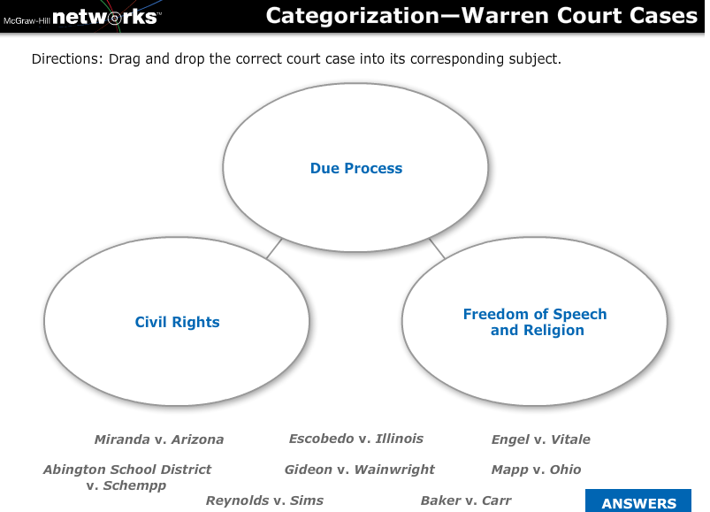

Slide 20
