Slide 1
Crusades and Culture in the Middle Ages
Chapter 12

Slide 2
Medieval Christianity
Chapter 10.1

Slide 3
Reform and Political Power of the Papacy
Church structure:
Since 400s, popes had been involved in political affairs as rulers of the Papal States in Italy.
Church became an increasingly feudal structure because nobles selected Church officials.
Nobles chose other nobles to be bishops and abbots
many of those selected cared little about their spiritual responsibilities.
Reforms by Gregory VII:
ended the practice of secular, or lay, rulers choosing church officials.
pope had authority over the Christian world, including kings and nobles.
tried to improve the guidance provided by the church

Slide 4
Reform and Political Power of the Papacy
The Investiture Controversy:
Gregory's ending of lay investiture brought him into conflict with the German king Henry IV
wanted to maintain his power to appoint church officials.
Pope Gregory VII used his power to excommunicate the king, in what came to be known as the Investiture Controversy.

Slide 5
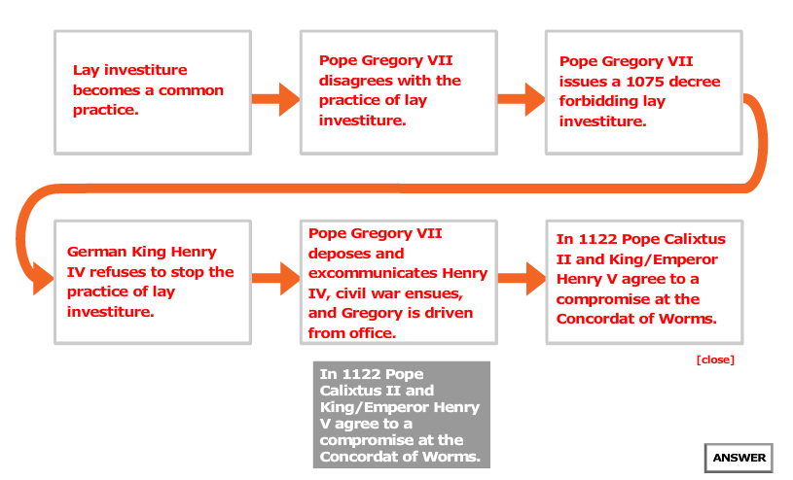
"Investiture Controversy"

Slide 6
Innocent III
Under Pope Innocent III, the Catholic Church reached the height of its political power.
Used interdicts to motivate kings. (forbids priests from offering someone sacraments, such as communion.)
pope was able to compel them to obey his commands.
What is the difference between power that comes from the people and power believed to come from God?

Slide 7
New Religious Orders
New orders:
monks felt that their religious orders lacked discipline, and some founded new orders.
Cistercians were a strict new order of activist monks in southern France who lived simple lives and took religion to the people.
Women in religious orders:
increase in the number of women joining convents
devote their lives to intellectual and spiritual quests.
Hildegard of Bingen was a composer and an abbess, or leader of a convent.

Slide 8
New Religious Orders
Franciscans and Dominicans:
Franciscan order, friars vowed to preach in poverty and work as missionaries.
encouraged people to return to the simplicity of the early Church and seek repentance
Dominican order arose in Spain- wished to defend Church teachings from heresies.
members of the order would be most effective if they could preach effectively and live in poverty.

Slide 9
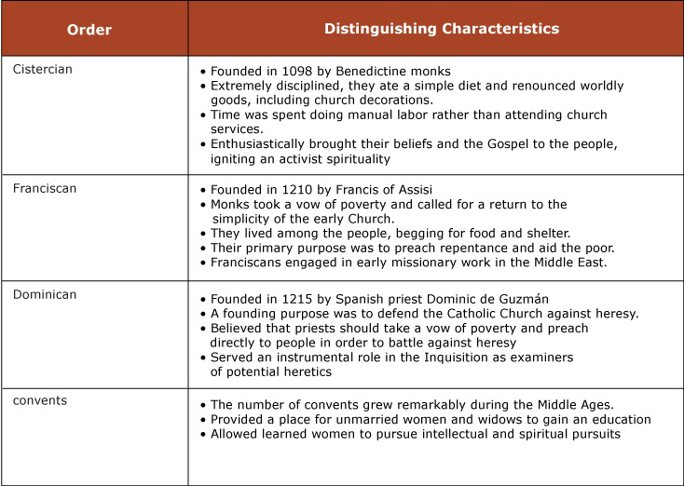

Slide 10
The Inquisition
The Inquisition:
Church created a high court called the Inquisition for finding and trying heretics—those who denied basic Church teachings.
The goal of inquisitors was to get heretics to confess their beliefs and be received back into the Church so that their souls might be saved.

Slide 11
Rise of Inquisition
In 1184, Pope Lucius III required bishops to make a judicial inquiry, or inquisition, to identify heresy in their dioceses.
Not effective - not all bishops introduced inquisitions in their dioceses.
1227, Pope Gregory IX appointed papal inquisitors - authority over everyone, except bishops and their officials.
1252, Pope Innocent IV licensed inquisitors to allow torture.
Torture was most famously used in the trial of the Knights Templar, a military-religious order.
Persecution also contributed to the collapse of Catharism, a heresy that had great influence in southern France and northern Italy.

Slide 12
Religion in the High Middle Ages
Sacraments: came to be seen as necessary for salvation
baptism, marriage, and the Eucharist (Communion)
Saints: men and women recognized by the Church for their holiness.
Saints could ask for favors from God on behalf of the people who prayed to them.
Mary, the mother of Jesus, came to be seen by many as the most important saint.

Slide 13
How do you become a “saint”?
A saint is a person whose reputation for sanctity or heroic virtue has been recognized by the Roman Catholic Church through canonization. In the early church, there was no formal canonization, but local martyrs who were buried in churches were automatically recognized as saints. The first saint canonized by a pope was Ulrich, bishop of Augsburg, who died in 973. Canonization by the Holy See became general law under Gregory IX (1227–1241). The investigation of the candidate involves gathering material that speaks to the candidate's sanctity, as well as information about miracles performed by the candidate during life or after death. A "devil's advocate" is tasked with ensuring that the entire truth is made known about the candidate. Candidates are then declared "blessed," a process known as beatification. At least one miracle must be verified after beatification before canonization is considered. Canonization continues to this day; for example, Mother Teresa was beatified in 2003, which is a key step in the canonization process.

Slide 14
Religion in the High Middle Ages
Relics: Objects connected to the saints, including their skeletons, were believed to have healing powers.
People worshiped relics because they provided a link between God and life on Earth.
Pilgrimage: to a holy place produced spiritual benefits.
Jerusalem and Rome - most popular

