Slide 1
China Reunified
Chapter 11.1

Slide 2
UNIFICATION OF CHINA
Yang Jian (541–604) (Sui Wendi)
founder of the Sui dynasty was
Yang Jian – entered military at 14 & rose quickly through ranks
served the house of the Bei Zhou dynasty and seized throne after emperor’s death. (581AD)
Wendi quickly to created a strong, well-organized central government.
Strong military eventually unified the empire, conquering s. China and breaking the power of the Turks in the north.
Wendi—a devoted Buddhist—began a series of elaborate religious ceremonies in shrines built throughout the empire.
Died at 63, some believe at the hand of his son, Yang Guang, who succeeded him as Emperor Sui Yangdi.

Slide 3
UNIFICATION UNDER THE SUI
The Sui Dynasty (581–618)
reunified China after hundreds of years disorder and civil war.
The building of the Grand Canal:
Under Emperor Sui Yangdi
linked the Huang He and Chang Jiang rivers
facilitated trade between northern and southern China.
Rebellion: Sui Yangdi
Angered people by using forced labor on Canal
levying high taxes to fund court
rebellion that ended the Sui dynasty

Slide 4
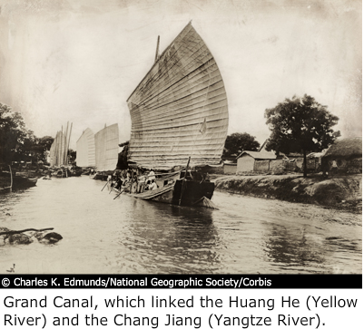

Slide 5
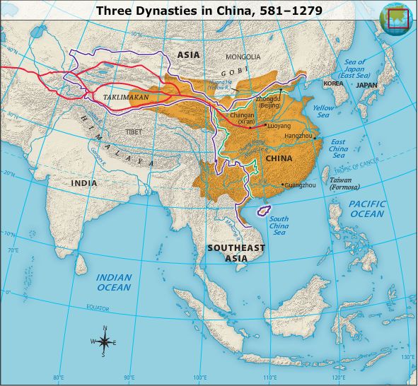

Slide 6
REFORMS UNDER THE TANG
The Tang Dynasty (618–907)
Land reform: The Sui dynasty was followed by the Tang dynasty. Tang rulers weakened the power of large landholders by giving land to peasants.
Government reform:
civil service examinations to staff the government
Exams based on the teachings of Confucius.
Restoring China's influence:
established peace in northwestern China
extended China's control into Tibet
established diplomatic relations with Southeast Asia

Slide 7
COLLAPSE OF TANG
Corruption & rebellion
emperors became unpopular because of government corruption
Hired Uighurs to fight for them
series of rebellions leading to the collapse of the empire.

Slide 8
PROSPERITY UNDER THE SONG
The Song Dynasty (960–1279)
Internal stability
notable for the prosperity and rich cultural life that prevailed within China.
Invasions
unable to contain invasions from China's northern neighbors
Mongols, overwhelmed Song defenses in the late 1200s and controlled all of China within decades.

Slide 9
GOVERNMENT, TECHNOLOGY, AND TRADE
Government and Economy During the Three Dynasties
Monarchy and merit-based bureaucracy:
mature political system
civil service examination resulted in a literate and more efficient bureaucracy
Farming:
economy grew in size and complexity
agricultural economy, improved farming methods
land reform resulted in an increase in food production.

Slide 10
GOVERNMENT, TECHNOLOGY, AND TRADE
Steel, cotton, and gunpowder:
blast furnaces to make steel
Cotton began to be used to make clothing
gunpowder led to the production of powerful explosives and weapons.
Private merchants and guilds:
Loosened control of long-distance trade and allowed private merchants to invest
guilds began to appear

Slide 11
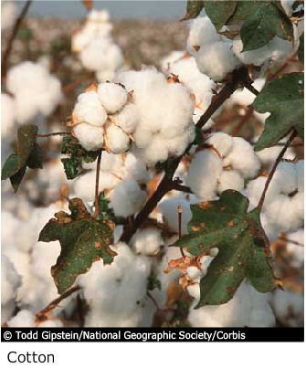
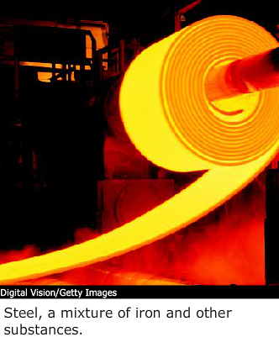

Slide 12
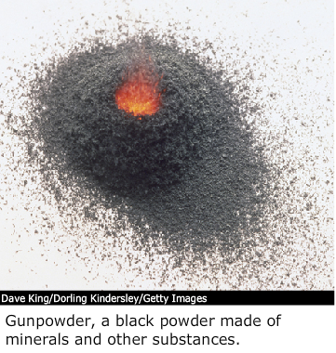
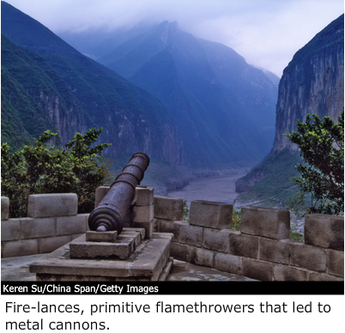

Slide 13
GOVERNMENT, TECHNOLOGY, AND TRADE
Money economy and paper currency:
700’s-800’s paper money replaced some of the copper coins that had comprised the basic currency in China
banking system developed
Growth of trade and the Silk Road:
Under Tang - Silk Road trade network began to revive
Arab unification of much of Southwest Asia
exchange of technology and ideas, including religions

Slide 14
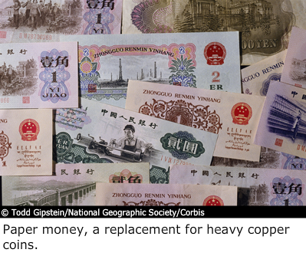
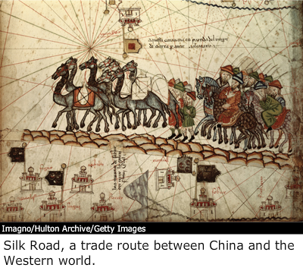

Slide 15
CHINESE SOCIETY
An age of prosperity:
Under Tang and Song - economic progress = prosperous cities
Wealthy urban families enjoyed leisure activities
Peasants and the landed gentry:
gap b/w rich landowners and poor peasants narrowed, but landed gentry remained powerful
Role of women:
little power
Parents preferred male children

Slide 16
Empress Wu
Empress Wu of the Tang dynasty
ruled China after the death of her husband
during a time when Chinese women had few rights and privileges.

