Slide 1
The Jazz Age
Chapter 17
1920’s

Slide 2
A Clash of Values
Chapter 17, Lesson 3

Slide 3
Resurgence of Nativism
Nativism
racial fears and ethnic intolerance grew in 1920’s
aftermath of World War I saw prejudice toward Germans and Communists
Crime and other social problems were often blamed on immigrants
Americans to support nativism—the belief that immigrants threatened the American way of life and that the United States must take steps to keep its culture, society, and people safe from outsiders.

Slide 4
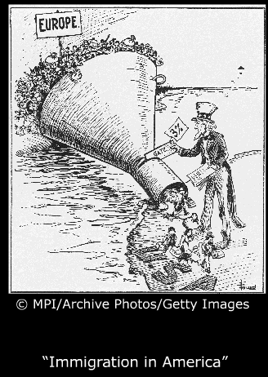
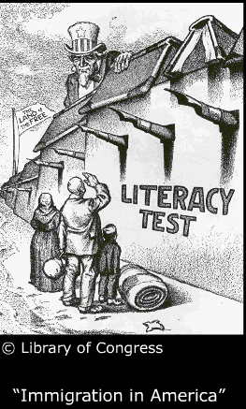

Slide 5
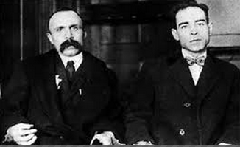
Sacco and Vanzetti
Sacco and Vanzetti
murder trial of Italian immigrants Nicola Sacco and Bartolomeo Vanzetti increased anti-immigrant sentiment.
The men, who were anarchists, were found guilty and executed despite flimsy evidence.

Slide 6
Ku Klux Klan
KKK
expanded in the 1920s to target Catholics, Jews, immigrants, and other “un-American” groups
goal was to preserve the US as a nation they believed belonged to white Protestants.

Slide 7
Changing Roles for Women
Suffrage
19thAmendment led women to push for more social change
Ex: marriage emphasized the romance and friendship between partners.
Social Mores The automobile allowed
young people start to socialize in public rather than at home (car)
“bobbed” hair and movie-star glamour changed fashion
flappers smoked cigarettes, drank liquor, and wore more revealing clothing

Slide 8
Flapper
Would we consider this mode of dress unconventional today? Why or why not?

Slide 9
Changing Roles for Women
Educated Professionals
More working-class married women worked to support their families.
Single women establish financial independence
earnings allowed them to become greater consumers
Women’s colleges encouraged their students to pursue careers and to challenge traditional ideas about women’s roles in society.

Slide 10
Fundamentalism
Culture Clash
Fundamentalists viewed the consumer culture, relaxed ethics, and changing roles of women as evidence of moral decline
“Christian Bible was without error”
They pointed to the biblical version of creation as proof that the theory of evolution was wrong.
Scopes Trial 1925
Trial lawyer Clarence Darrow and William Jennings Bryan prosecutor
highly publicized trial over the teaching of evolution.
John Scopes, was convicted and fined $100
ruling was overturned
Fundamentalist movement suffered a set back.

Slide 11
Prohibition
Temperance 1830’s
American Temperance Society spearheaded the Temperance Movement
religious and social reasons.
Enforcement Failures
Volstead Act/18th Amendment (1920), proved very
difficult to enforce
U.S. Treasury personnel had authority to enforce the law, but many Americans ignored it
In cities - alcohol in "speakeasies"; in rural areas - from bootleggers.

Slide 12
Rise of gangs & “organized crime”
Organized Crime
smuggling and distributing liquor
Gangsters like Al Capone paid off politicians and law enforcement to turn a blind eye
struggle by federal agents to enforce the law was bloody, cost the lives of 70+ agents
1933 the 21st Amendment ended Prohibition.

Slide 13
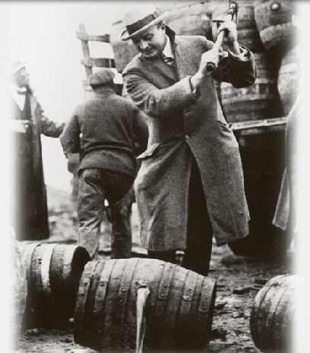
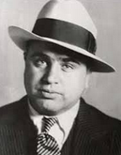
Prohibition

Slide 14
