Slide 1
The Crusades
Chapter 12.2

Slide 4
Beginning of the Crusades
Request from Byzantine emperor: Asked Pope Urban II for help against Muslim Seljuk Turks
had beaten them at the battle of Manzikert
overran Byzantine territory in Asia Minor
1095, Urban called on Eur. Christians to join in a war to free the Holy Land from Muslim control
Considered infidels – (non believers)
Different motivations:
religious fervor; others sought
adventure and wealth
opportunity for trade

Slide 5
The First Crusade
Progress of the First Crusade:
Byzantines began to have second thoughts about the possible actions of the crusaders (had to go through Byzantine lands) (also – Norman leaders were Byzantine enemies)
Large army of warriors succeeded in capturing Antioch in 1098 and then moved down the coast of Palestine toward Jerusalem.

Slide 6
Crusader Conquests and Losses
Capture of Jerusalem and formation of crusader states:
1099, Christian warriors captured Jerusalem and created Crusader states around the area.
1140s, however, Muslim forces began to strike back, regaining territory taken by Christians.
Saladin, the sultan of Egypt, united Muslim armies and made them stronger.
Loss of Jerusalem to Saladin:
Second Crusade - launched to support the crusader kingdoms failed miserably.
Saladin retook Jerusalem in 1187.
The Third Crusade failed as well, but Saladin agreed to allow Christian pilgrims to visit Jerusalem. (King Richard I)

Slide 9
Growth of Trade in Italy
Dependence on Italian ports:
Only source of supplies for the crusader kingdoms
Genoa, Pisa, and Venice
grew wealthy and powerful from the trade.

Slide 10
The Later Crusades
Fourth Crusade: crusading army became involved in a fight for the Byzantine throne
sacked Constantinople
widening the rift between the Eastern Orthodox Church and the Catholic Church.
Other Crusades: - little success
Children's Crusade of 1212 failed to get anywhere near the Holy Land, with many died, shipwrecked, or sold into slavery
Two Crusades led by King Louis IX of France failed to conquer any Muslim territory.
Last Crusade: Some historians consider the last minor crusade to have taken place in Spain in the late 1400s, when Ferdinand and Isabella defeated the last of the occupying Muslim armies.

Slide 11
Impact of the Crusades
Persecution of Jews:
First extensive attacks against Jews in Europe, who were viewed by some fanatics as greater enemies to Christianity than Muslims.
Breakdown of feudalism:
Nobles who joined or financed the Crusades often sold their land and freed their serfs
loss of the nobles' power allowed kings to create stronger central governments, paving the way for the rise of powerful nation-states.

Slide 12
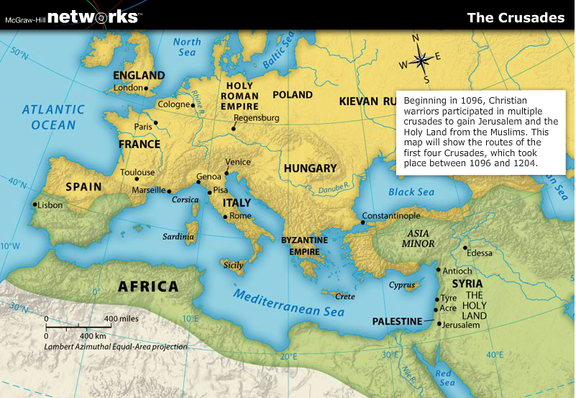

Slide 13
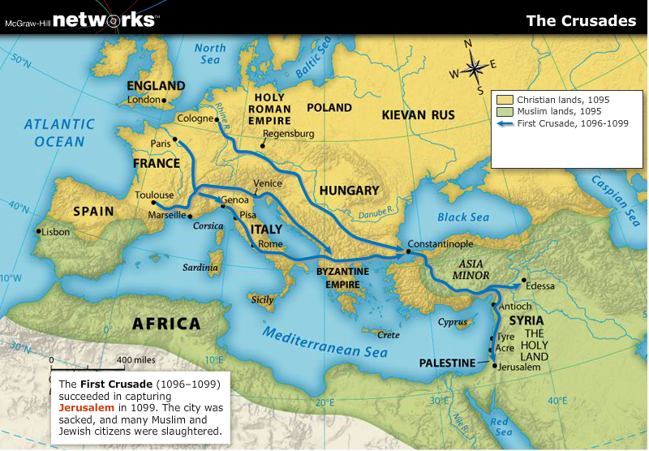

Slide 14
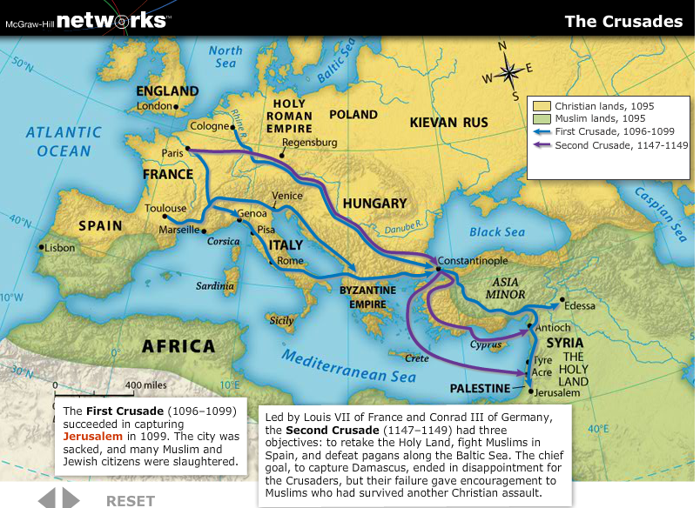

Slide 15
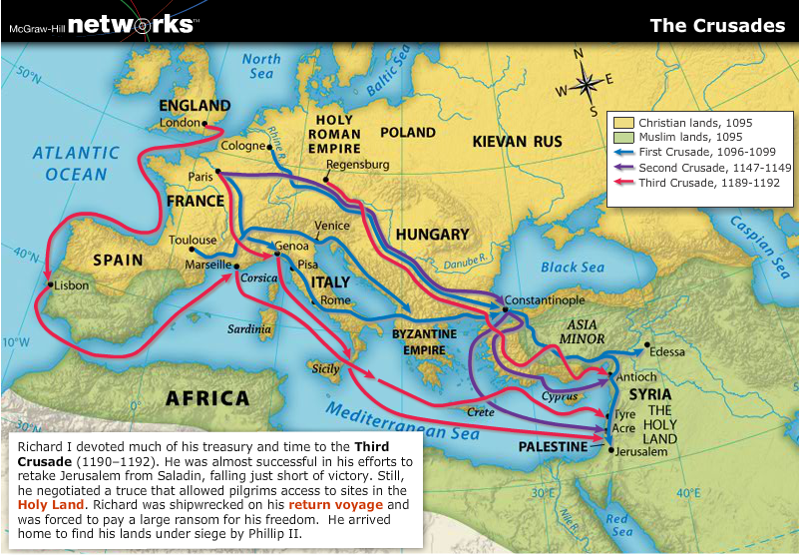

Slide 16
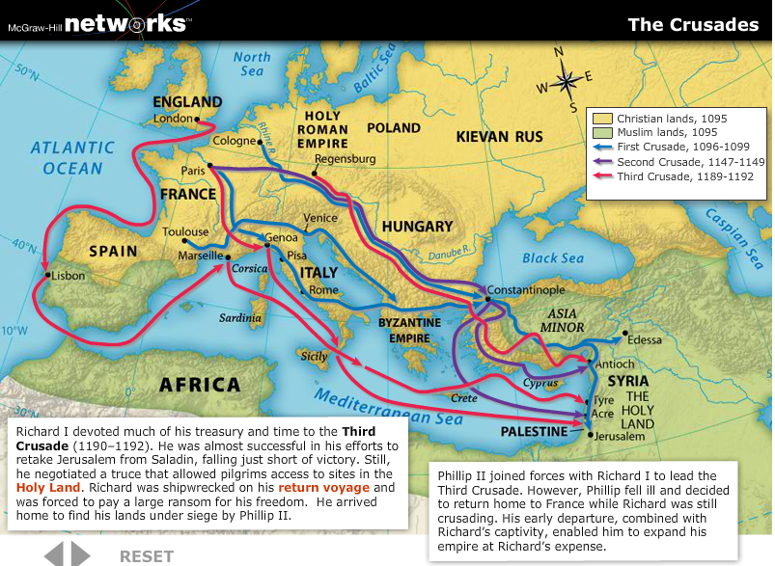

Slide 17
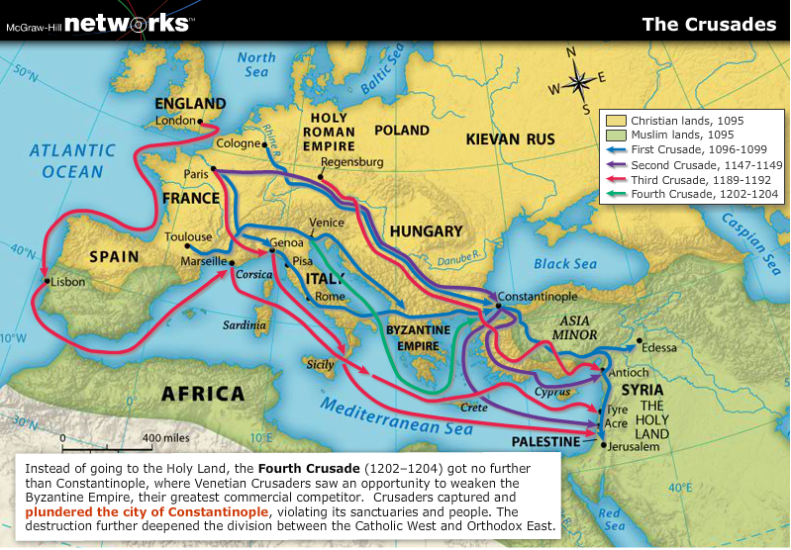

Slide 18
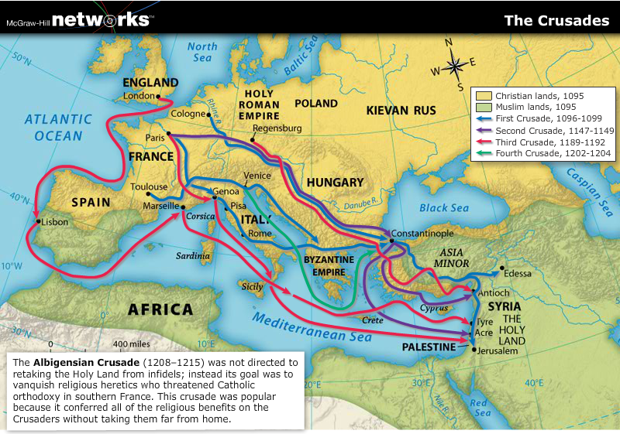

Slide 19
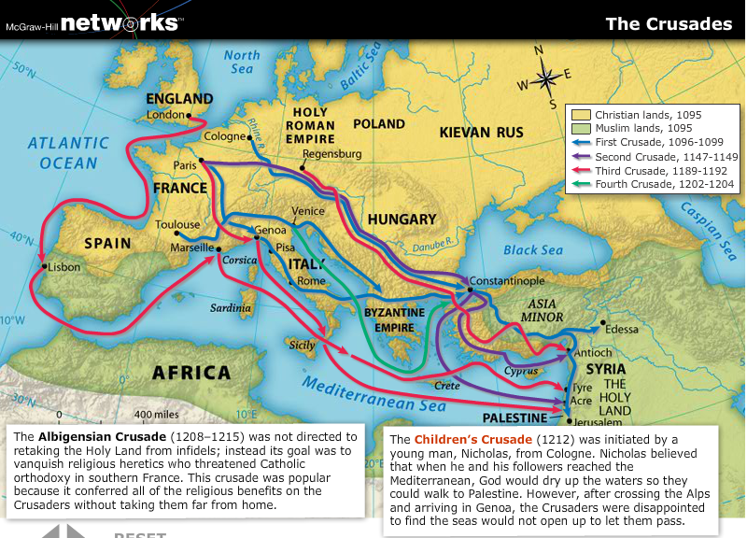

Slide 20
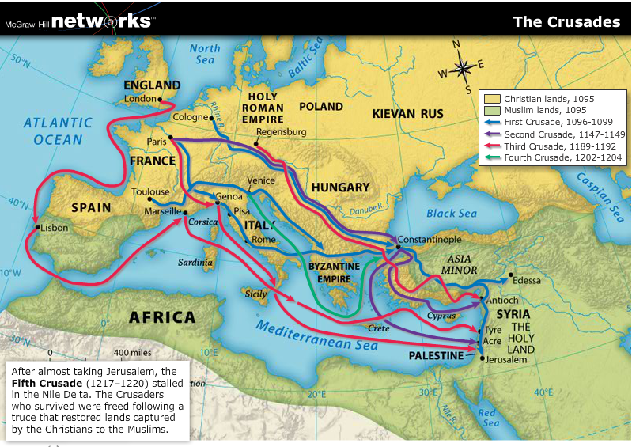

Slide 21
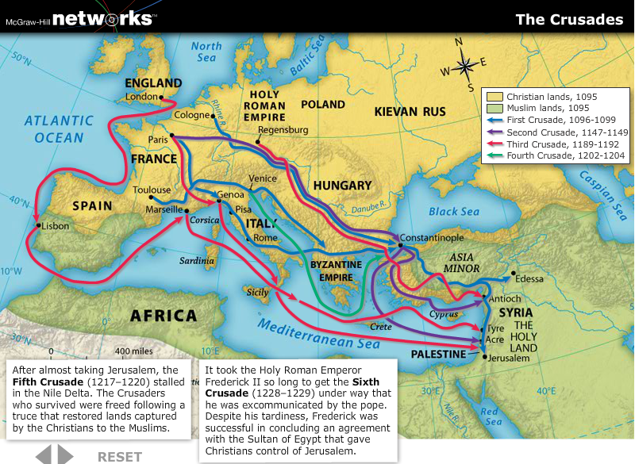

Slide 22
