Slide 1
Culture of the Middle Ages
Chapter 12.3

Slide 2
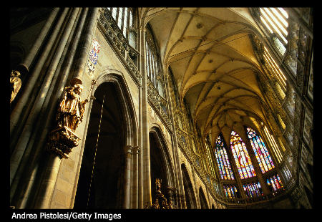
Architecture in the Middle Ages

Slide 3
Architecture
Romanesque Cathedral
Roof formed from an arched stone vault
Cathedral in the shape of a cross
Gothic Cathedral
Ribbed vaults and pointed arches
Flying buttresses
Thin walls and large stained glass windows

Slide 4
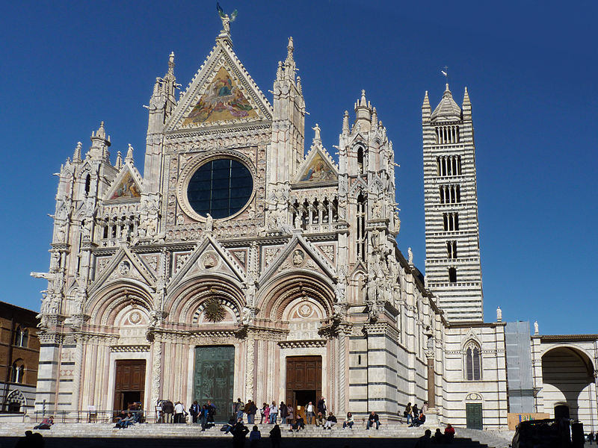
Romanesque Cathedral

Slide 6
Intellectual Revival
Birth of the University
First European universities
Bologna, Italy; Paris, France ; Oxford England– men only
Subjects and degrees
Liberal arts (grammar, logic, rhetoric, arithmetic, music)
Bachelor of Arts and Master of Arts added later
Doctorates – law, medicine, theology
Study of theology – Study of religion and God
Scholasticism influenced theology – tries to show faith is in harmony w/ reason
Anselm, Aquinas, and Bacon – all philosophers that used scholasticism in their work.

Slide 7
University then….

Slide 8
University then….

Slide 9
University now….

Slide 10
Modern University
The modern university evolved from medieval schools known as studia generalia
formed to educate clerks and monks beyond the level of the cathedral and monastic schools
main difference between the studia generalia and monastic schools was the inclusion of scholars from foreign countries.
The early universities were groups of students and masters who were free to govern themselves, provided that the masters taught neither atheism nor heresy.
had to finance selves, so teachers charged fees, and to assure themselves a living, they had to please their students
early universities had no permanent buildings and little property
subject to the loss of dissatisfied students and of masters who could move to another city

Slide 11
Vernacular Literature
The Rise of Vernacular Literature
Literature as a new source of entertainment
Vernacular – written in every day speech
Features of troubadour poetry
Poetry of knights and nobles
Features of heroic epic poetry
Battles of knights for their lords/kings
Geoffrey Chaucer
Canterbury Tales

Slide 12
Extras…
The late 1100s and the 1200s were the golden age of the troubadour. This singing poet was most common in regions near the Pyrenees and the southern Alps. Troubadours, who were usually nobles or knights, entertained ladies of the court with songs of love. The texts of their songs had a great influence on the development of lyric poetry in Europe. Some of their work was preserved in books called chansonniers, which give evidence of the brilliance of the troubadours' art. One of the earliest troubadours was Guilhem de Peitieus, who composed songs about his experiences in the Crusades.

