Slide 1
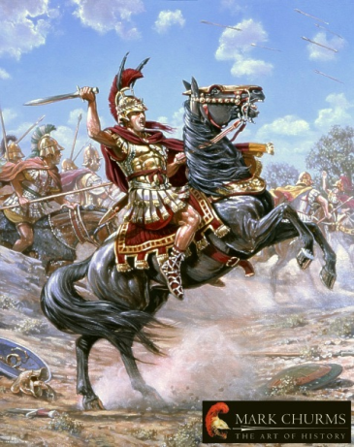
Classical Greece
Outcome:
Alexander the Great & Hellenistic Culture

Slide 2
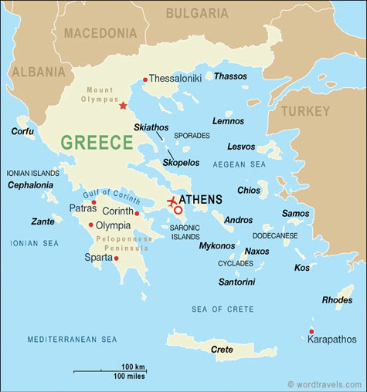
Alexander the Great
Setting the Stage: Macedonia
Located north of Greece, Macedonia had a rough terrain and cold climate
People lived in mountain villages instead of city-states
Many Macedonians though of themselves as Greeks, however…
The Greeks looked down upon them as uncivilized foreigners

Slide 3
Philip II of Macedonia

Slide 4
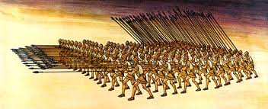
Philip II
Philip II of Macedonia
Philip II became king of Macedonia in 359 B.C. at age 23
Trained rugged peasants into a professional army which consisted of:
Phalanx (16 x 16 men)
Each soldier carried an 18 foot pike
Fast moving cavalry (soldiers on horseback)
Philip invades Greece, but not to destroy or enslave the Greeks

Slide 5
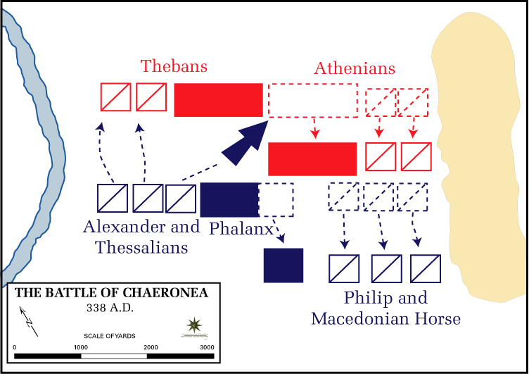
Philip II
Battle of Chaeronea:
Athens & Thebes joined forces to fight Philip’s army
Philip’s army is too powerful and defeats the Greeks
Ends Greek independence; Philip controls Greece
Philip next sets out to defeat the mighty Persian Empire but won’t…
Philip stabbed to death in 336 B.C. at his daughter’s wedding

Slide 6
Oliver Stone’s Alexander

Slide 7
Alexander the Great

Slide 8
Alexander the Great
Alexander the Great
Background
Takes over at age 20 after the death of his father Philip II
Taught by Aristotle: learned science, geography & literature
Enjoyed Homer’s description of the heroic deeds of Achilles during the Trojan Wars
Killed 6,000 Thebans in a rebellion; cruelty frightened Greeks into accepting Alexander as their leader

Slide 9
Alexander the Great
How Alexander defeats the Persians
Philip wanted to conquer Persia, never had the chance
Alexander leads 35,000 troops into Anatolia (Turkey)
Met 40,000 Persians at Granicus River, Alexander’s army attacks first and is victorious
Darius III responds with army of 50,000-75,000
Macedonians break through weak point, Darius III flees
Result: Alexander has control of Anatolia

Slide 10
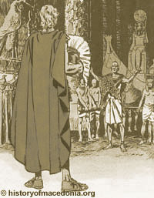
Alexander the Great
Persia: Egypt
332 B.C. Alexander marches into Persian controlled Egypt
Welcomed by the Egyptians as a liberator, crowned pharaoh
Result: Alexander has control of Egypt

Slide 11
Alexander the Great
Persia: Mesopotamia
Battle of Gaugamela: 250,000 Persians under Darius III
Alexander launched a massive phalanx attack followed by a cavalry charge and the Persian lines crumbled
Again Darius III flees in battle
Result: Alexander has control of all of the Persian Empire!!

Slide 12
Alexander’s Empire

Slide 13
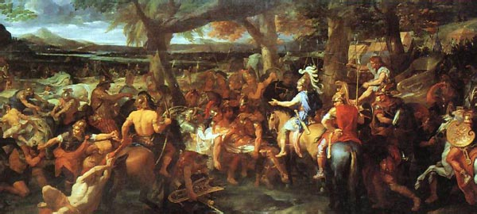
Alexander the Great
Other Conquests
Travels east to India- finds out Darius III was murdered
Soldiers exhausted- 11 years, 11,000 miles- turn back home

Slide 14
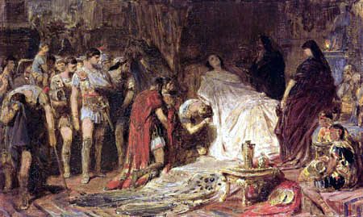
Alexander the Great
Alexander dies from illness at age of 32, very young

Slide 15
Alexander the Great
Legacy
Now what?
Empire broken into 3 main territories
Would last for centuries

Slide 16
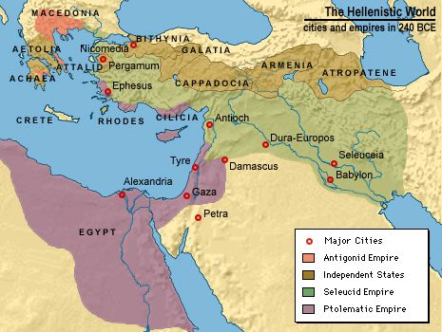
Hellenism
Hellenism
Hellenistic Culture: blending of Egyptian, Persian, Greek and Indian influences
Would forever transform Greece and Asia

Slide 17
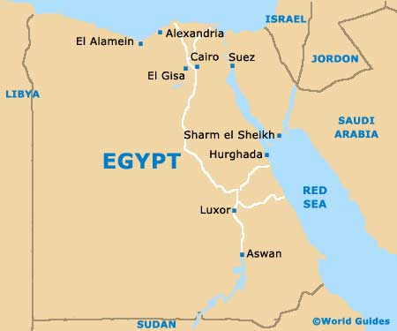
Hellenism
Alexandria
Center for trade
350 ft light house- first ever
Library with 250,000 scrolls; learning becomes a commodity

Slide 18
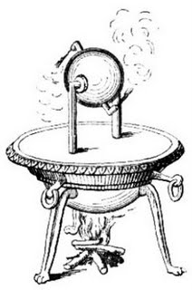
Hellenism
Science and Technology
Euclid: book The Elements became basis for geometry
Archimedes: accurately estimated Pi (3.14)
Hero: used steam power

Slide 19
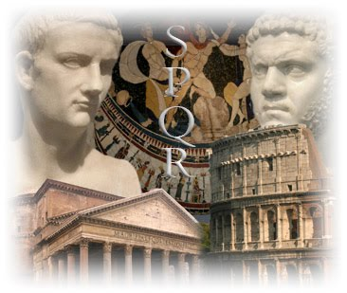
Alexander the Great
Result: Through Philip II’s and Alexander’s conquests of the Greeks, Egyptians, & Persians, ideas would spread and cultures would combine in a way that had never been seen before. After Alexander’s death, the Greek Civilization would gradually decline until many of their achievements and ideas would be absorbed into perhaps the greatest example of Hellenism in history: The Roman Empire.

