Slide 1
The Jazz Age
Chapter 17
1920’s

Slide 2
A growing Economy
Chapter 17
Lesson 2

Slide 3
Rise of New Economies
Mass Production
Ford’s assembly line (not new, just made more efficient!)
broke down building a car into simple tasks repeated by workers
Before assembly line, building a car took 12 hours.
By 1925 a new car came off line every 10 seconds.
Social Effects
Model T - $490 in 1914 to $295 in 1924.
Lower prices meant higher sales.
Workers’ average earnings grew 22 percent during 1920s.
shifts to 8 hours
more money to spend and more time to spend it
enabled people to live farther from work (rise of suburbs!)
Rise of Industries to supply it auto industry
oil, rubber, and parts manufacturers

Slide 4
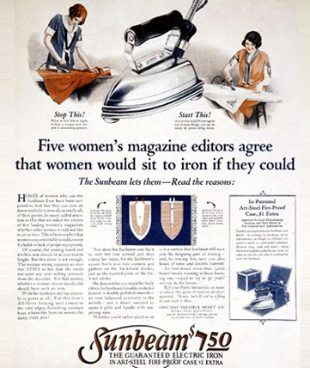
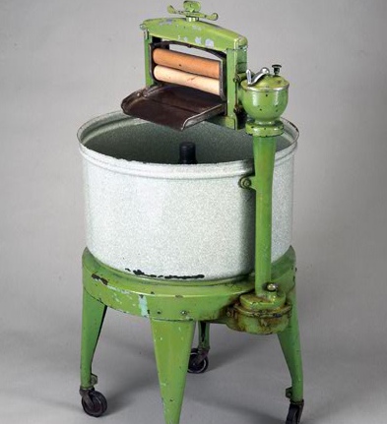
Consumerism

Slide 5
Consumerism
Advertising based on promises of improved living in the future if product was purchased.
Credit based on the notion that the improved life would also be a life in which they earned more money.
Created a demand for products that were new to the market or less expensive than they had ever been (cars).

Slide 6
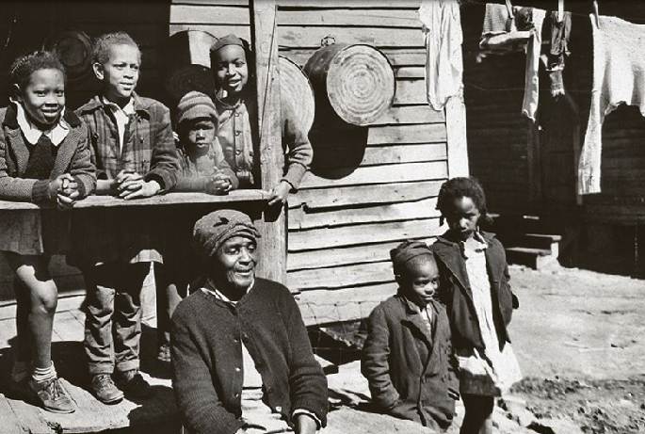
Average Earnings
Didn’t grow for everyone in the 1920’s. Prosperity for some meant poverty for others.

Slide 7
Welfare Capitalism
African Am and Native Am excluded from economic boom
Nativism created strong anti-immigrant feelings among many Americans
offered the lowest-paying, most dangerous jobs—if they were offered jobs at all
rarely able to take advantage union protection

Slide 8
Farm Crisis
Farmers in Deep South - 1920s were difficult:
Increased production of crops decreased prices.
Tariffs placed on imports created a backlash against American agricultural products in foreign markets.
President Coolidge did not support farmers
McNary-Haugen Bill that allowed government to purchase surpluses to support farmers, Coolidge vetoed it.
Unlike the airline industry, farmers received no government help.

