Slide 1
Han Dynasty
Chapter 6 Lesson 3

Slide 2
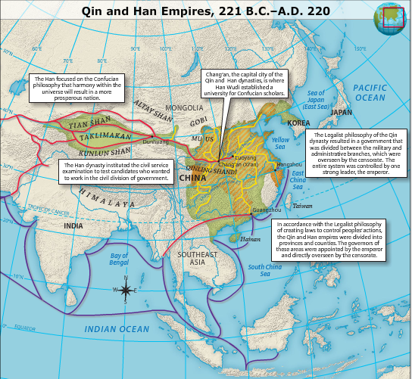
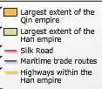

Slide 3
Start of Han Dynasty
Han Empire:
207 B.C. Liu Bang overthrew the Qin
Started the Han dynasty which ruled until 220 AD.

Slide 4
Qin structures retained by Han
Division of Central Government into:
Military
Civil
Censorate
Division of Empire into provinces and counties
Merit based appointment of govn’t officials

Slide 5
Political Changes introduced by Han
Abandonment of harsh Qin policies
Reliance on Confucian, rather than Legalist, policies.
Civil service exams, based on Confucian texts.

Slide 6
Expansion under Han Wudi
Reached peak of rule under Wudi
personally involved in all aspects of government.
extended empire to greatest yet size
Sent expedition led by Zhang Qian
Expedition failed but Zhang Qian returned 13 years later with much to tell.
Described Rome and the Romans and gave Wudi an interest in trade with the west.
Drove out Xiongnu – beyond great wall
Historical references of Xiongnu end after 5th century, (possibly Huns, or European Turks)

Slide 7
Expansion of Trade under Wudi
Silk Road:
Linked the east and the west
Traded gold, glass, silver, wool, fabric
Pax Sinica-
400 years of prosperity under the Han.
Coincided with the Pax Romana in the west.
Government collected food and stored it in years of surplus to feed population on bad years.

Slide 8
Expansion of Trade under Han
Textile manufacturing, water mills, steelmaking, and papermaking
Advances in ship construction
Establishment of teaching Confucian classics
Historical writing
Sima Qian and Ban Gu

Slide 9
Society under Han
Prosperous, however, free peasants suffered.
Taxes, military service, forced labor (1 mo/year)
Amount of land/person decreases to barely survival amount
Free peasants end up selling land and working as tenant farmers
Aristocrats again grow in power and wealth at expense of peasants.

Slide 10
Society under Han
Increased importance of family
Qin had weakened it (loyalty to govn’t!)
Confucianism – relationships – strengthens family
Family becomes basic economic unit and social unit.

Slide 12
Fall of Han Empire
Weak rulers
Increasing power of landed aristocrats
Government corruption
Widespread peasant unrest and uprisings
Attacks by northern tribes
Falls in 220AD
China falls into a period of no dynasty for nearly 400 years.

Slide 14
Changing River
The peasant revolts during the later years of the Han dynasty were related to the famines and floods that resulted from changes to the course of the Huang He during the early years of the first century. The river occasionally changes it course because of the sediment that accumulates in various places. Peasants who lost their land when the river changed course have trouble finding new placed to farm. Many peasants agreed to be tenant farmers for powerful landlords who mistreated them. Major floods of the Huang He continued into the 1900s, sometimes with the losses of millions of lives.

