Slide 1
India’s First Empires
Chapter 5

Slide 2
Society
Most basic unit of Indian society is family.
Aryans (Indo-Europeans) brought with them varnas or social groups.
Brahmins – priests
Kshatriyas – warriors
Vaisyas – famers/merchants
Sudras – peasants/servants

Slide 3
Society
The varnas became a rigid social structure over time creating a caste system (Jati)
Born into specific social structure
Determined jobs, marriage, social groups
Thought to be based on religious purity, which was deeply ingrained in society.

Slide 4
Society
Below caste system was the Untouchables
Too impure to be touched
5% of population
Degrading jobs like trash collection and handling dead bodies
No one ate food that was touched by an untouchable.

Slide 5
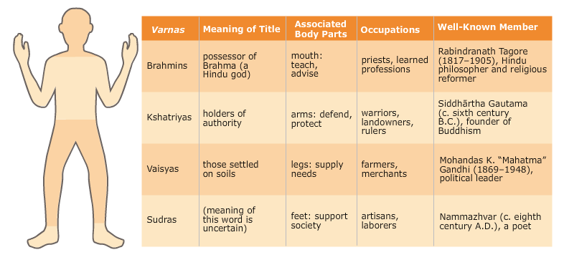

Slide 7
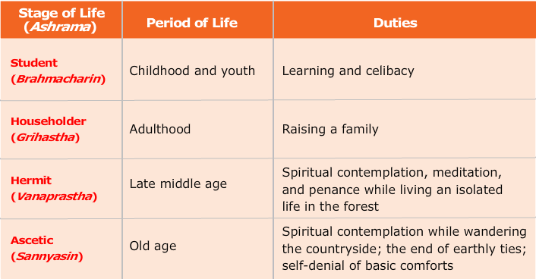

Slide 8
Hinduism
From Aryans – 1500BC
Vedas – hymns and religious ceremonies passed down and eventually written.
Believed in a single force – ultimate reality – called Brahman
Duty of self to know ultimate reality
Done through the practice of yoga!
Knowledge
Love
Work
Meditation

Slide 10
Hinduism
To create concrete ideals – came up with gods/goddesses
Brahma – creator
Vishnu – preserver
Shiva – destroyer

Slide 11
Hinduism Principles
Reincarnation: born into another form after death
Final death is the release of the soul from the cycle of reincarnation and unity with Brahman

Slide 12
Hinduism Principles
Karma: force of a person’s actions determine how person is born in the next life.
Current situation is not an accident
Brahmins are closest to becoming released frm cycle of reincarnation
Brahmins followed by other classes and then the classes of the animal kingdom
Cows hold high position, revered as a sacred animal.

Slide 13
Hinduism Principles
Dharma: Divine law
Requires people to do their duty
Brahmins held to higher expectations that lower castes and so on.
Can’t eat meat – have to kill – upsets Karma!
Have to do your duty regardless of consequense.
Being a bad warrior is better than being a great farmer (Kshatriyas)

