Slide 1
3 New Empires
Mauryan, Kush, and Gupta
Chapter 5.3

Slide 2
The Mauryans
Founder:
Candragupta Maurya founded the Mauryan Empire by driving foreign forces from India.
Established capital at Pataliputra
ruled from 324 to 301 b.c.
Government:
highly centralized government
divided into provinces - governors were appointed by emperor

Slide 3
Mauryans
Aśoka:
grandson of Candragupta Maurya, Aśoka considered the greatest ruler in Indian history.
adopted Buddhism – ruled empire caring for the welfare of both people and animals.
sponsored missionaries who spread Buddhism throughout India and China
Economy:
Regional trade expanded under Aśoka
India became a major crossroads b/w the Pacific, Southwest Asia, and the Mediterranean.
Decline:
declined after Aśoka died, collapsing completely in 183 b.c.

Slide 4
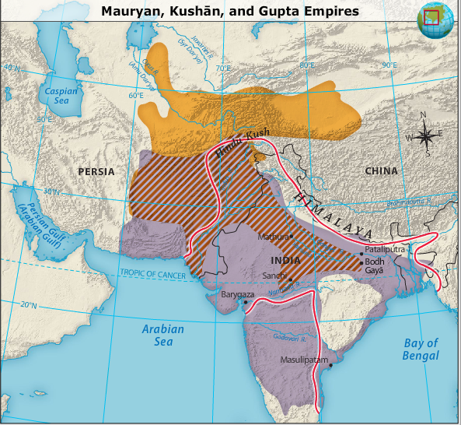
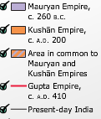

Slide 5
Kushan Empire
Founders:
nomadic warriors started the Kushān kingdom in present day Afghanistan.
Kushān power was extended over northern India
Advantageous location:
became a key link in the Silk Road trade between the Medit. region and easternmost Asia,
b/w the Roman Empire and China

Slide 6
Kushan Empire
Expansion of trade:
India's role in trade became prominent once sailors learned to navigate Indian Ocean.
Influences of other cultures:
Greek alphabet and Persian Zoroastrianism
developed a calendar based on the both the moon and the sun, a form of which is still used in India today.
Decline:
Persian invaders destroyed Kushan Em. In 3rd century a.d.

Slide 7
Influence of Trade on Kush

Slide 9
Kushān coins
Kushāns are known for the gold and silver coins they produced
Many have images of deities
Include some Greek, Iranian, and Indian religions
also have images of Kushān kings and princes.

Slide 10
Gupta Empire
Founding by Candra Gupta:
a.d. 320
a local prince, he established a new state in the central Ganges Valley
Made alliances with other powerful families in the area.
Geography:
Guptas became the major political force in northern India
spread their influence to central India
Their empire became the largest Indian state since the Mauryan Empire.

Slide 11
Gupta Empire
Culture:
Gupta rule was a golden age of Indian culture
Hindu and Buddhist arts flourished
Economy:
prosperity from both domestic and foreign trade
China, Southeast Asia, and the Mediterranean
trade served to enrich the Gupta rulers (lived in luxury)
Decline:
Late 5th century - invasions by nomads
collapsed in the 7th century
northern India was once again politically disunited

Slide 12
The Price of Pepper
Primary export of s. India was pepper
Spices impt for preservation of food.
Pepper used to cover flavor of rancid meat
Europeans discovered it and were willing to pay with gold for it.
Nero (he’s nuts) banned the importation of peppercorns in order to stop the drain on the Roman economy.
Pepper will play a role in history as the enticement for European traders and explorers of the 15th & 16th centuries!

Slide 13
Indian Accomplishments
Literature:
Vedas
epics Mahabharata (including the Bhagavad Gita) and the Ramayana
writings of Kālidāsa - The Cloud Messenger
Architecture:
Spread of Buddhism led to three main types of religious architecture in Mauryan Empire
the pillar - erected along roads to mark events in the life of the Buddha
Stupa - place for devotion
rock chamber - to house monks and place for ceremonies
Science and mathematics:
studied astronomy, Earth is a rotating satellite of the sun
used algebra and introduced concept of the number zero
numerical system (used in the U.S. today) adopted from India by Arabs, later introduced into Europe.

