Slide 1
Mongols and Chinese Culture
Chapter 11.2

Slide 2
Mongol Empire
Origins:
clans of nomads in northern Asia
raised livestock and traveled
fought primarily on horseback.
Genghis Khan:
Early 1200s - unified the Mongols and conquered much of Eurasia.
After Genghis Khan died, his empire was divided into regions called khanates.
Kublai Khan:
grandson of Genghis Khan
completed the conquest of China and established the Yuan dynasty.
Mongol efforts to conquer Japan and the Indonesian islands were unsuccessful.

Slide 3
Genghis Khan
"Genghis Khan" is a term that means "strong ruler.”
Temüjin was his real name
created the largest land empire in history during the early 1200s

Slide 8
Expansion of trade under Mongols
Adopted existing Chinese system of government and employed Chinese in the bureaucracy.
Many Chinese appreciated the stability of Mongol rule.
Chinese merchants benefited from the extensive trade networks under the control of the khan.
Marco Polo was a visitor to China at this time.
Mid-1300s, corruption and revolts fatally weakened the Mongols' dynasty in China.
The Yuan (Mongols) were replaced by the Ming in 1368.

Slide 9
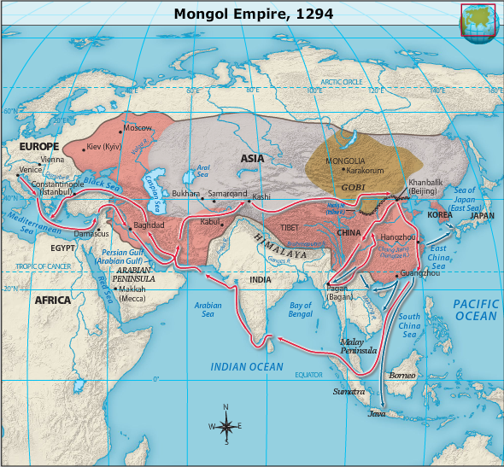
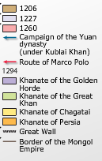

Slide 10
Marco Polo
Marco Polo's stories about the remarkable Chinese society referred not to the reign of Genghis Khan but to that of Kublai Khan.

Slide 11
Religion and Government
Buddhism introduced in the 1st century
As the religion gained followers, it lost favor with the imperial court
its monasteries gained much land and serfs
Emperors during Tang dynasty destroyed Buddhist temples
Forced thousands of monks and nuns to return to secular work
Song dynasty supported neo-Confucianism
emphasized study of moral principles

Slide 13
CULTURAL ACHIEVEMENT
Printing introduced during Tang dynasty in the form of movable type
made literature more available to educated people in China
Increase in poetry occurred during the Tang dynasty.
Famous poets of the time included Li Bo and Du Fu.
Great landscape paintings by Chinese artists were produced during the Song and Yuan dynasties.
Daoism influenced painters to focus on nature.
Techniques for making porcelain advanced during the Tang dynasty.

Slide 14
Origin of Printing
Chinese, not the Europeans, invented woodblock printing.
7th century a.d., during the Tang dynasty,
earliest known printed book is a Chinese translation of the Diamond Sutra, a Buddhist text from a.d. 868.
11th century - Bi Sheng invented movable type, though his fragile porcelain type was not suited for large-scale printing operations
Europe, during the 15th century, a German named Johannes Gutenberg developed a method of printing with movable metal type.

