Slide 1
Kingdoms in Medieval Africa
Chapter 13

Slide 2
Africa's Geographic Diversity
Geographic zones: South of the mountainous Mediterranean coast of Africa lies the huge desert of the Sahara. In the west, the Sahara is bordered to the south by grasslands, which in turn give way to tropical jungles. In the east are mountains, plateaus, and the Great Rift Valley, with the jungles of the Congo River basin to the south. The southern part of the continent consists of more hills, plateaus, and deserts.
Climate zones: The four basic climate zones of the continent are a mild zone in the far north and south; deserts, including the Sahara and the Kalahari, in the north and south; rain forests along the equator; and savannas bordering the rain forests to the north and south.

Slide 3
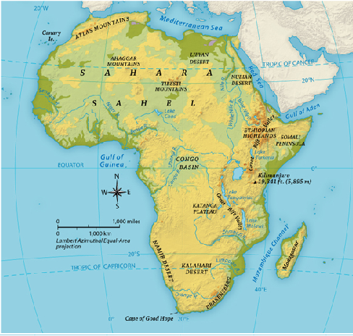

Slide 4
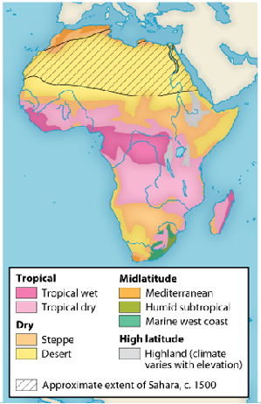

Slide 5
African Society
Towns and villages: Towns in Africa grew from smaller villages as government and trade centers. Most Africans, however, lived in small villages.
Extended families and lineage groups: Extended families lived together in small dwellings as part of a community consisting of a lineage group—a collection of people descended from a common ancestor. Women were usually subordinate to men, although many African societies were matrilineal.

Slide 6
African Society
Education: Very young children were raised and taught by their mothers. As they got older, boys learned necessary skills from their fathers, whereas girls continued to learn from their mothers. When they reached puberty, children underwent an initiation ceremony and were accepted as adult members of their communities.
Captives and slavery: Some African societies raided or warred with other groups to obtain slaves for their own use or for sale.

Slide 7
Traditional Beliefs
Gods and rituals: Most African societies believed in a single creator god, often accompanied by lesser gods. Communication with the gods was usually the preserve of diviners, who carried out rituals for the purpose.
Ancestors: An important element in African religions was ceremonies dedicated to ancestors, the founders of the various lineage groups.

Slide 8
New Religions
Spread of Islam: Islam spread quickly across northern Africa as Arabs conquered the region. Largely through trade, the ideas of Islam gradually spread to the rest of the continent south of the Sahara.
Impact of Christianity: In Ethiopia, the rulers of Axum had adopted Christianity in the fourth century. Eventually, as Muslim states moved inward, conflict with these Muslim states led to the fall of Axum.

Slide 9
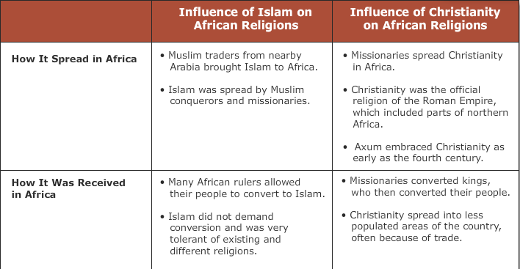
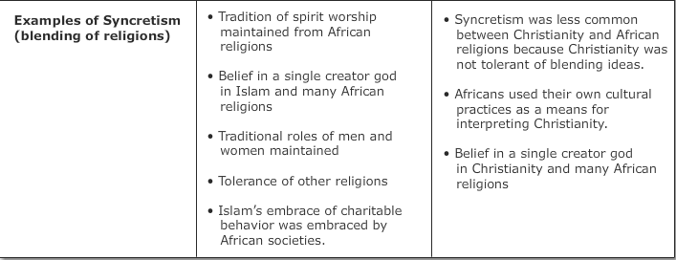

Slide 10
African Culture
Religious purpose of art: The works of African artists were a means of serving religion. Masks and statues representing gods and ancestors were thought to be imbued with their powers.
Metalwork: In Ife and Benin, artists produced impressive statues in bronze and iron.
Music, dance, and storytelling: These arts usually had a religious purpose as well. Songs conveyed folktales and religious stories from one generation to another, as did storytellers known as griots.

Slide 13
The Kingdom of Ghana
Beginnings of Ghana: The kingdom of Ghana emerged around the sixth century. It lay between the Sahara and the West African coast.
Ghana's kings: Kings ruled Ghana as powerful rulers unbound by laws. They were wealthy and maintained large standing armies.

Slide 14
The Kingdom of Ghana
Abundance of ores: Ghana blacksmiths were able to convert the kingdom's vast reserves of iron ore into tools and weapons. Deposits of gold ore were even more valuable and useful in trade.
Prosperity from trade: Ghana's gold made it a major center of trade. Merchants came from the north to trade salt, textiles, and other goods for Ghana's gold. In addition to gold, Ghana used ivory, animal hides, and enslaved persons as barter for goods.

Slide 15
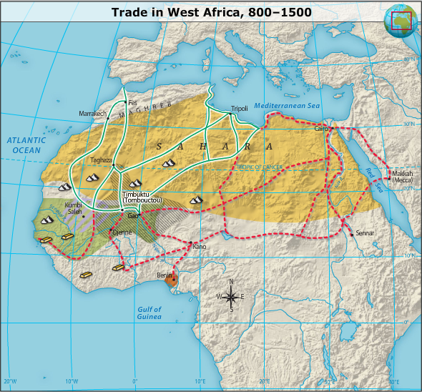
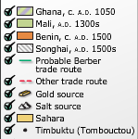

Slide 16
The Berbers
A nomadic people: The Berbers were nomads who carried vast quantities of goods across the Sahara. They formed a vital link between the societies on opposite sides of the Sahara.
Camel caravans: To transport goods across the desert, Berbers used large groups of camels in caravans. Berbers often purchased goods from people on one side of the desert and then sold the goods to people on the other side.

Slide 17
The Kingdom of Mali
Founding by Sundiata Keita: After the collapse of the kingdom of Ghana in the 1100s, another great trading empire emerged nearby. In the mid-1200s, Sundiata Keita united the people of Mali and established a stable central government.
Gold and salt: As in Ghana, gold and salt were major trading commodities in Mali. The Mali city of Timbuktu became legendary as a center not only of trade but also of education.

Slide 18
The Kingdom of Mali
Mansa Mūsā: One of the greatest African leaders of the era was Mansa Mūsā. This ruler of Mali doubled the size of the kingdom and created a strong central government. He became legendary for the pilgrimage he made to the Islamic holy city of Makkah in the early 1300s. He traveled in a huge caravan with great quantities of gold. He distributed gifts made of gold and used gold to purchase many goods to bring home to Mali. After the death of Mansa Mūsā, Mali fell into civil war and soon collapsed.

Slide 19
The Kingdom of Songhai
Location: The Songhai kingdom arose in a fertile area along the Niger River. As in Ghana and Mali, most of the people in Songhai made their living as farmers.
Sunni Ali: In 1464, Sunni Ali created a dynasty based on Sunni Islam. He was a strong military leader who captured Timbuktu and made it one of the bases of a great trading empire. Gold and salt were again key commodities in the trading network.

Slide 20
The Kingdom of Songhai
Muhammad Ture: The height of Songhai power occurred during the reign of Muhammad Ture. Another strong military leader, he expanded Songhai so that it stretched about a thousand miles along the Niger River. He created a government based on provinces, and he established a navy on the river.
Decline: Under the ruler Askia Dawud, Songhai became the biggest empire in the history of Africa. After his death, however, Songhai went into decline and lost much territory to the sultan of Morocco.

Slide 22
Migration of the Bantus
Move to East Africa: Long before the Songhai created their empire along the Niger, many of the people living in the region gradually migrated east, toward the coast of the Indian Ocean. These farming peoples spoke dialects of the Bantu language.
Sharing knowledge: The Bantus had developed techniques for smelting iron and growing high-yield crops, and they spread this knowledge across Africa. Women handled much of the farm work, while many men were involved in hunting or trade.

Slide 23
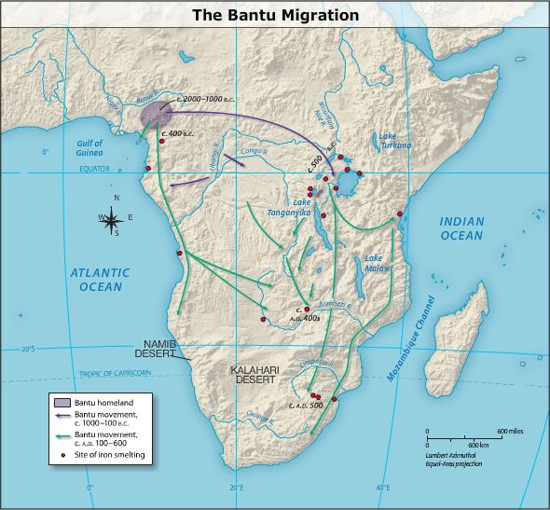

Slide 24
Indian Ocean Trading Network
Muslim trade outposts: Starting in the 700s, Muslim traders from Arab lands established bases along the eastern coast of Africa. In the centuries that followed, Bantu-speaking peoples began to take part in this network of trade.

Slide 25
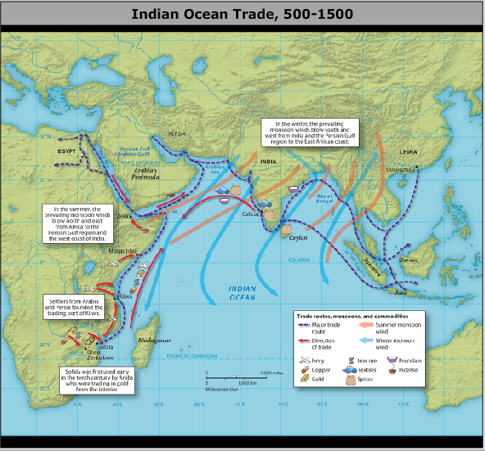

Slide 26
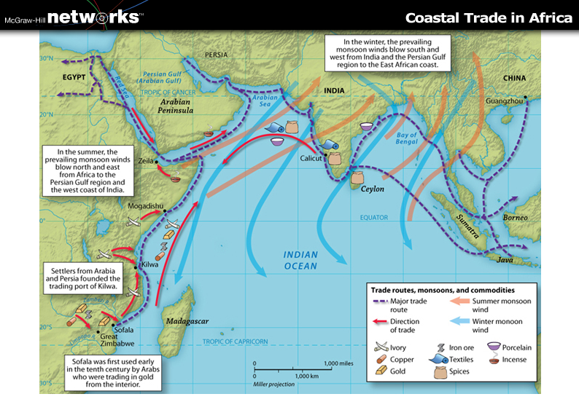

Slide 29
Indian Ocean Trade
Port of Kilwa: Kilwa, in what is now Tanzania, was filled with magnificent buildings. Two of the finest were made of coral, and the city had indoor plumbing. Portuguese forces destroyed the city in the early 1500s.

Slide 30
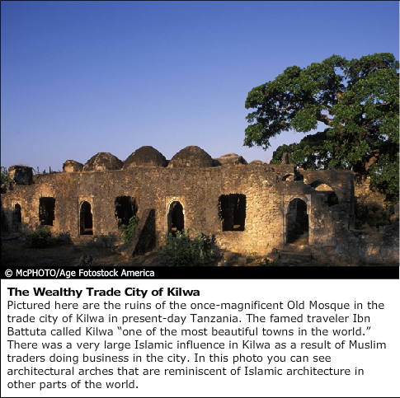

Slide 31
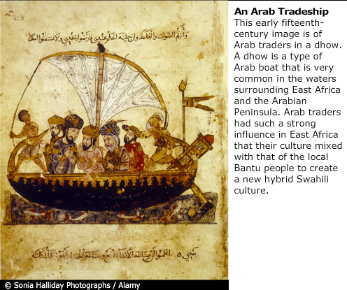
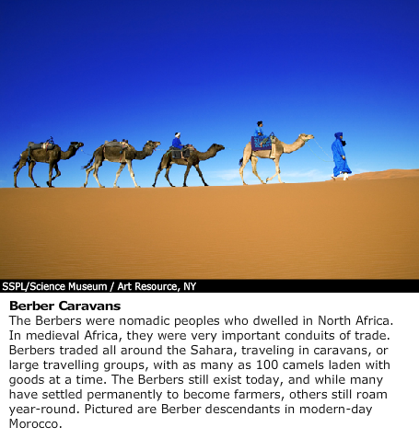

Slide 32
Indian Ocean Trading Network
Ports of Mogadishu and Mombasa: Mogadishu, now the capital of Somalia, was established in the 900s. For much of the next six hundred years, it was highly prosperous. In what is now Kenya, the port of Mombasa also became prosperous. Mombasa was founded in the eleventh century.
Swahili culture and language: Over time, there was a blending of African and Arabian cultures along the eastern coast of Africa. The Swahili language developed as a mix of Arabic and Bantu dialects. Today Swahili is the national language of Kenya and Tanzania.

Slide 33
Societies in Southern Africa
Stateless societies: Until the eleventh century, people in southern Africa lived in groups of independent villages, sometimes called stateless societies. Then some of the groups of villages began to unite, initiating the development of states.
Zimbabwe and the gold trade: Zimbabwe became one of the most powerful states in southern Africa in the early 1300s. Trading gold with the Swahili merchants along the eastern coast of Africa brought Zimbabwe much wealth.
Ruins of Great Zimbabwe: The ruins of Zimbabwe's early capital, Great Zimbabwe, are considered one of the world's most impressive archaeological sites. The ruins overlook the Zambezi River and include stone walls around the perimeter.

