Slide 1
The Jazz Age
Chapter 17
1920’s

Slide 2
Politics of the 1920’s
Chapter 17, Lesson 1

Slide 3
Harding Administration
“Return to Normalcy” campaign slogan
return to the American way of life before World War I
For Republicans, also meant turning away from Progressivism, to a pro-business attitude
little corporate oversight
high protective tariffs
tax cuts for the rich
Unwise Appointments
Friends/political allies to government positions resulted in corruption and graft
“Ohio Gang” profited by selling government jobs and materials.

Slide 4
Harding Administration
Scandals
Secretary of the Interior Albert Fall secretly leased oil-rich lands to individuals.
“Teapot Dome Scandal” resulted in Fall’s imprisonment.
Charles Forbes, head of the Veterans Bureau, sold items intended for the military for a profit.
Attorney General Harry Daugherty illegally sold a German chemical company held by the United States after World War I.
Harding’s Death
Touring west US – most likely had a heart attack
Vice President Calvin Coolidge becomes president

Slide 5
1920’s Business Policies
Coolidge Policy
Retained most respected cabinet members
Secretary of the Treasury Andrew Mellon
Secretary of Commerce Herbert Hoover
Business Principles
Mellon applied business principles to:
correct the nation’s budget deficit
reduce government debt
cut taxes
established the Bureau of the Budget and the General Accounting Office to track spending

Slide 6
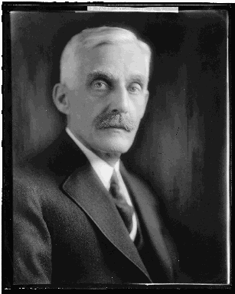
1920’s Business Policies
Mellon: supply-side economics - “trickle-down” theory
lower tax rates would help the economy grow
Americans would earn more money
government would actually collect more taxes at the lower rate

Slide 7
1920’s Business Policies
Lower Taxes
1920 most taxpayers paid 4 percent federal income tax, while wealthy Americans in the highest bracket paid 73 percent.
By 1928 most Americans paid 0.5 percent and the wealthiest Americans paid 25 percent.
Hoover’s Beliefs Secretary of Commerce
wanted businesses to form associations to share information with the federal government
“cooperative individualism”

Slide 8
Trade
U.S. Foreign Policy
did not join the League of Nations
heavily involved economically with other nations
Dawes Plan - Am. banks loaned money to Ger. banks so the Germans wouldn’t default on loans to other Eur. countries
@ U.S. urging, Eur. Countries accepted lower payments from Germany
allowed Britain and France to repay war debts and European countries to buy American exports.
Peace was maintained through trade

Slide 9
Arms Control
Arms Control
Eur. nations expanded navies
hurt their ability to pay their debts
The Washington Conference 1921
Sec. of State Charles Hughes proposed that each nation destroy some warships and halt the building of new ones for 10 years
The Kellogg-Briand Pact 1928
signed by 15 nations - settle disputes by peaceful means instead of war
no binding force but was hailed as a victory for peace
The London Naval Treaties 1930
five naval powers - in London - agreement on the number of warships in their navies.
temporary halt in the arms race until the mid-1930s.

