Slide 1
Qin Empire
Chapter 6 Lesson 2

Slide 2
Rise of an Empire
Qin Claimed throne at 13 y.o – 246BC
Qin Shihuangdi – 1st Qin Emperor
Created single $ system
Built roads – many leading to capital
Xianyang
Dug canals to supply armies
Extended into present day Vietnam
Divided aristocrat land to peasants and taxed them directly
Defeated all rival states by 221 BC.

Slide 3
Emperors Army
Discovered in 1974 by the tomb of Qin
Thousands of life sized terra-cotta statues
All individual in faces
Thought to be buried to accompany him on journey to next life
Organized into military formation
May have cost as much as 1/3 of national income to make
Used forced labor to create the army.

Slide 4
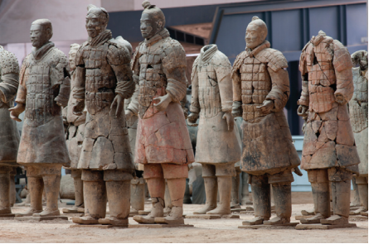
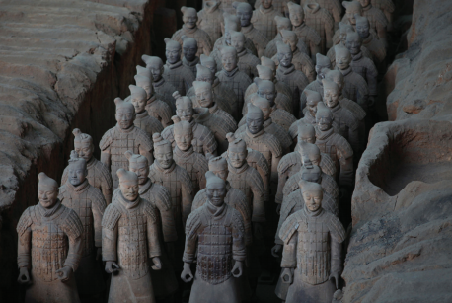

Slide 5
Great Wall of China
Started under Qin
Aimed at keeping out Xiongnu (“shug-noo”)
Nomads from the North – mastered the use of horses and bows.
Shihuangdi linked existing local walls
Thousands of laborers – many died during construction – bodies buried within wall.

Slide 6
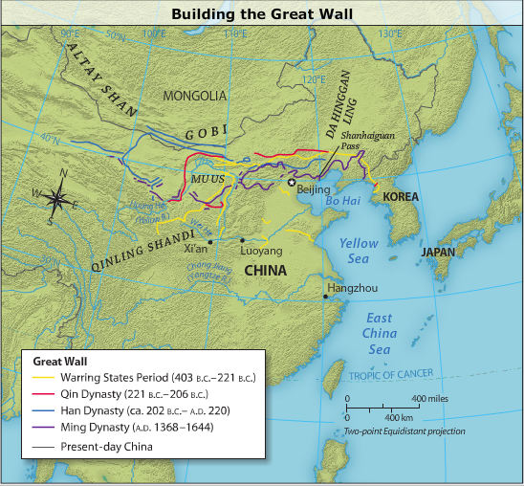

Slide 8
Policies of Qin
Legalism adopted policy of regime
All that opposed executed
All books that taught anything else burned

Slide 9
Policies of the Qin
Highly centralized state
Civil Division
Military Division
Censorate
Government inspectors
2 Levels of administration
Provinces
Counties
All positions appointed

Slide 10
Fall of Qin Dynasty
Hoped his dynasty would last centuries
Collapsed after his death…
Why?
Angered too many Chinese
Opposed censorship
Forced labor
Taxed too heavily

