Slide 1
The Renaissance in Europe
Chapter 13 Lesson 1

Slide 2
Characteristics of the Italian Renaissance
Urban-oriented society
Renewed interest in ancient culture
Emphasis on the individual

Slide 6
Emergence of States in Italy
Thriving trade network: The trade networks that expanded during the Middle Ages helped create a society that was much more urban than the rest of Europe.
No Centralized Monarchical State: The lack of a single strong ruler made it possible for a number of Italian states to remain independent.

Slide 7
Major States in Italy
Milan: Milan lay at the crossroads of trade routes from Italian coastal cities to passes in the Alps. Beginning in 1447, the Sforza family ruled the city and generated enormous revenues by creating an efficient tax system.
Venice: Venice was a major port city which traded goods between Asia and Western Europe. Wealthy merchant aristocrats ran the government. The trade empire was very profitable and made Venice an international power.

Slide 8
Emergence of States in Italy
Florence: Located in the northern region of Tuscany, Florence came under the control of the Medici in 1434.
Rome: Rome was the capital of the territories known as the Papal States and was under the control of the Church.
Naples: Located in southern Italy, Naples was the only major state in Italy ruled by a hereditary monarchy.

Slide 9
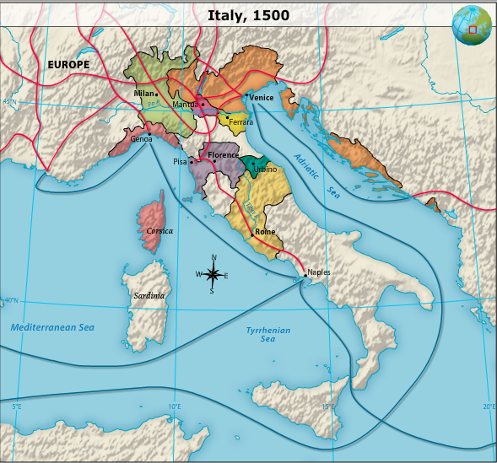

Slide 10
The Italian Wars
Europe: By the time of the Renaissance, France and Spain had become unified into powerful nations. These nations eagerly eyed the wealth of the Italian states.
Fighting in Italy: France struck in 1494, taking Naples, but the Spanish took over the city with the help of papal forces in 1501. During the next 60 years, France and Spain battled over parts of Italy. Spain emerged victorious.

Slide 12
Machiavelli's Views on Political Power
Morality and self-interest: Machiavelli rejected the popular notion that rulers should base their decisions solely on Christian principles. Instead he argued that rulers should take whatever actions are necessary to maintain their power.
Importance of the individual: Machiavelli's ideas emphasized the importance of the individual, which was consistent with other scholars and artists during the Renaissance.

Slide 13
Social Structure and Lifestyle of the Renaissance
Social classes: the nobility and the leaders of the clergy, the burghers, and the urban workers and rural peasants
Growth in trade: percentage of the population made up of burghers grew, partly as a result of the growth in trade

Slide 14
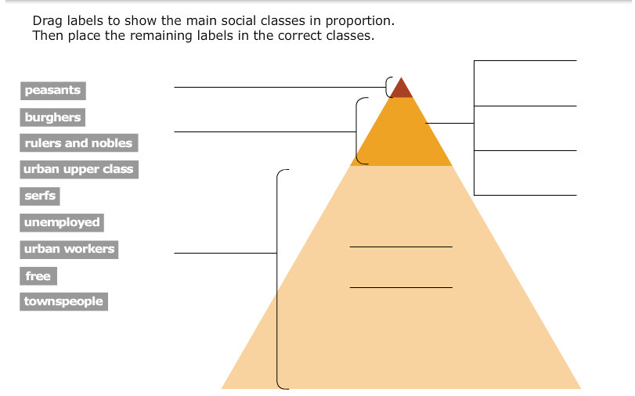

Slide 15
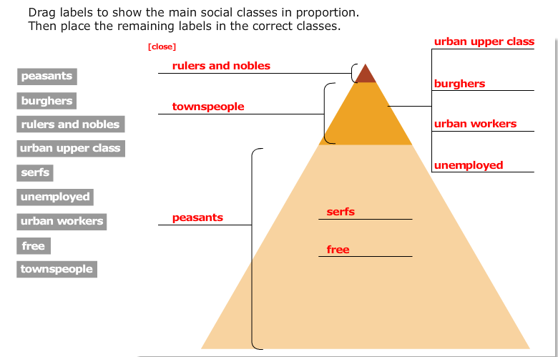

Slide 16
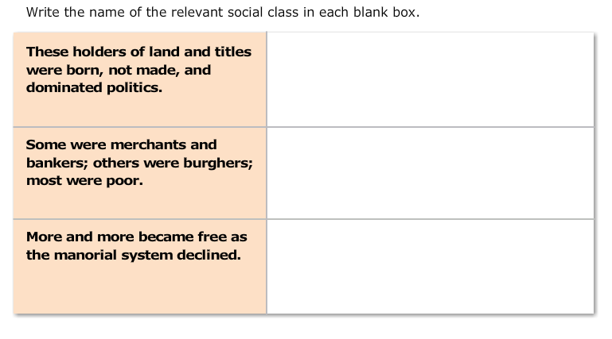

Slide 17
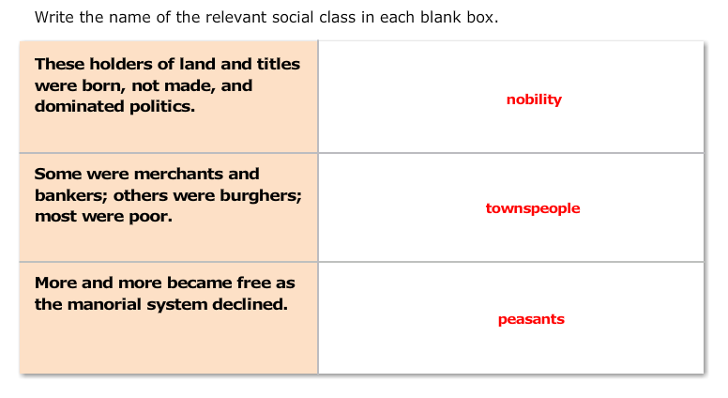

Slide 18
