Slide 1
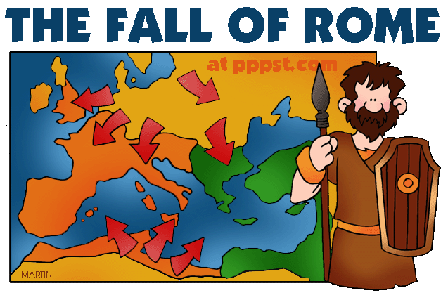
Ancient Rome & The Origin of Christianity
Outcome: The Fall of the Roman Empire

Slide 2
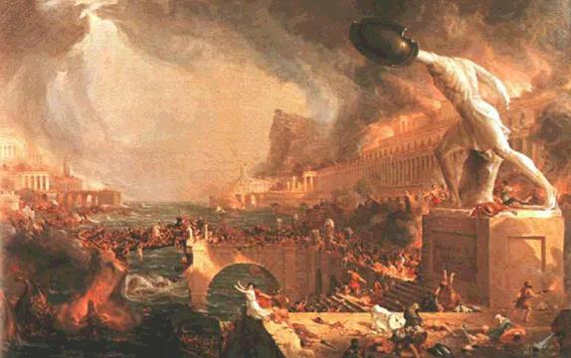
The Fall of the Roman Empire
A Century of Crisis
Pax Romana came to an end with Marcus Aurelius (AD 161-180)
The rulers that followed were unable to manage the large empire and its growing problems.
Result: The Roman Empire began to decline

Slide 3
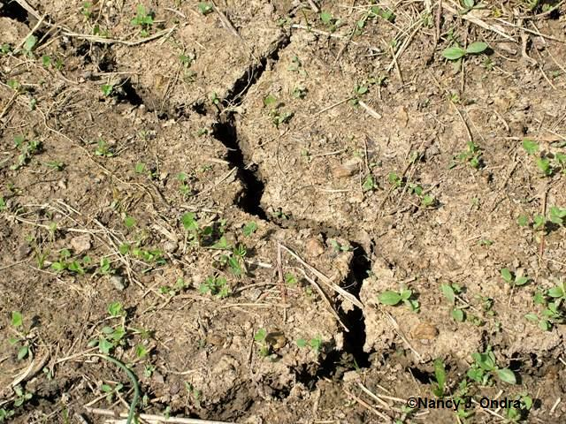
The Fall of the Roman Empire
Problems
Economic
Trade was disrupted by hostile tribes and pirates
No new gold or silver sources = raise taxes
Created more money = inflation (bad)
Soil in Italy and Western Europe became increasingly less fertile

Slide 4
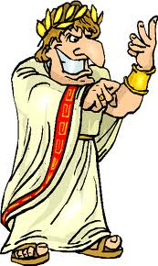
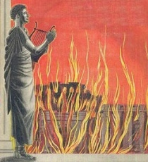
The Fall of the Roman Empire
Political
Citizens were losing their patriotism towards Rome
Government began to be controlled by military
Terrible emperors such as Nero, Commodus, & Caligula murdered, raped, and impoverished their people

Slide 5
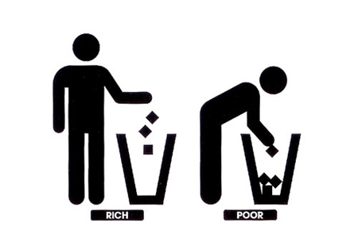
The Fall of the Roman Empire
Social
People were slowly losing their confidence in the Empire
Gap between rich and poor was still very wide
Decline in interest in public affairs

Slide 6
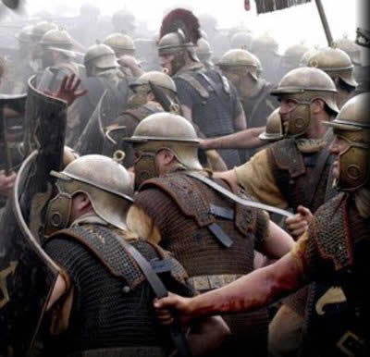
The Fall of the Roman Empire
Military
Low funds for defense
Mercenaries (foreign soldiers) hired who accepted lower pay
Soldiers were less disciplined and loyal

Slide 7
The Fall of the Roman Empire
Reform Attempted
Emperor Diocletian
Becomes emperor in 284 AD
Ruled with iron fist and limited personal freedoms
Doubled size of army
Sought to control inflation
Divided empire in two: Greek Speaking East & Latin Speaking West

Slide 8
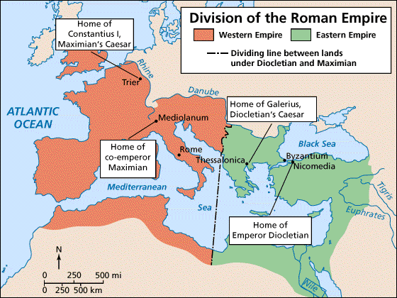
Split of the Empire

Slide 9
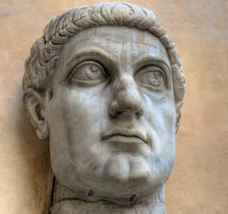
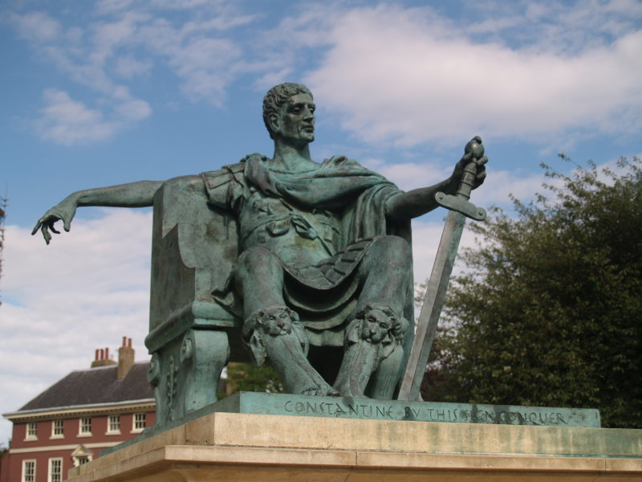
Emperor Constantine

Slide 10
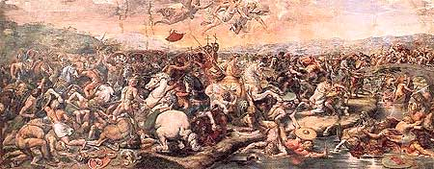
The Fall of the Roman Empire
Emperor Constantine
Embraced Christianity due to vision he had at the battle of Milvian Bridge; victory at Milvian Bridge made him sole ruler of Rome
First Christian Roman emperor
Issued the Edict of Milan which allowed Christians to worship freely
Moves capital of empire east to Byzantium; builds new city
New city is later renamed Constantinople (in modern day Turkey)
Eastern empire flourishes due to trade and wealth

Slide 11
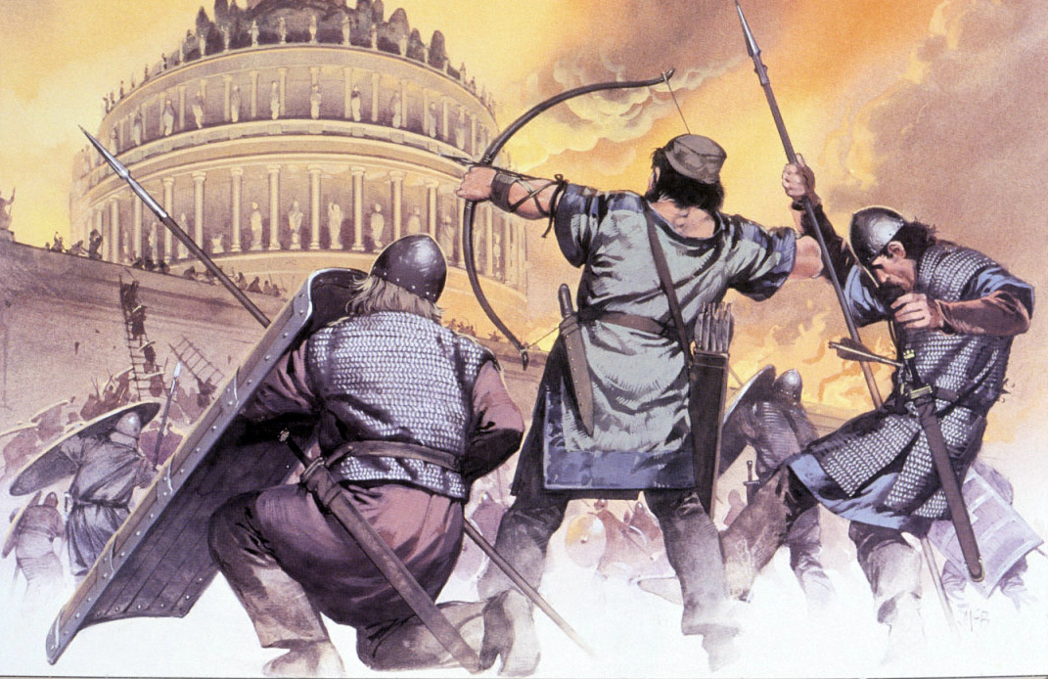
The Fall of the Roman Empire
Western Empire Crumbles
The decline of the Western Roman Empire took place over many years
Final collapse was due to:
Worsening internal problems
The separation of the Western Empire from wealthier East
Outside invasions

Slide 12
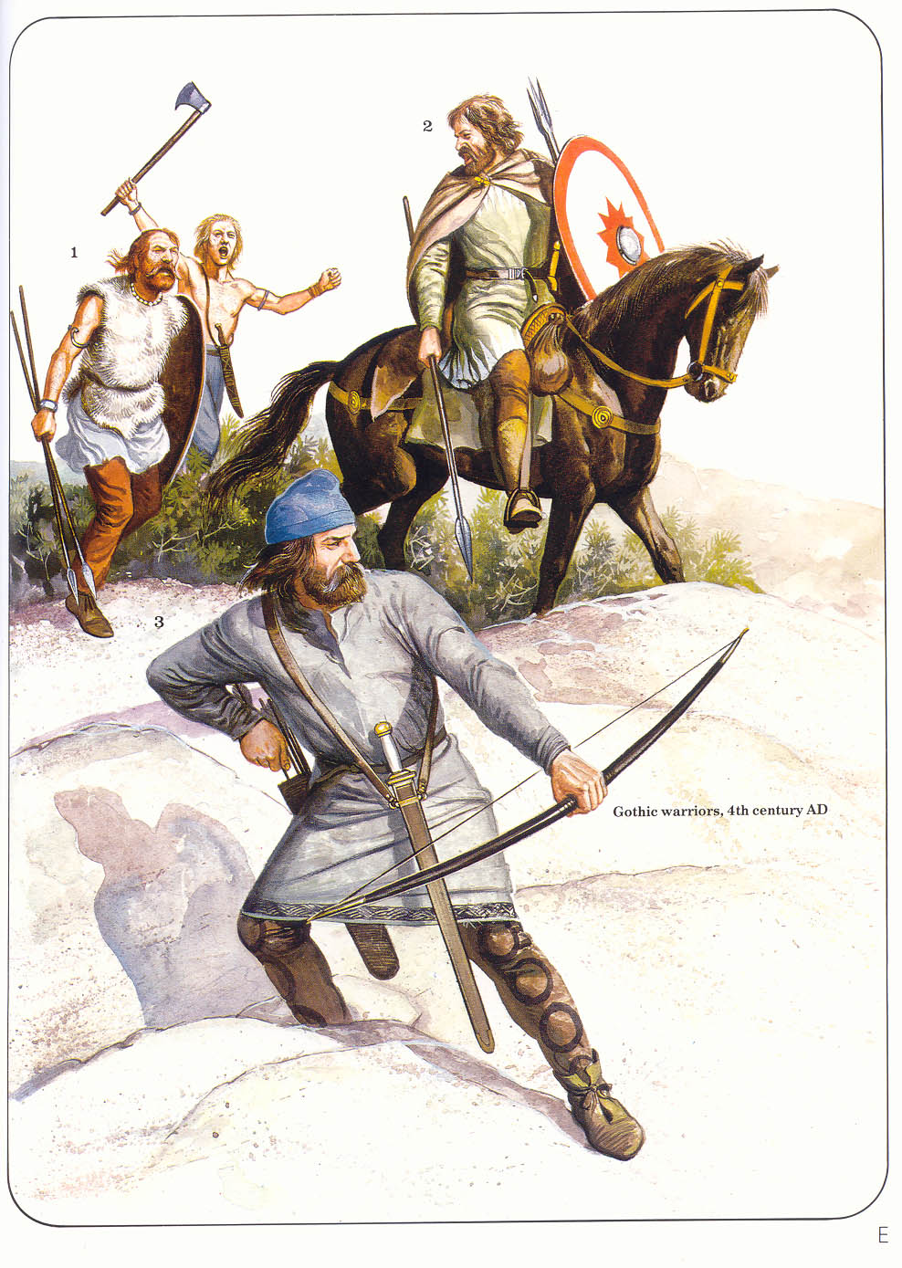
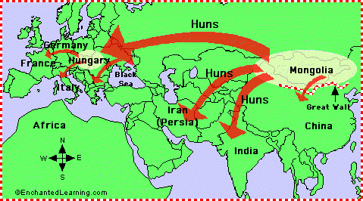
The Fall of the Roman Empire
Germanic Invasions
Mongol nomads, The Huns, forced Germanic peoples on empire’s borders to push into Roman lands
Last Roman Emperor, Romulus Augustulus, ousted by Germanic forces in 476 AD

Slide 13
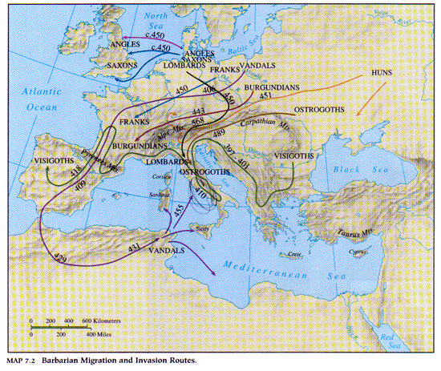
Invasion Routes

Slide 14
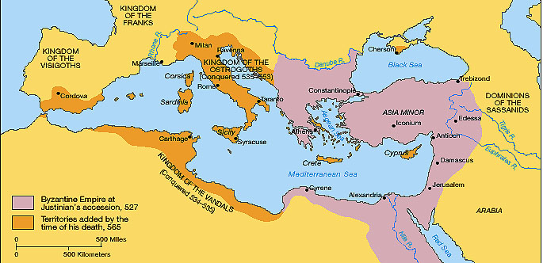
The Fall of the Roman Empire
Result: The Western Roman Empire was no more but the eastern empire would continue to thrive as a region known today as Byzantium

