Slide 1
The Scientific Revolution
Chapter 19
Lesson 1

Slide 3
Causes of the Scientific Revolution
Roots in the past: Ideas about physics, science, math, philosophy, and astronomy that developed from the time of ancient Greece through the Renaissance led to the Scientific Revolution.
Basis of the revolution: Technological inventions and developments in mathematics formed the foundation of the Scientific Revolution.

Slide 5
Important Discoveries of the Scientific Revolution
Changing views of the universe: For centuries, people believed in a Ptolemaic, or geocentric, model of the universe, in which Earth is the center of the universe. During the Scientific Revolution, Nicolaus Copernicus argued that the universe is instead heliocentric, with the planets revolving around the sun. Johannes Kepler confirmed this view and showed that the planets' orbits are elliptical, not circular.
Galileo's discoveries: Galileo Galilei used a telescope to discover mountains on Earth's moon, moons revolving around Jupiter, sunspots, and the fact that heavenly bodies were made of material substance. The Catholic Church attacked him for challenging traditional beliefs.

Slide 7
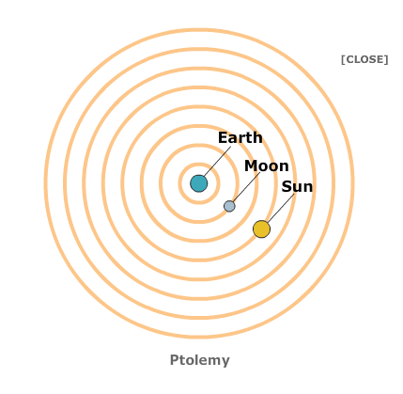

Slide 8
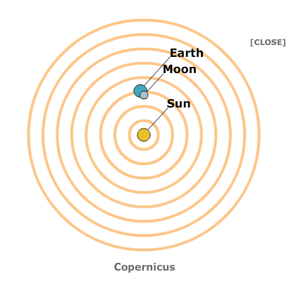

Slide 9
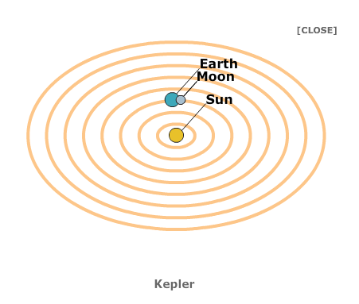

Slide 10
Important Discoveries of the Scientific Revolution
Newton's laws: In his Principia, Isaac Newton defines the three laws of motion, as well as the universal law of gravitation. He believed that the world is like a machine, governed by natural laws.
Medicine: Andreas Vesalius and William Harvey used human dissection to learn about organs, the structure of the human body, and circulation.
Chemistry: Blaise Pascal, Robert Boyle, and Antoine Lavoisier made significant discoveries related to liquids, gases, and the chemical elements.

Slide 13
Changes in Scientific Thinking
Descartes and rationalism: Rationalism, as practiced by philosopher René Descartes, is based on the belief that reason is the chief source of knowledge. Descartes argued that the mind and body are detached and independent, and that matter could be investigated by reason.
Bacon and the scientific method: Francis Bacon developed the scientific method—a series of steps for testing explanations for what has been observed. He promoted the use of inductive reasoning for learning about nature.

